Slide 1
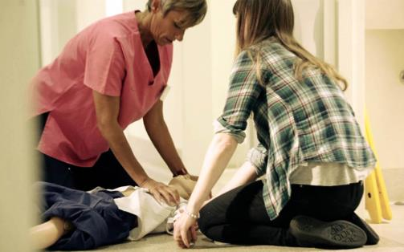
7th edition
Review of
Paediatric BLS & ALS
Notes:
Please review 7 ED Part 4 Life support section

Slide 2
Review of
Paediatric BLS & ALS
To demonstrate an understanding of the structured approach for managing a child who has arrested.
To highlight specific management for prevalent pre-arrest cardiac conditions
Briefly outline resources for managing neonatal arrest.
Notes:
Notes for Faculty
Interactive session is also to:
Facilitate development of small groups to enhance their learning.
Environment (this has happened in Welcome & Aims):
Move into coloured groups & be joined by 1-2 instructors - ideally instructors who will be on their first skill station – introduce each other.
4 tables with 8 chairs (huddle -don’t need to be seated as if having dinner). If no tables create 4 groups of chairs & use A3 clip board.
Candidates nominate a scribe and a spokesperson
ACTIVITY PACKS x 4 - one per group of six candidates

Slide 3

Why APLS Structured Approach?
Notes:
Write down three reasons to have a structured approach to a serious ill child.
I minute for activity – 3 minutes for shared answers
Multiple answers (incl. Human Factors issues - Chapter 3 in 6e)
so you don’t miss anything
method to calm oneself down in panic position
prioritise assessment and treatment in a logical order
learn an automated response.
Minimise fixation
Shared situational awareness
Communication
SEGUE to algorithm activity – click to show aeroplane - repetition assists in established automated responses

Slide 4
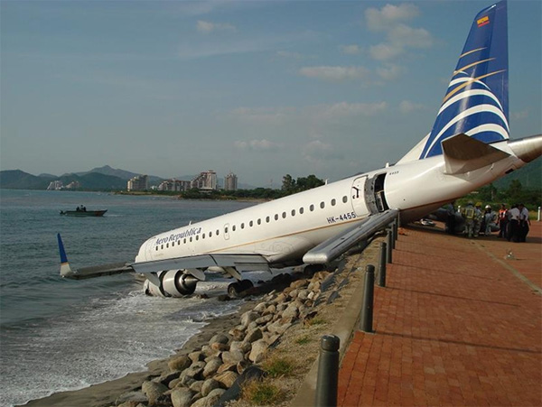
Why APLS Structured Approach?
Notes:
- Human factors - Chapter 3

Slide 5

Notes:
Pack of laminated sections of BLS and ALS algorithms
5 mins to order cards into BLS and ALS algorithm sequences & keep displayed on table
Start whole group review of questions with activity:
Tap/clap at CPR rate of 100-120 beats/min - give group min 20 secs – watch, some in group will adapt to others or some stay confident. Encourage whole group to listen to each other & yet know their own beat.
* can use REALITi on CPR rhythm or SR to give audible rate – (set up in advance to ensure volume on iPad is on maximum)
Ask why is CPR rate is at 100-120 beats/min?
- They will know the answer, however knowing doesn’t mean doing…….
clinicians (in simulation) haven’t shown to be great at keeping rate or sustaining depth –
Studies show that we need repeated practice and feedback on performance – ( what they are going to get on the face to face course)
As main evidence for resuscitation is primarily related to effective CPR – need to change manpower to prevent exhaustion & maintain rate and depth

Slide 6

p210
Notes:
Check with cards on the table

Slide 7
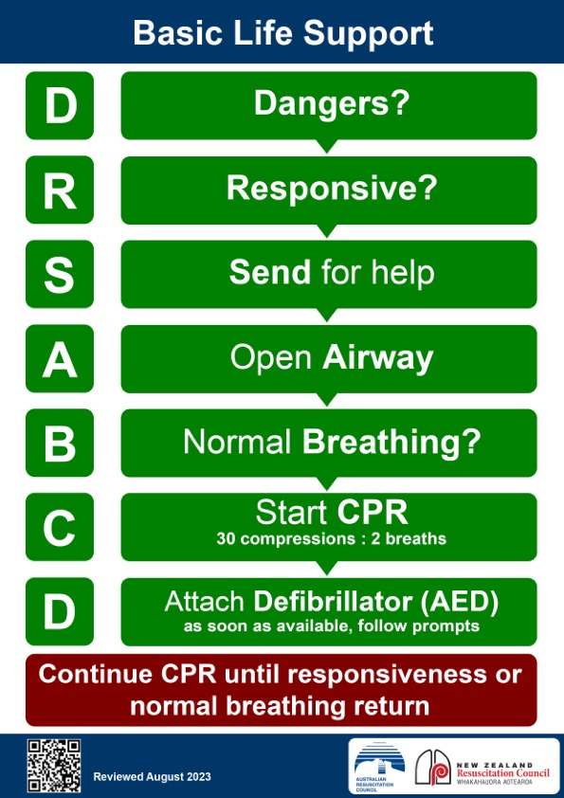
Notes:
Points of difference
APLS sequence is for trained paediatric healthcare providers
Normal breathing? – Include 2 rescue breaths
(children have hypoxic arrests)
Signs of life?
Start CPR 15:2 vs 30:2

Slide 8
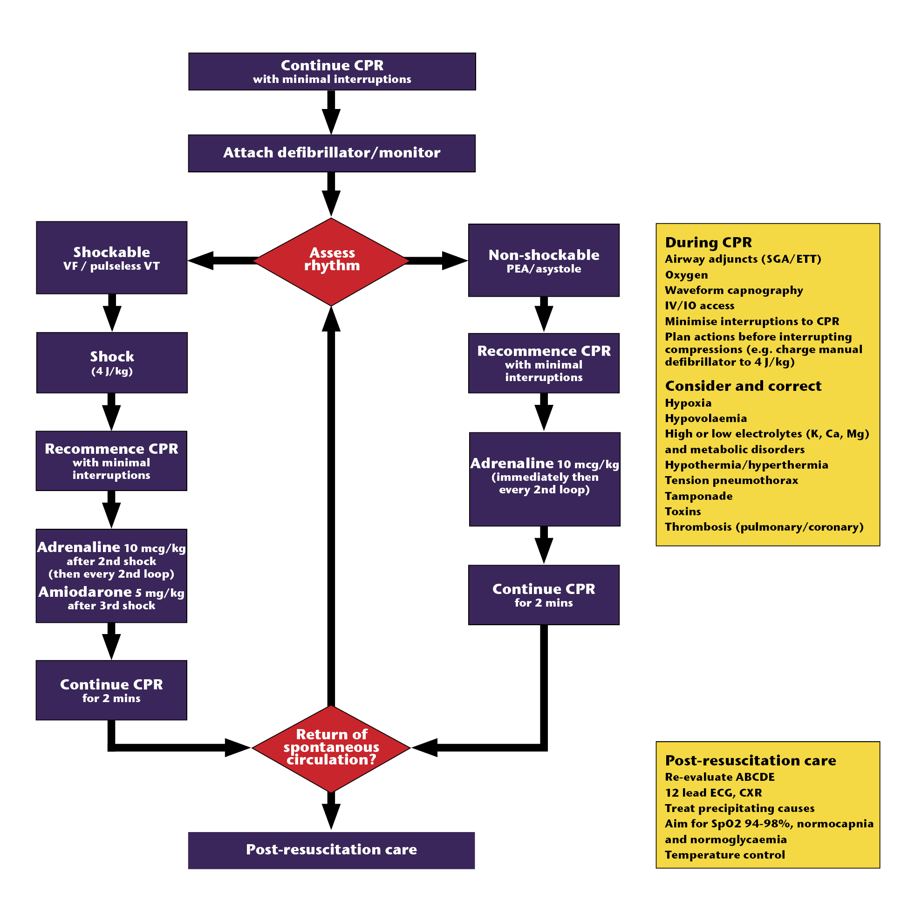
PEA/Asystole algorithm
Ch 18
Notes:
Check with cards on the table
..

Slide 9
VF/VT algorithm
Ch 18
Notes:
This is the part of the ALS algorithm for VF/VT
5 mins of small group activity
Questions to be answered in their groups – worksheet with questions provided
How long is a cycle?
What do you do during the 2 minute cycle?
When is adrenaline given? VT/VF vs asystole?
Which of the Hs and Ts are of particular importance in asystole?
hypoxia
hypovolaemia
anything else suggested by history of child’s illness/injury
Which of the Hs and Ts are of particular importance in PEA?
hypovolaemia
hypocalcaemia
tension pneumothorax
cardiac tamponade
hypothermia
pulmonary embolus
How is ROSC assessed? – why feel for a pulse?
Where do you feel for a pulse?
9

Slide 10
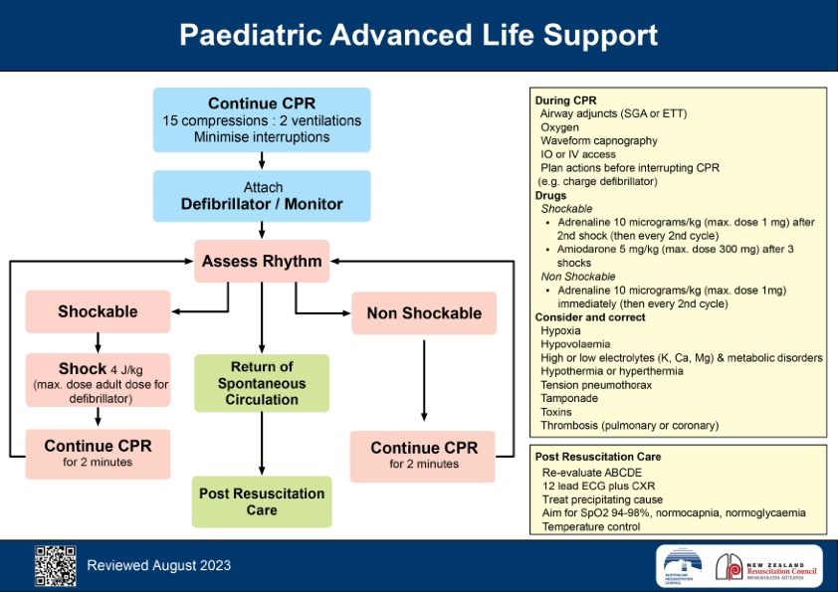
Notes:
Points of difference
Defibrillator charging prior to asystole
Segue – ideally we prevent an arrest from happening
Lets look at some rhythms that commonly happen in critically ill and injured children

Slide 11
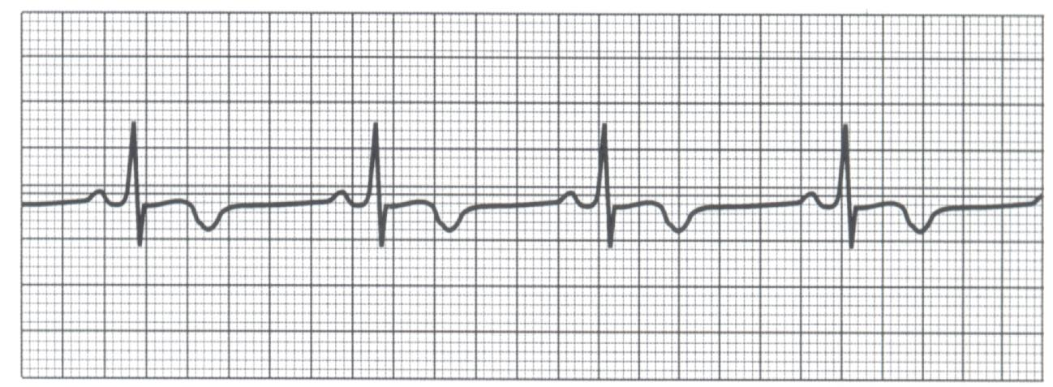
Abnormal pulse
rate or rhythm
Notes:
Activity in groups - image & question on sheet of paper
List treatment options for these common causes of bradycardia
Cause of Bradycardia –Treatment options
pre-terminal in respiratory / circulatory failure - oxygen, ventilate, fluids
vagal stimulation - oxygen, ensure adequate ventilation, atropine
raised intra-cranial pressure - intubate and ventilate, mannitol,
poisons, eg digoxin, beta-blockers - Adrenaline, specific antidotes, consider pacing
complete heart block - adrenaline (if symptomatic), external pacemaker

Slide 12
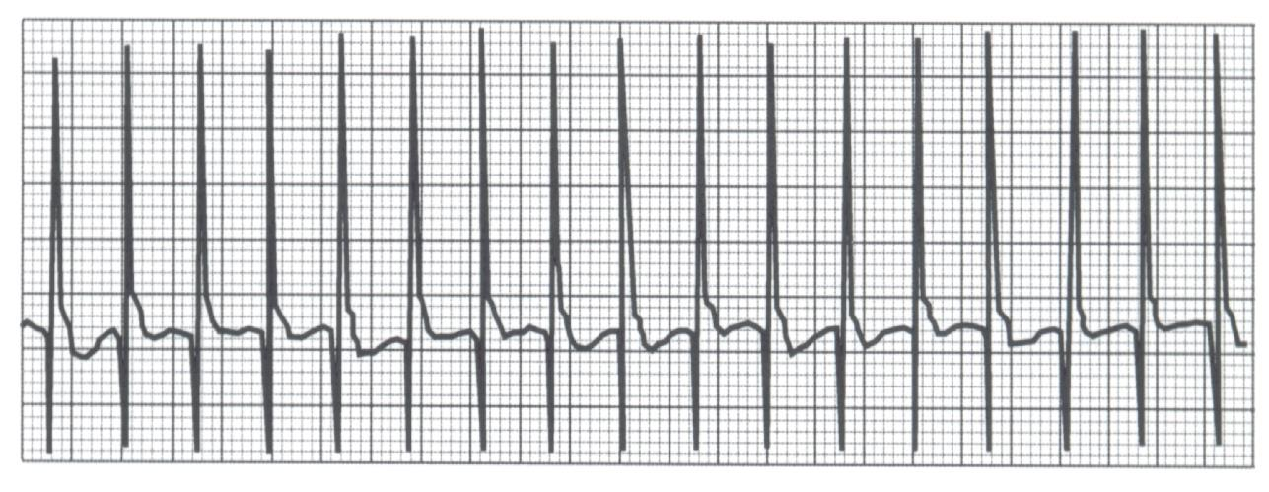
Abnormal pulse
rate or rhythm
Notes:
Activity – on sheet, with image and space for 5 answers
Supraventricular tachycardia (SVT) is the most common non-arrest arrhythmia during childhood and is the most common arrhythmia that produces cardiovascular instability during infancy. SVT in infants generally produces a heart rate > 220 bpm, and often as high 300 bpm.
Name 5 clinical features that assist you differentiate between SVT and Sinus tachycardia?
1) Rate: Sinus tachycardia usually <200 per minute in infants and children
2) P-waves : may be difficult to identify in both sinus tachycardia and SVT once the ventricular rate >200 beats per minute.
If P-waves are identifiable, they are usually upright in leads I and AVF in sinus tachycardia while they are negative in leads II, III and AVF in SVT.
3) ST beat to beat variability & responsive to stimulation vs. SVT with no no beat-to-beat variability
4) Termination of SVT is abrupt vs sinus tachycardia slows in response to treatment.
5) History: consistent with shock (eg, gastroenteritis or septicaemia) is usually present with sinus tachycardia.
‘Now we will review the treatment for SVT’

Slide 13
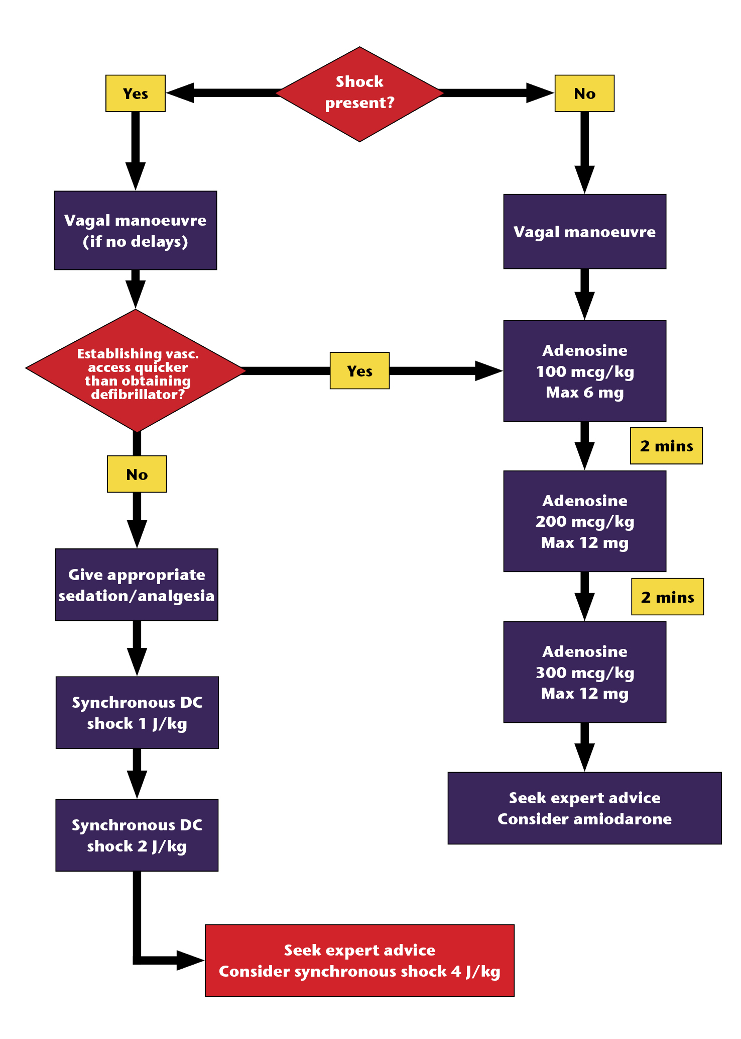
SVT algorithm
How is this done?
Notes:
Candidate packs have this algorithm with sections blanked out for them to complete
Number of joules to administer shock
L) Side - Yellow box Consider ________________
R) Side – blue box consider options _______________, ___________________ OR _______________

Slide 14
Notes:
Confirm answers
Joules per shock when synchronous DC
L) Side - Yellow box Consider Amiodarone
R) Side – blue box consider options Synchronous DC shock ,Amiodarone OR Other Antiarrhythmics

Slide 15
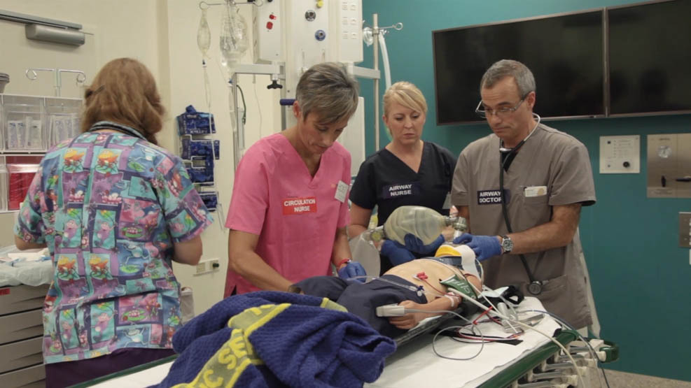
Team work
Notes:
Work in team (chapter 3)
During scenarios later today
Team leader takes responsibility for primary actions and decisions
know who you need, what you want your team to do and be accountable for their actions

Slide 16
Newborn Life Support
Airway management will resuscitate most babies.
Dry babies, assess ABC all together.
Read chapter in Manual (Appendix 1) & follow algorithm
Notes:
Important to spend a few minutes on neonatal resuscitation as many APLS providers are exposed to an occasional need to resuscitate babies especially in regional areas.
Points to emphasise.
Very good chapter in manual.
If there is a regular need to resuscitate babies then a neonatal resuscitation course should be attended.
Nearly all babies can be resuscitated with good airway management and bag and mask ventilation. This is taught in airway skills session. Intubation is rarely needed.
If available in hospital learn to use T-piece (neopuff) device. Provides CPAP as well as positive pressure.
Point out the algorithm which should be on all resuscitation trolleys and also on APLS app.

Slide 17
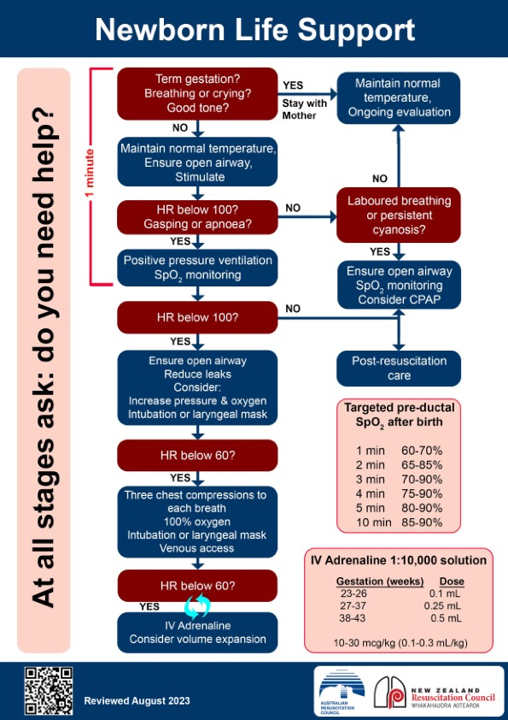

Temp. control
Assessment
Ventilation
oximetry
Chest compressions
UVC and adrenaline
App. G
p419
Notes:
The principles of management are on this slide &

Slide 18

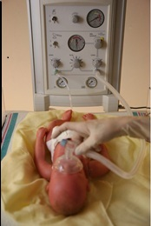
Newborn Life Support
Learn to use a t-piece if available
Attend neonatal resuscitation course
Notes:
If candidates work in a context where neonatal resuscitation is expected, APLS recommends that they should complete a specific neonatal resuscitation course.
T piece circuits are not included in the Airway management Skill Station. If their institution uses T piece resuscitation circuits, it is very important that they familiarise themselves with their use.

Slide 19
?

Slide 20
Review of
Paediatric BLS & ALS
Managing a child who has arrested requires
a structured approach to effectively apply knowledge, skills and work as a team
Notes:
At the end of this session – candidates will go to either airway management or BLS/ALS/AED skill stations.
The review of knowledge from this session will be further consolidated in skill stations and cardiac scenarios.

