Slide 1
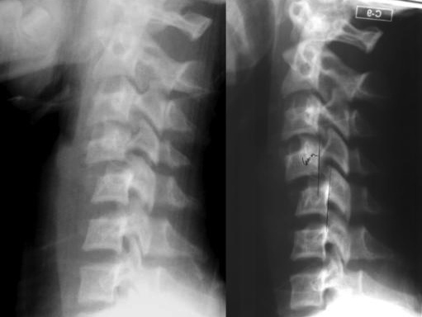
Trauma Radiology
Notes:
Please read the notes under the slides
For use with APLS ANZ 7th Ed manual

Slide 2
Trauma Radiology
On completing this workshop, you will be able to:
Have an approach to analysing the following trauma radiology images:
  lateral cervical spine X-rays
  chest X-rays
  pelvic X-rays
  head CTs
Recognise important injuries on radiology images that alter management.
Notes:
Lateral Cx Spine X-rays are still important as the use of CT for Cx spine imaging is not as universal as with adults (because of the radiation risk, particularly to the thyroid), and in many cases MRI is the preferred imaging modality if the plain X-ray is abnormal.

Slide 3
AAABCS approach
Adequacy
Alignment
Apparatus
Bones
Cartilage and
Soft tissues

Slide 4
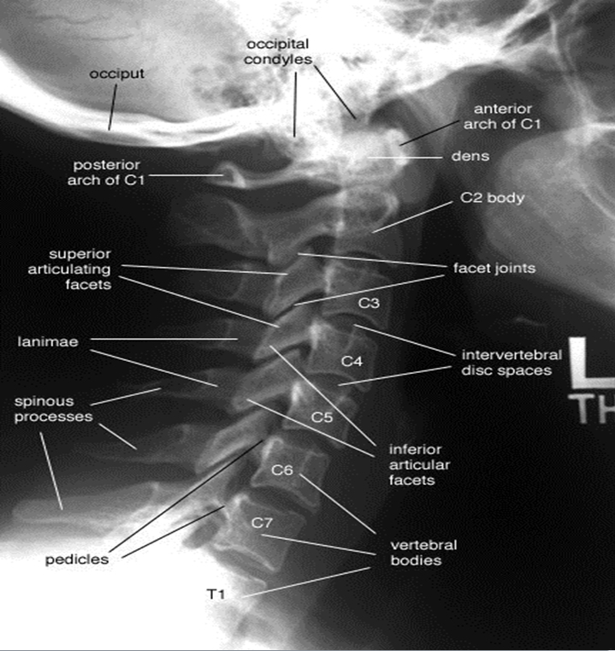
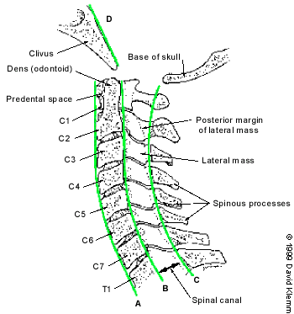
Lateral view – lines of alignment
laminae

Slide 5
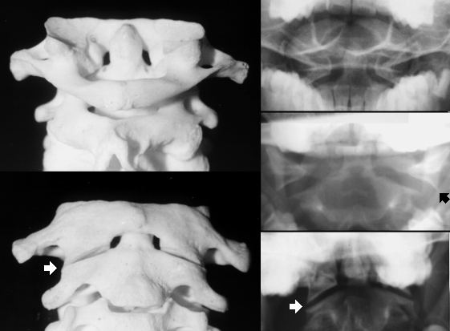
Odontoid view
Odontoid view
Notes:
Not part of initial trauma series

Slide 6
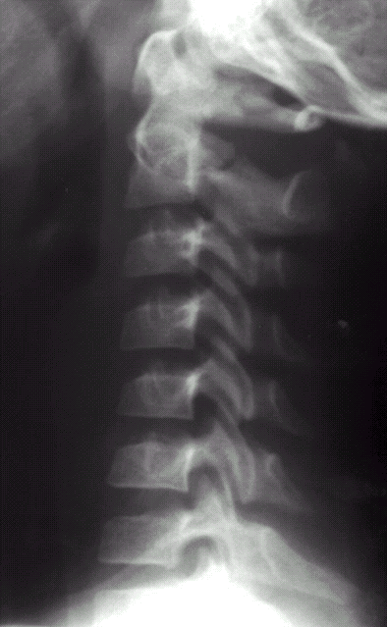
7 yo female unrestrained passenger in MVA
Notes:
DIAGNOSIS - C2 pedicle fracture (Hangman’s fracture) Cx1
KEY FEATURES
A
Adequate film
Abnormal alignment at C2/3 spino-laminar line
B
Both pedicles are fractured (unstable)
The hangman's fracture is an unstable fracture of the C2 pedicles, with forward displacement of C1 and the body of C2 on C3. This is the result of hyperextension of the head relative to the neck.

Slide 7
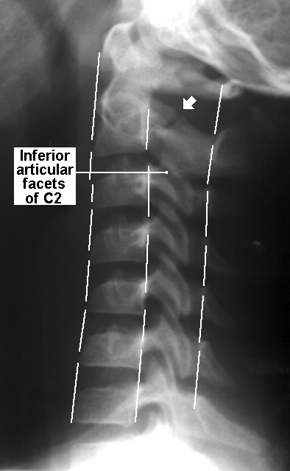
Hangman’s Fracture
pedicle # C2
7 yo female unrestrained passenger in MVA
Notes:
DIAGNOSIS - C2 pedicle fracture (Hangman’s fracture) Cx1
KEY FEATURES
Adequate film
Abnormal alignment at C2/3
Both pedicles are fractured (unstable)
The hangman's fracture is an unstable fracture of the C2 pedicles, with forward displacement of C1 and the body of C2 on C3. This is the result of hyperextension of the head relative to the neck.

Slide 8
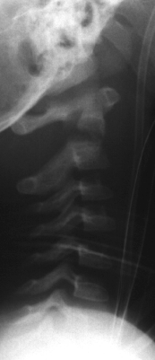
Odontoid fracture
NGT, ETT
8 yo male
Motor vehicle accident
Notes:
DIAGNOSIS - Odontoid fracture Cx3
KEY FEATURES
A
Inadequate film
C1 and skull displaced anteriorly
B
Fracture line through base of odontoid process
Anterior displacement of the odontoid process with anterior angulation with respect to the vertebral body
Unstable fracture
C/S- can’t see the soft tissues clearly enough to comment on them

Slide 9
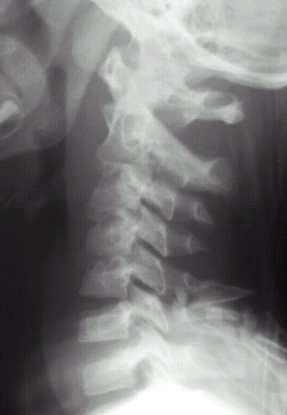
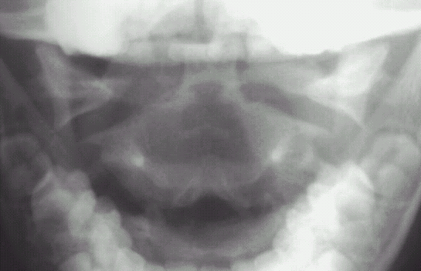
7 yo male, neck pain after diving into shallow water
Notes:
DIAGNOSIS: C1 burst fracture (Jefferson fracture) Cx10
KEY FEATURES:
Normal alignment
Fractures of anterior and posterior arches- increased space between anterior part of odontoid process and anterior arch of C1 (atlantodens interval)
Prevertebral soft tissue swelling
On the Odontoid view there is lateral displacement of the lateral masses of C2
A Jefferson fracture is a compression and/or bursting fracture of C1. This unstable fracture is the result of a direct blow to the vertex of the head (axial compression load), either from a fall or from an object striking the vertex of the head.
The lateral margins of the lateral masses (inferior articular facets of C1) should align with the lateral margins of the structures below it (superior articular facets of C2). The space between these two facets is the atlanto-axial joint. In this radiograph, the lateral masses of C1 are displaced outward, indicating a "bursting" of the ring of C1.

Slide 10
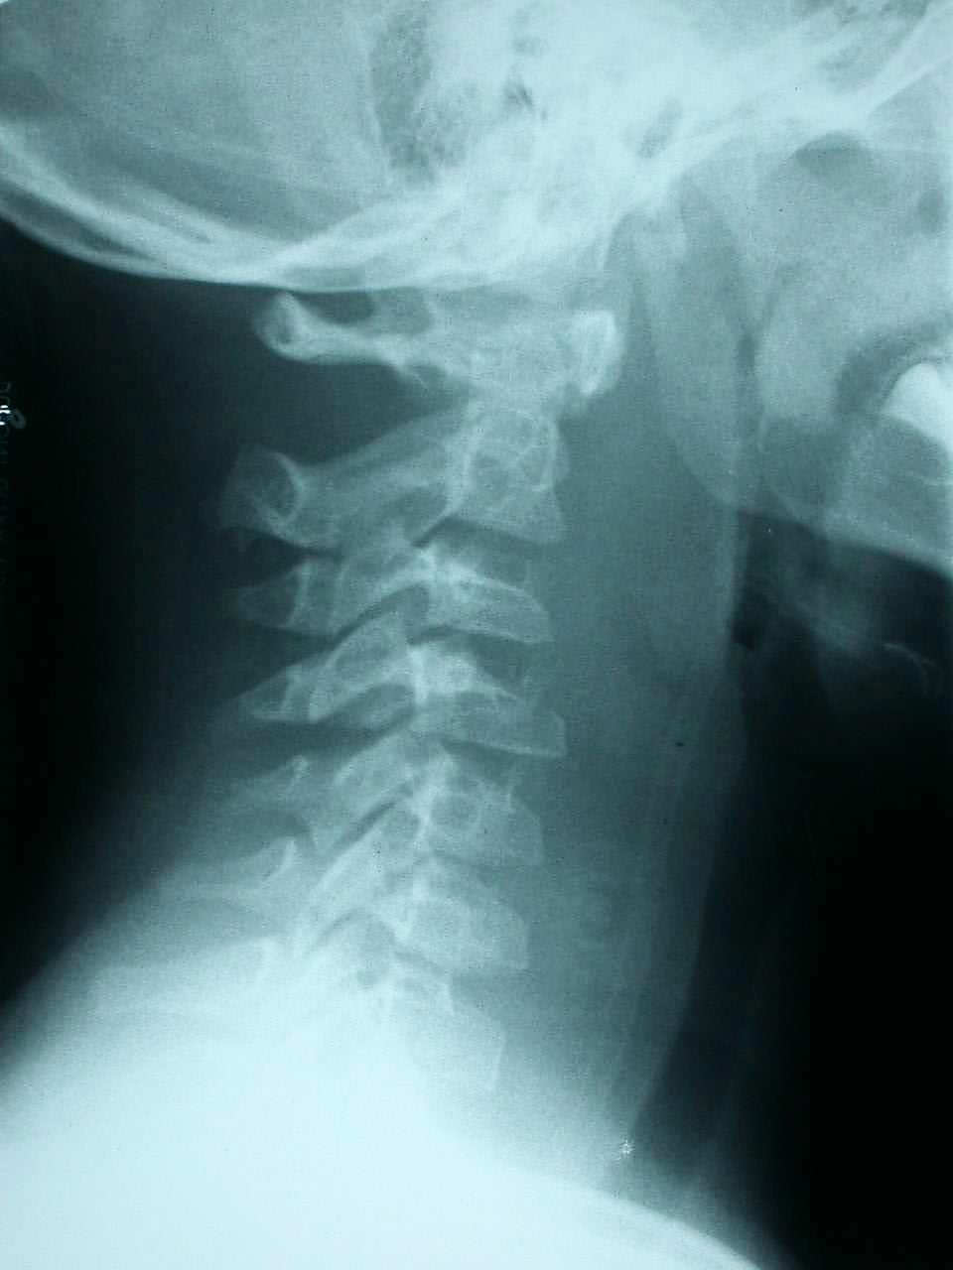
C4 fracture
7 yo male involved in high speed MVA
Notes:
Cx5
DIAGNOSIS - C4 fracture
KEY FEATURES
abnormal alignment at C4/5
abnormal shape to C4 vertebral body
extensive prevertebral soft tissue swelling

Slide 11
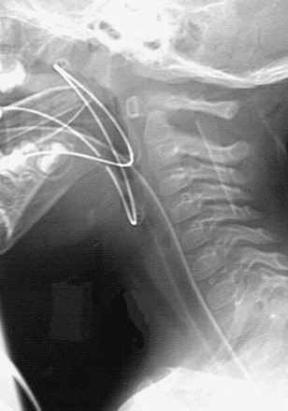
Intubated 7 year old
Oesophageal intubation
Gastric tube coiled in pharynx

Slide 12
Approach to head CT interpretation
A - alignment (is there midline shift)
A - air spaces (sinuses)
B - brain (and ventricles)
C - cranium (any skull fracture)
S - scalp (any scalp haematoma, and is there a contra-coup injury seen).

Slide 13
4 yo – fall from bunk, initially OK, now vomiting and drowsy
Extradural haematoma
Mixed density blood (several hours)
Mass effect – midline shift, compression of lateral ventricles

Slide 14
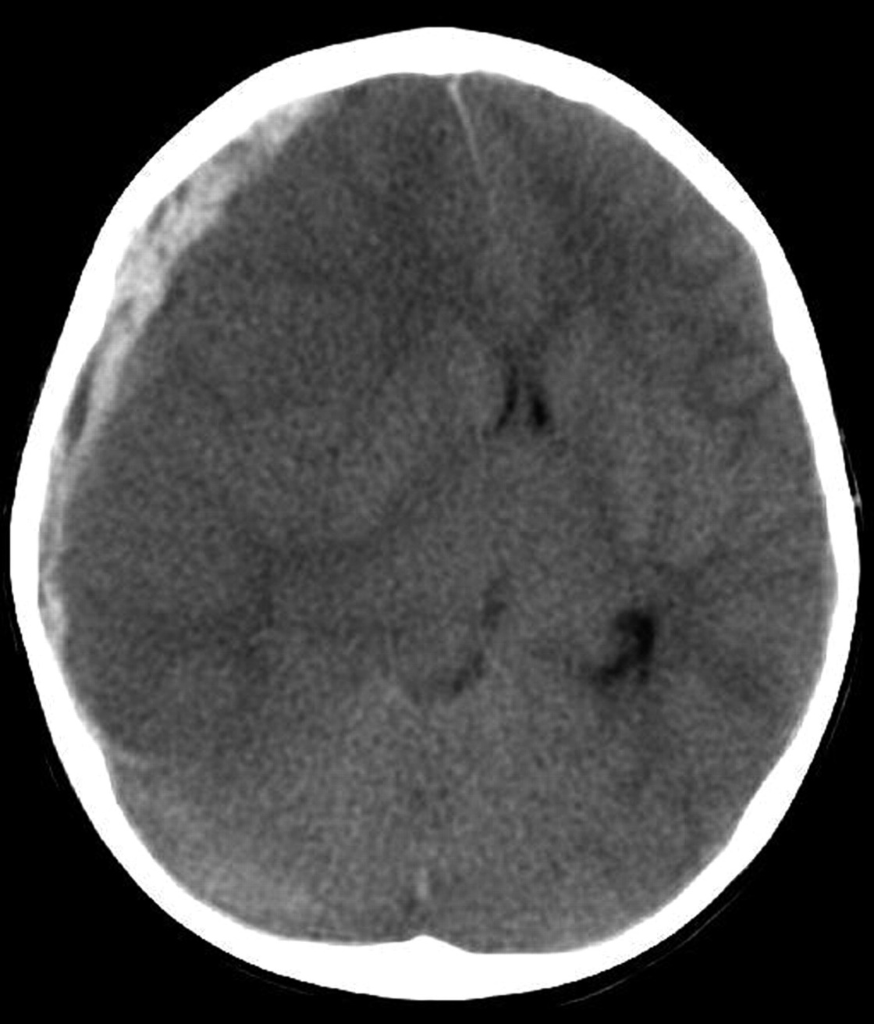
15 yo boy – motorcross rider, head injury
Subdural haematoma
Mass effect, midline shift
Loss of grey/white differentation

Slide 15
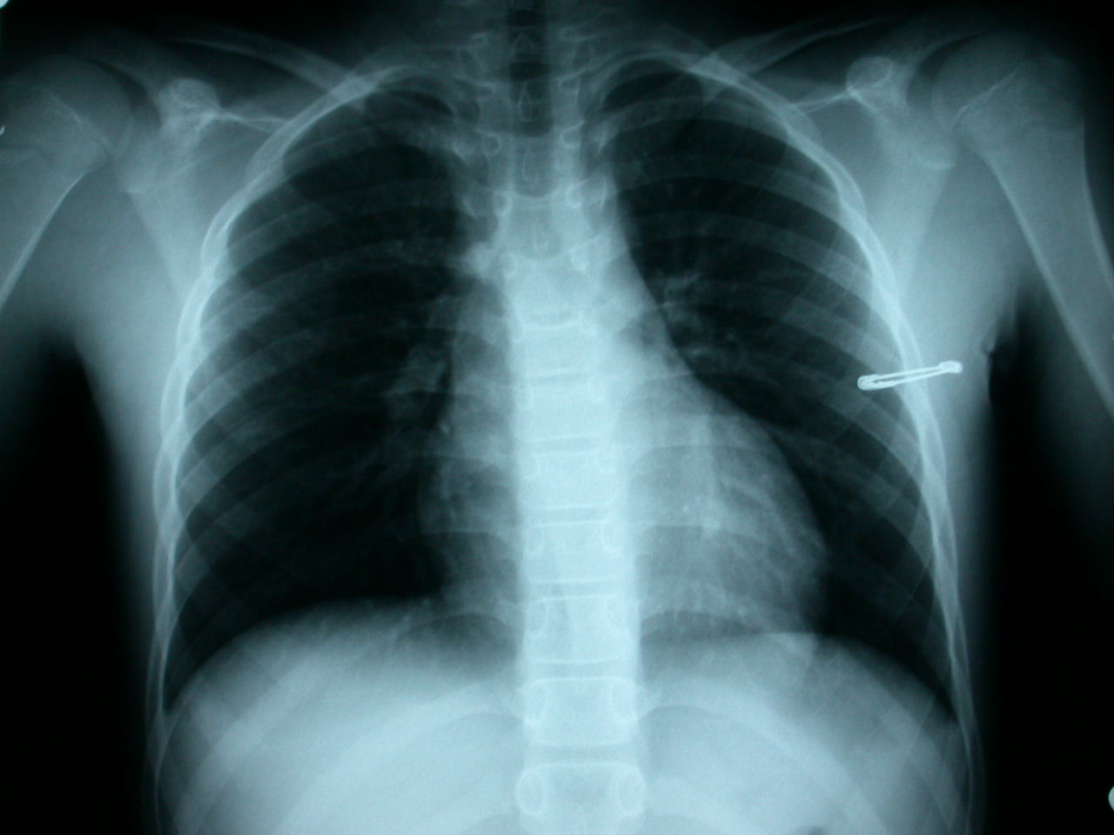
Adequacy
Alignment
Apparatus
Bones
Cartilage and
Soft tissues:
  Lungs
  Heart
  Mediastinum
Normal CXR 12 yo male
Notes:
Ch1
TYPE - PA vs AP
AP- patient ill
- pitfalls - enlarged heart, enlarged mediastinum, high diaphragms
supine - seriously ill +
- pitfalls - upper lobe blood diversion: may miss pneumothorax (as sits anteriorly): may miss pleural fluid (as sits posteriorly)
ROTATION
DEGREE OF INSPIRATION
MEDICAL EQUIPMENT
MEDIASTINUM
HEART SIZE - should be less than half of internal thoracic diameter
DIAPHRAGM - outline
LUNG FIELDS - airspace opacity
- pneumothorax: pneumomediastinum
BONES - esp ribs,clavicle, spine, sternum
SOFT TISSUE - S/C emphysema
- under diaphragm

Slide 16
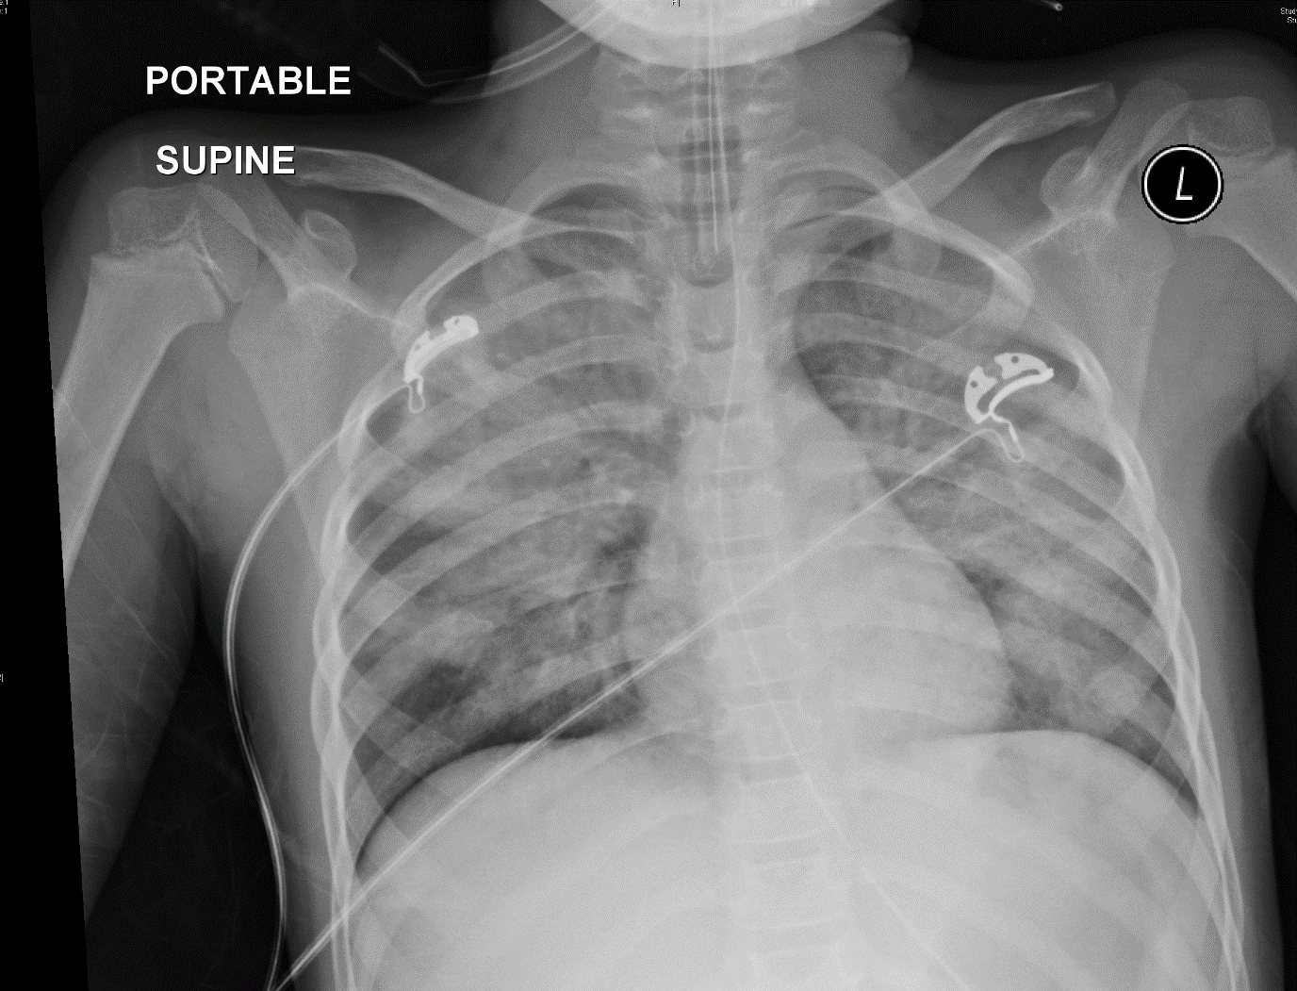
ETT, NGT
Bilateral lung contusion
7 yo female involved in MVA
Notes:
DIAGNOSIS - right lower lobe lung contusion Ch2
KEY FEATURES
air space opacity within the right lower lobe
no further abnormality

Slide 17
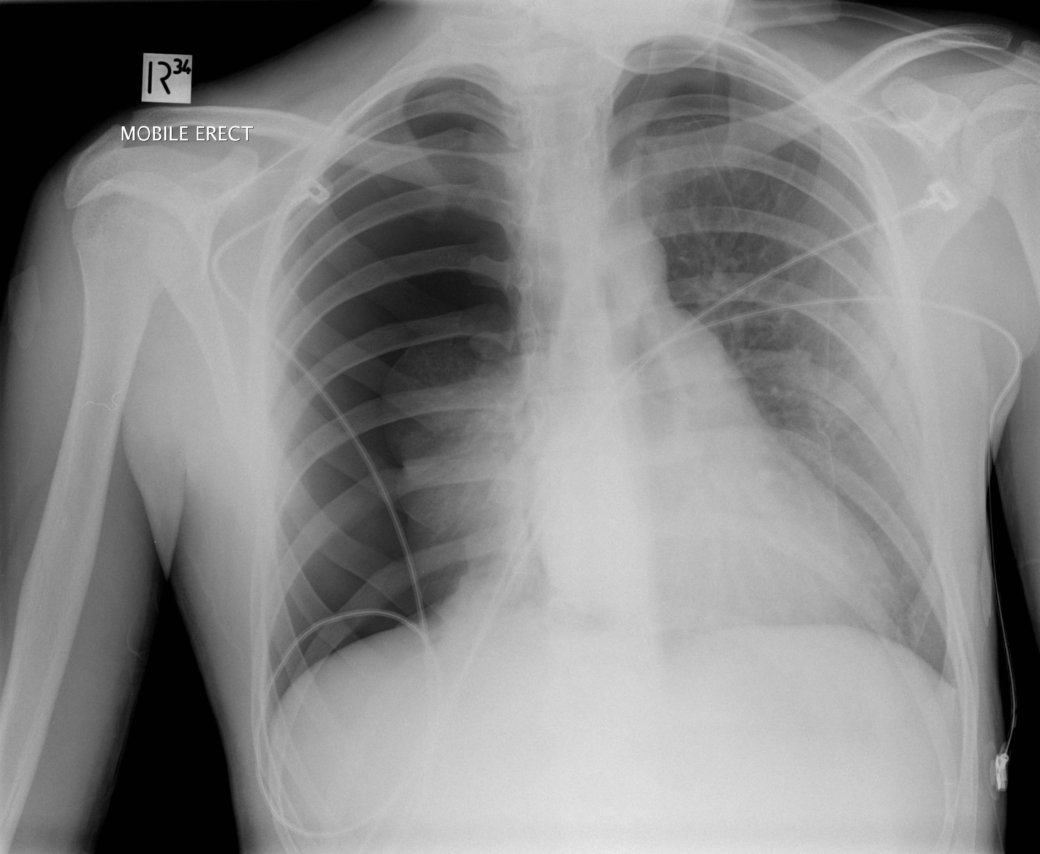
Large R & small L pneumothorax
14 yo male involved in MVA
Notes:
DIAGNOSIS - right sided pneumonthorax Ch3
KEY FEATURES
loss of lung markings towards the periphery of the hemithorax
edge of lung seen
no underlying rib fracture

Slide 18
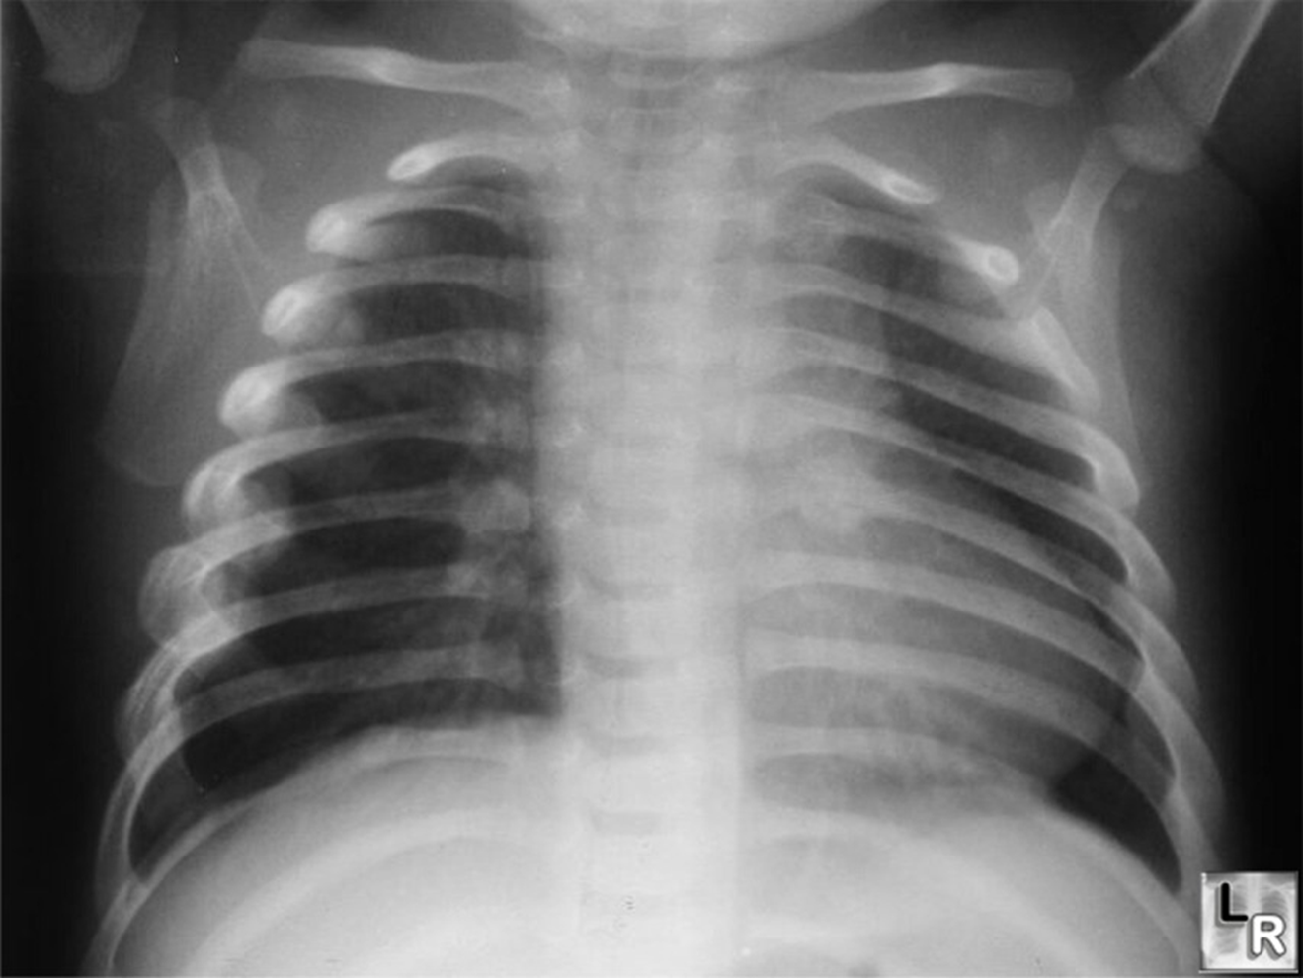
Healing posterior rib fractures
3 yo male, head injury
Notes:
DIAGNOSIS - NAI Ch4
KEY FEATURES
If candidate is stuck ask group why you would do a CXR in a child this age with a head injury?- “they will usually come up with screening for NAI “as the answer
left sided posterior healing ribs fractures
NEXT PAGE
skeletal survey demonstrates skull fracture and long bone fracture of humerus

Slide 19
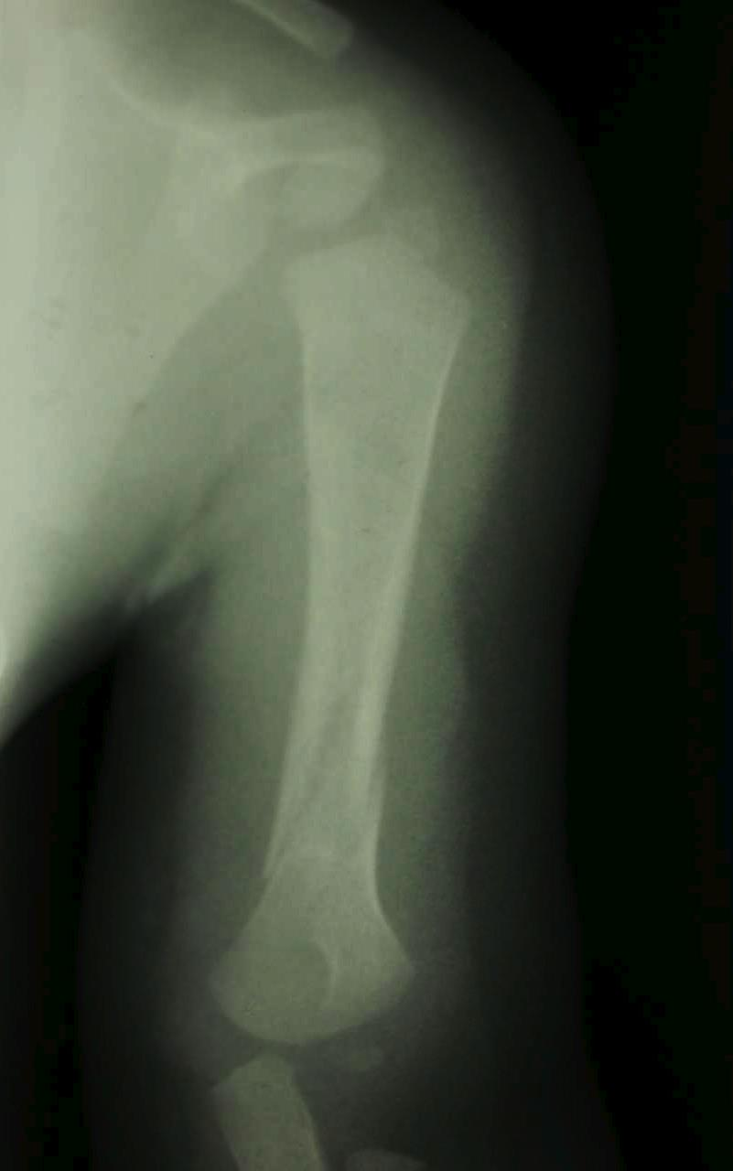
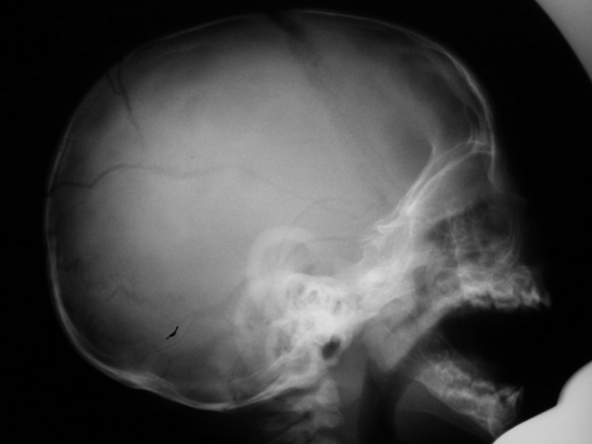
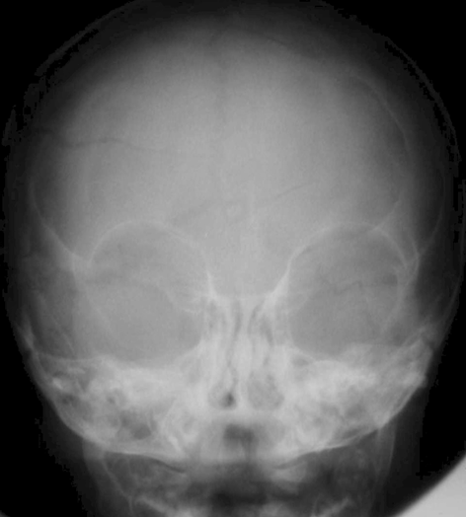
Same child – further #’s on survey

Slide 20
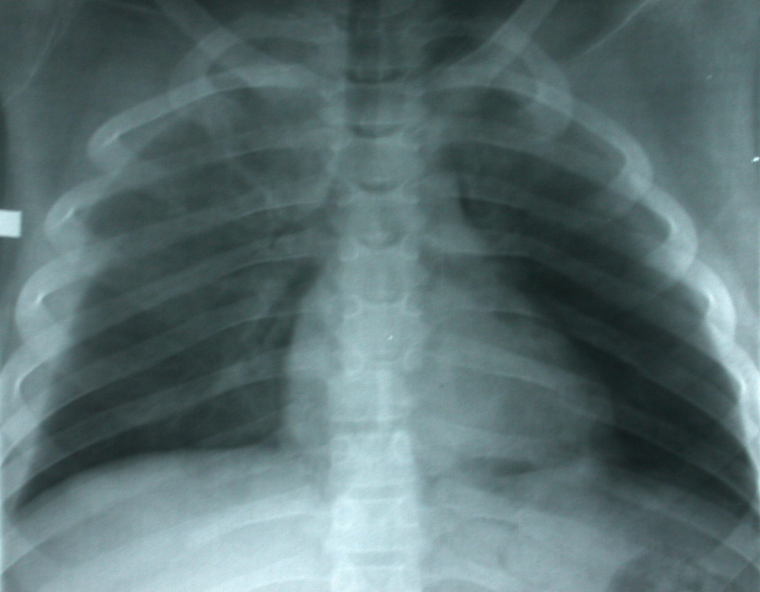
T6/7 fracture dislocation,
left sided rib fractures,
right haemothorax
9 yo male involved in rollover MVA
Notes:
DIAGNOSIS - T6/7 fracture dislocation Ch5
- left sided rib fractures
- right haemothorax
KEY FEATURES
posterior rib fractures on left
large right haemothorax- absence of air-fluid level as patient is supine.
air space opacity in both upper zones - lung contusions
displacement of pedicles with relation to the vertebral body at the T6/7 level

Slide 21
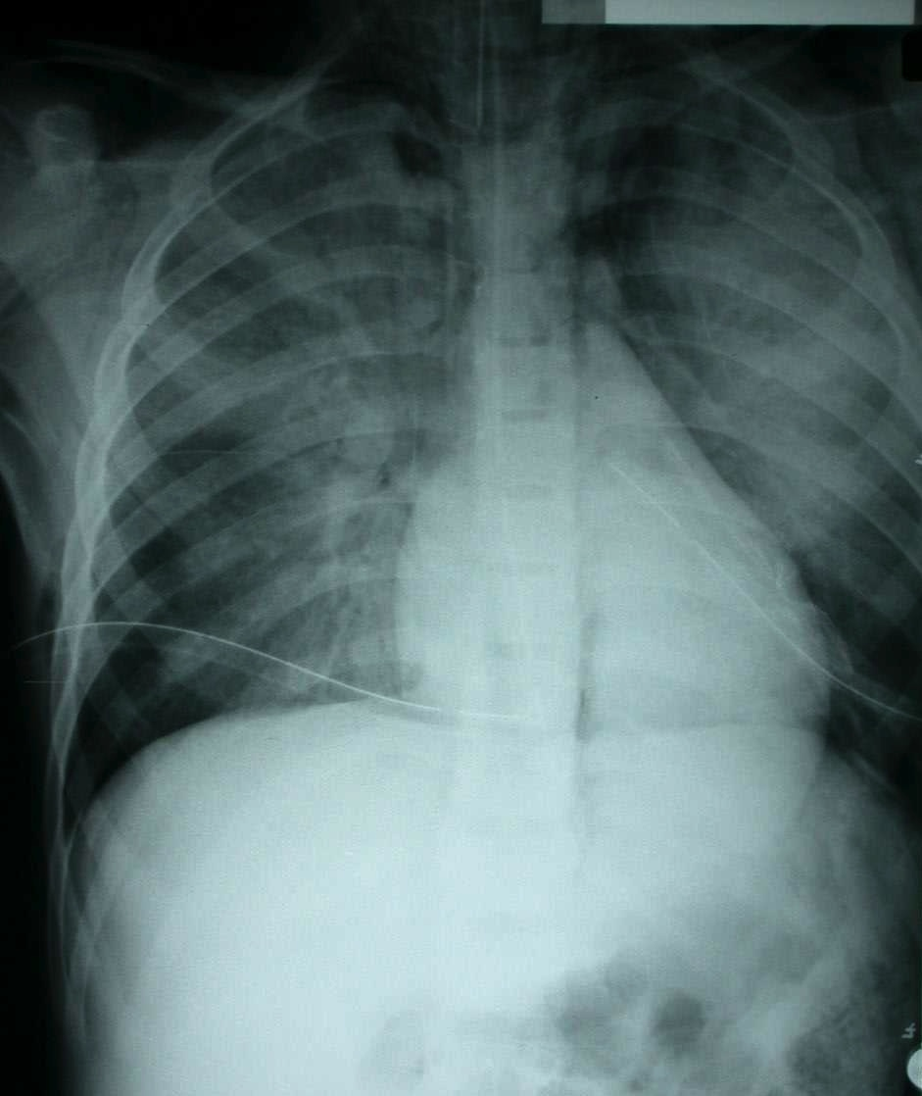
Pulmonary contusions,
subcutaneous emphysema,
Pneumomediastinum,
bilateral chest drains
8 yo male involved in high speed MVA
Notes:
DIAGNOSIS - pulmonary contusions Ch6
- subcutaneous emphysema
- pneumomediastinum
- bilateral chest drains
KEY FEATURES
inadequate film - whole of left hemithorax not visualised
air space opacity seen throughout both lung fields - lung contusion
chest drains - treatment for pneumothoraces
streaky gas opacity over the mediastinum - pneumomediasinum

Slide 22
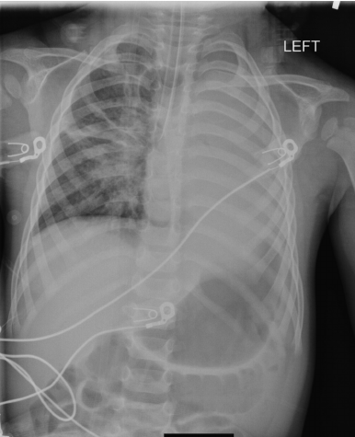
8 yo boy, intubated post head injury
Right main bronchus intubation
Collapsed L lung
No NGT, dilated stomach

Slide 23
10 yo boy – motorbike into wire
Extensive subcutaneous emphysema
Pneumomediastinum
Likely ruptured major airway (larynx, trachea, bronchus)

Slide 24
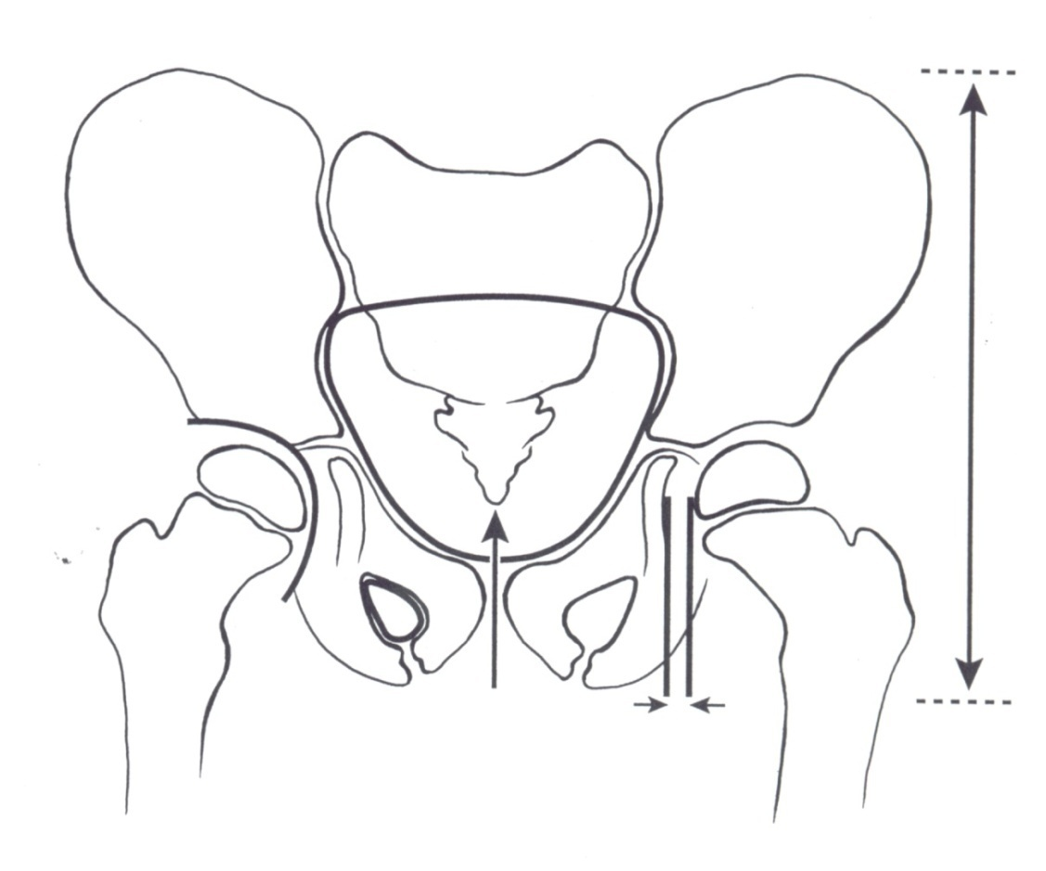
Trauma radiology
The pelvic rings

Slide 25
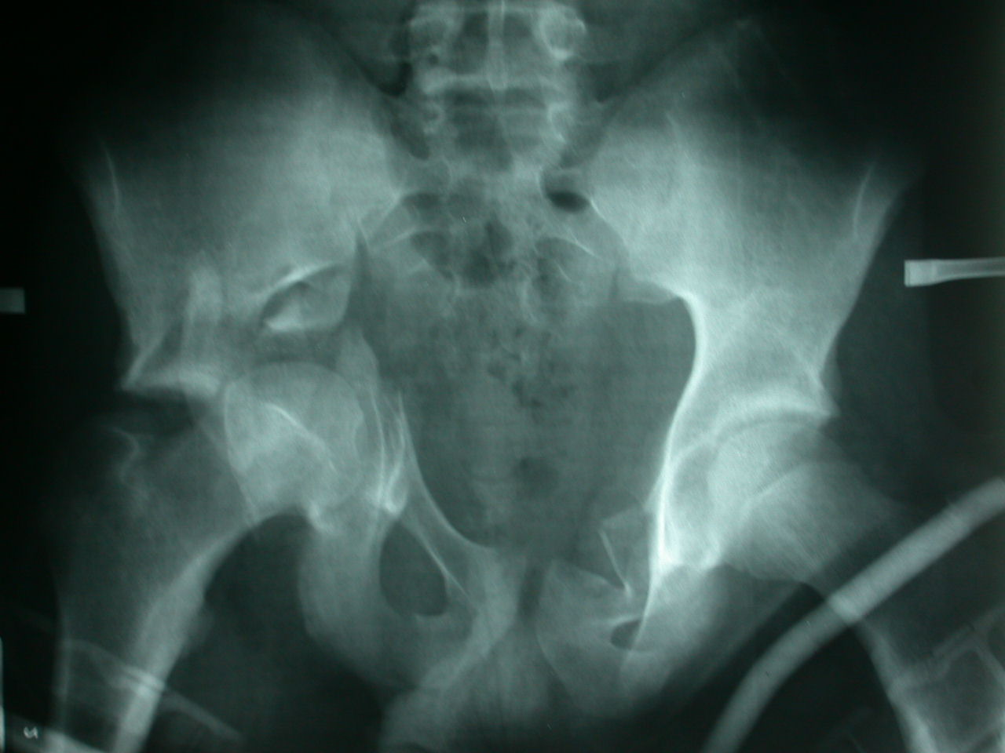
Multiple pelvic fractures,
acetabular fracture
14 yo pedestrian vs car
Notes:
P2
DIAGNOSIS - Multiple pelvic fractures
- Acetabular fracture
KEY FEATURES
Disruption of right side of pelvic ring - fracture of acetabulum - hip joint involved
Disruption of left inferior aspect of pelvic ring - fracture of left superior pelvic ramus
- pelvic ring disrupted in two places

Slide 26
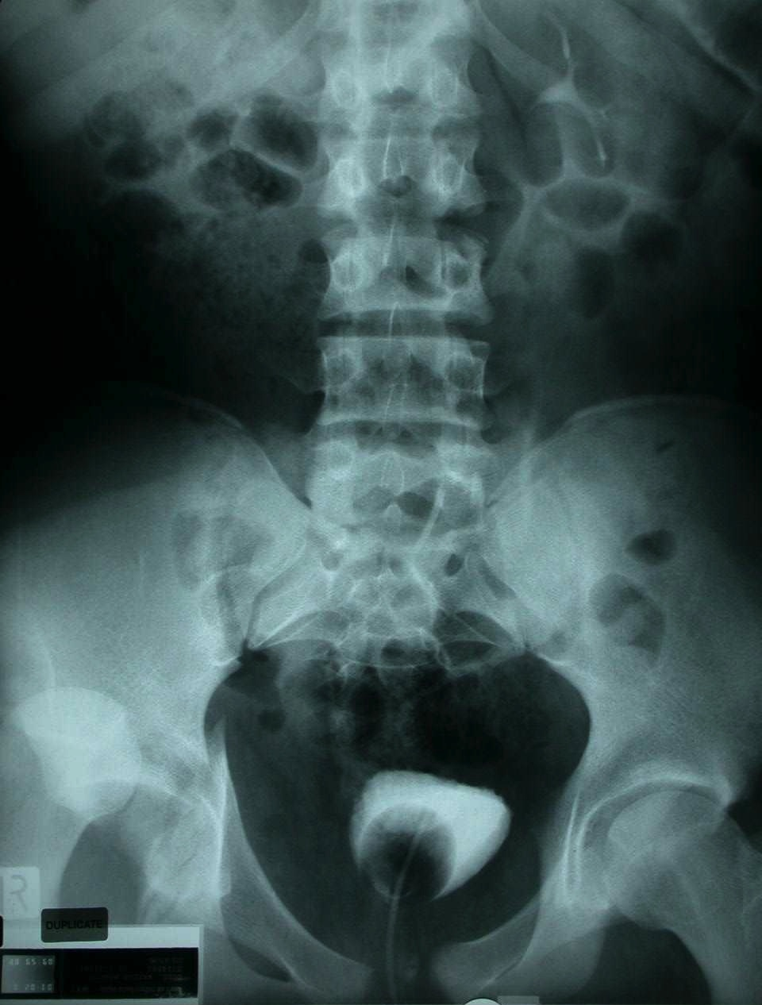
Pelvic fractures,
dislocated right hip
15 yo male,
high speed MVA
Notes:
DIAGNOSIS - Pelvic fractures P3
- Dislocated right hip
KEY FEATURES
Inadequate film - whole of pelvis and proximal femora are not seen
Disruption of the right side of the pelvic brim - fracture of ilium and acetabulum
Widened pubic symphysis - diastasis
- pelvic ring broken in two places ie one bone fracture the other cartilage

Slide 27
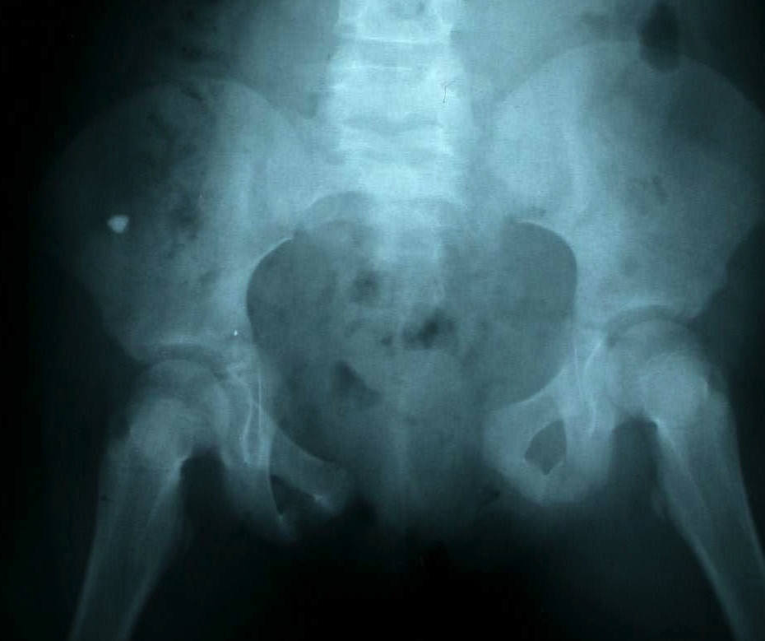
Multiple pelvic ring fractures, pubic diastasis
9 yo female involved in high speed MVA
Notes:
P6
DIAGNOSIS - Multiple pelvic ring fractures
- Pubic diastasis
KEY FEATURES
There are multiple disruptions to the pelvic brim
- fracture to left side of sacrum
- fracture to acetabulum
- gross pubic diastasis
presacral haematoma
subcutaneous pelvic gas

Slide 28
?

Slide 29
Summary
You should now be able to:
Approach the interpretation of common trauma radiology images.
Identify important trauma injuries such as
  Extradural and subdural intracranial haemorrhage
  Important cervical vertebral fractures
  Chest injuries
  Fractures of pelvic rings

