Slide 1
Pain Management
Notes:
Please read notes under the slides
For use with APLS ANZ 6e manual, March 2017 & pre-course online learning modules
There are 4 clinical cases to support discussion in this workshop.
Case No Case Aims
1. 6 y.o appendicitis Pain assessment, Pain management, oral/nasal/IV/LA analgesics, non-pharmacological
2. Baby, 4% burns, 4 y.o # ankle First aid, dressings, splints, procedural sedation safety
3. 12 y.o trauma, # femur Splints, nerve blocks
4. 9 y.o, headache Pain assessment, social/emotional/family issues

Slide 2
Objectives
On completing this workshop, you will be able to:
  Understand the assessment of children’s pain
  Understand the principles of pain management
  Appreciate safety aspects of acute pain management

Slide 3
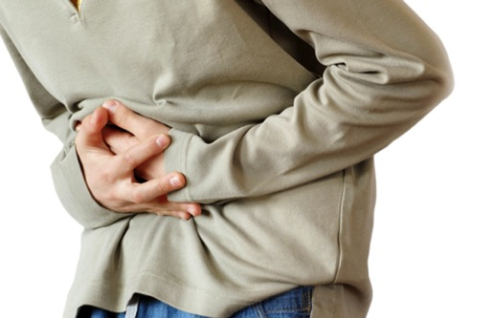
Case 1
Initial Information
6 y.o boy brought to ED by Mum complaining of abdominal pain. Initially dull pain at belly button, now localised to right iliac fossa. Mild fever, anorexia, one episode of vomiting, loose bowels
Further information
Working diagnosis of acute appendicitis. Referred to surgical team who are unable to attend as busy in theatre
How would you assess this boy’s pain?
The boy indicates his pain at the third face on the pain scale.

Slide 4
Pain Assessment
FACES Wong-Baker Pain Scale
What would you do next?
Notes:
The FACES pain scale shows a close linear relationship with visual analog pain scales across the age range 3 through 16 years.
Mention that pain assessment in babies and younger children is more difficult, with a number of validated behavioural scale in use.
FLACC scale, Face, Limbs, Activity, Crying, Consolabilty, 0-10, originally developed for post-op pain
MBPS, Modified Behavioural Pain Scale, Face, Cry, Movements, 0-10, developed for procedural pain
Assessment will also include observation of physiological parameters (pulse rate, respiratory rate), skin changes (pallor and sweating) along with behavioural cues (e.g. crying).
Always consider the anticipated pain with a known injury.

Slide 5
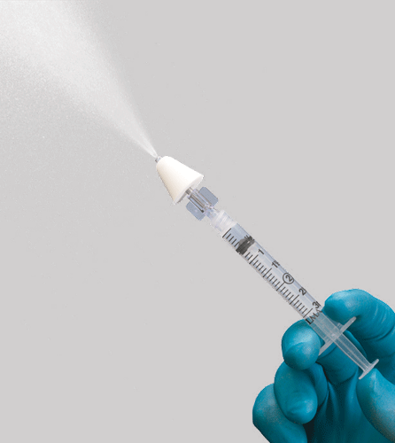
Common analgesics
    Mild to moderate pain
          sucrose
          paracetamol
          ibuprofen
        Moderate to severe pain
          fentanyl (including intranasal)
          morphine
          oxycodone
Notes:
Be prepared to discuss removal of Codeine from WHO pain ladder.
Problems with CYP2D6 genetic polymorphism and potential for respiratory depression or inadequate analgesia

Slide 6
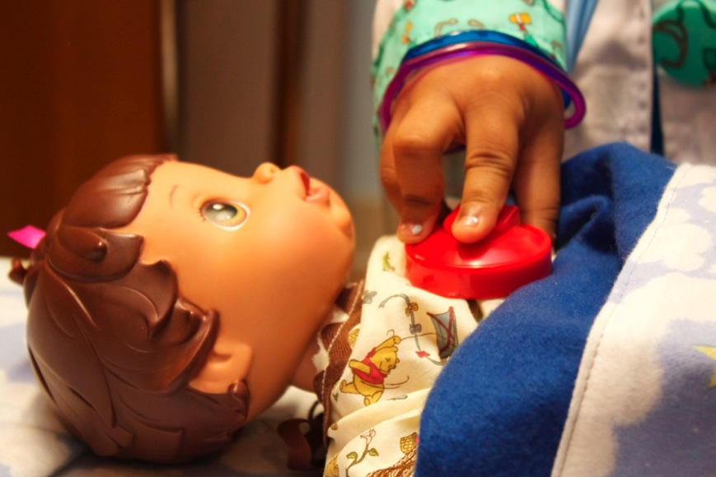
Common analgesics
    Local anaesthetics
      topical analgesia for IV access
      ALA (laceraine) for lacerations
      topical lignocaine for mucositis
      ring blocks for partial amputation
      LA drops for eye injuries
Remember distraction
techniques and environment
Notes:
Topical analgesia may include Lignocaine/Prilocaine mixtures or 4% Amethocaine together with cold sprays in older children with larger veins.

Slide 7

Case 2
Initial Information
A woman runs in to the Emergency Department carrying a baby. The child is screaming loudly. The woman explains that she accidentally knocked her cup of tea onto the baby.
Further information
The child is crying loudly. There are partial thickness burns to the front of the chest, right shoulder, thigh.
You estimate the total area at 4%.
Notes:
First aid, cold water for 20 mins
Initial analgesia
Covering burn – cling film

Slide 8
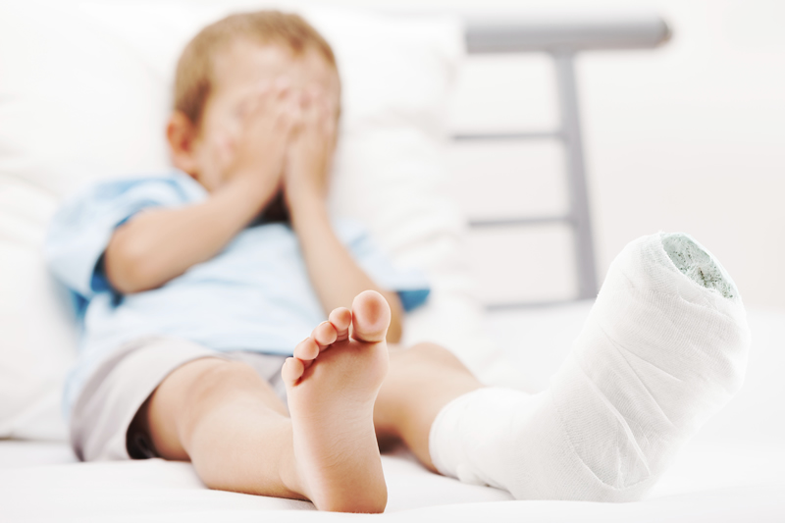
Specific therapies
Burns management
  first aid
  dressings
What if the patient were a 4 year old with a deformed ankle after jumping off a trampoline?
Fracture stabilisation
  splinting / back slab
  reduction of fractures / dislocations
Notes:
This relates to Case 2 (burns) and is segue to Case 3 (fractured femur)

Slide 9
Procedural sedation
Ketamine
Nitrous oxide
Notes:
Emphasise safety when using procedural sedation.
Adverse effects
Ketamine
hypersalivation, respiratory depression (rare), laryngospasm, nausea and vomiting, emergence delirium/agitation
Nitrous oxide
adverse effects, over-sedation, respiratory depression, nausea and vomiting, diffusion hypoxemia, expansion of gas spaces (eg pneumothorax)
9

Slide 10
Procedural sedation safety
Appropriate
  Training
  Equipment, environment
  Personnel / assistance
Safety
  Drugs and dosing, monitoring
  Resuscitation equipment and medications
Notes:
10

Slide 11
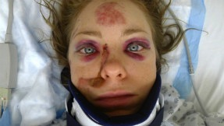
Case 3
Initial Information
A 12 year old girl pedestrian has been hit by a car. She is brought in by a paramedic crew with a cervical collar. There is a box splint around her left leg. She is screaming in pain.
Further information
Initial assessment and management are carried out. There is considerable swelling mid left thigh and angulation of the femur. She is still crying in pain and points to her left thigh. There are no other major injuries.
Notes:
Further management?

Slide 12
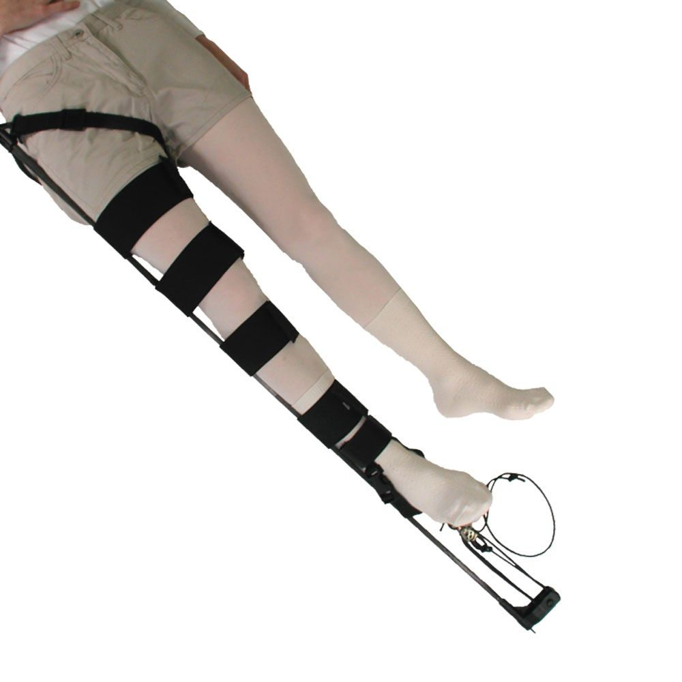
Splints
CT6 splint
Notes:
RFDS WA CT6 Information
https://www.flyingdoctor.org.au/wa/clinical/aeromedical-retrieval/our-retrieval-service/retrieval-equipment/ct-6-traction-splint/
CT-6 Traction Splint
The CT-6 is a leg traction splint designed for prehospital/hospital care and patient transport. It is primarily used on patients with mid-line femur fractures. The CT-6 helps relieve patient pain and muscle spasm, aligns the fractured bone, decreases bleeding and prevents further damage to surrounding muscle and tissue.
12

Slide 13

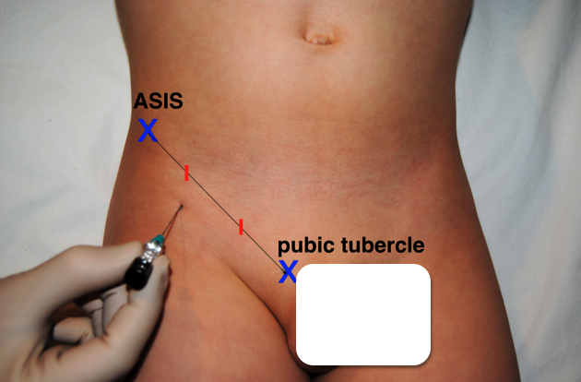
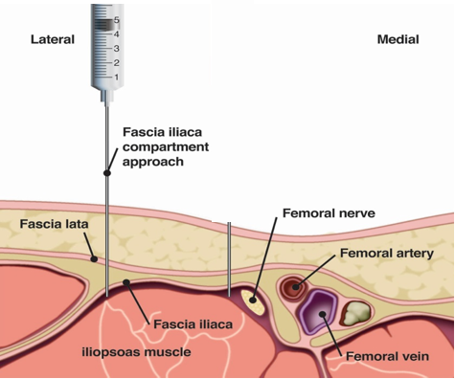
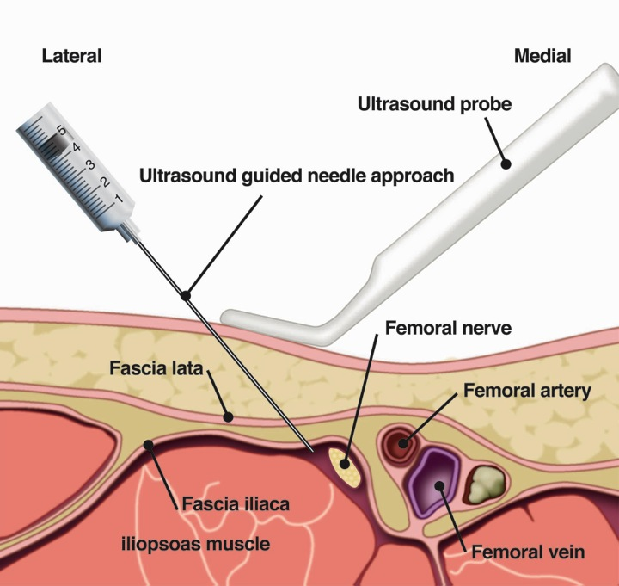
Fascia iliaca block
Femoral Nerve Block
Ultrasound Guided
Notes:
Fascia Iliaca or Ultrasound Guided Femoral nerve block provide rapid and effective analgesia
Fascia Iliaca block
The Injection point is 0.5-1cm below the junction of the lateral 1/3 and the medial 2/3 of the skin projection of the inguinal ligament. Regional anaesthesia needle (short bevel) is inserted at right angles to the skin and two loss of resistances (pops) are sought – the fascia lata and the fascia iliaca. Effective and safe block with lower chance of intra-vascular and intra-neural injection
Ropivacaine 2mg/ml (0.2%) at 1 ml/kg (=2 mg/kg) to maximum of 30 mls
Ropivacaine
Less toxicity than bupivacaine as the isomer binds less avidly to cardiac tissue. Lower incidence of VT/VF
Less motor block than bupivacaine

Slide 14
Nerve block safety
Appropriate
  Training
  Equipment, environment
  Personnel / assistance
Safety
  Ultrasound guidance
  Drugs and dosing, monitoring
  Resuscitation equipment and medications
  Block 'time-out'
Notes:
Prior to performing a regional block, a “block time out” should be performed. This requires verification with another clinician (nurse/medical practitioner) of
correct site and side of the proposed block
patient identification
confirmation of consent
14

Slide 15

Case 4
Initial Information
A 9 year old boy is brought in to the ED by his mother. Vomiting at school now complaining of severe headache. He indicates his pain is at the top of the pain ladder, “worst ever”.
Further information
You notice that the boy is able to walk normally and is interested in surroundings. He starts playing a computer game and eating. He says the pain is still “terrible”.
Notes:
How would you manage?

Slide 16
?

Slide 17
Summary
Use age appropriate assessment tools, clinical signs and family advice to assess pain
Apply the principles of pain management and multi-modal analgesia to provide optimal pain relief
Safely manage pain and seek resources if required

