Slide 1
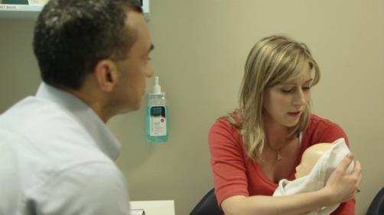
7th edition
Structured Approach to the Seriously Ill Child & Child in Cardiac Arrest
Notes:
Instructor Notes
This session is 45 mins.
Read notes on facilitating plenaries.

Slide 2
Seriously Ill Child & Child in Cardiac Arrest
By the end of this session, you will be able to demonstrate an understanding of:
the structured approach to the seriously ill child
the clinical assessment sequence to identify life-threatening illness in a child
the structured approach to a child in cardiac arrest
Notes:
Consider commencing the session in a usual plenary style and moving into groups of 3-4 after slide 4 (Rapid Assessment).
Sit candidates in groups ( 3-4 people each group). They will need pen, clip board and 2 double sided copies per group of the A4 Serious Illness Activity Sheet
Interactive session is also to:
Candidates nominate a scribe and a spokesperson
ACTIVITY PACKS x 4 - one per group of six candidates
Aim of this session is to recap the recognition and resuscitation of the seriously unwell child, briefly recap identifying when circulatory arrest has occurred, revision of BLS and ALS , and the use of two cases to practice the material discussed

Slide 3

Why APLS Structured Approach?
Notes:
Write down three reasons to have a structured approach to a serious ill child.
I minute for activity – 3 minutes for shared answers
Multiple answers (incl. Human Factors issues - Chapter 2 in 7e)
so you don’t miss anything
method to calm oneself down in panic position
prioritise assessment and treatment in a logical order
learn an automated response.
Minimise fixation
Shared situational awareness
Communication
SEGUE to algorithm activity – click to show aeroplane - repetition assists in established automated responses

Slide 4
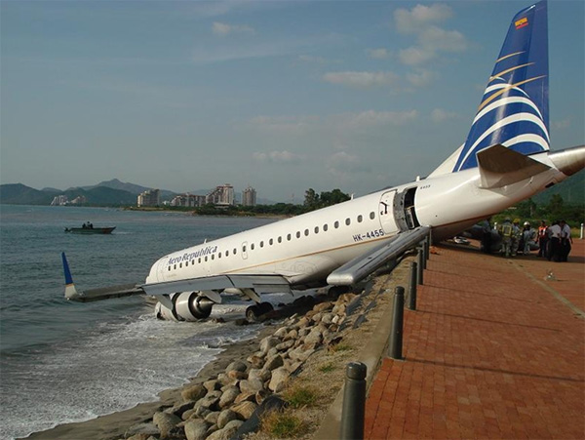
Why APLS Structured Approach?
Notes:
- Human factors - Chapter 2

Slide 5
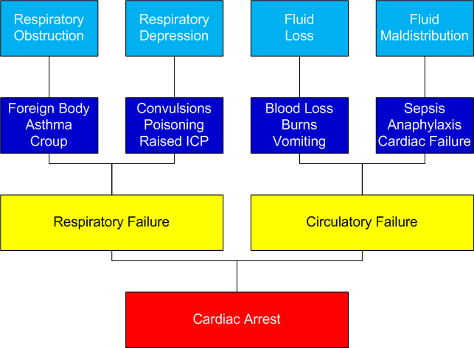
Notes:
Pathways to cardiac arrest
Pale Blue Row – presenting issue
Dark Blue Row – possible reversible causes
Yellow – where the situations are heading
Talk about how assessment and intervention with the conditions on the top of the slide can prevent or slow progression to the serious consequences on the bottom of the slide.
This involves rapid assessment of the seriously ill child (summarised on next slide).
Be brief – this and the next slide is recall from pre-reading and the online learning.

Slide 6
Rapid assessment
Airway & Breathing
  Effort
  Efficacy
  Effects
Circulation
  Heart rate
  Capillary refill time
  Blood pressure
  Skin temperature
Disability
  Conscious level
  Posture & Pupils
Notes:
In Disability also mention along with posture COLOUR & TONE
This slide has animation.
Rapid assessment features are emphasised in the online learning – this slide is a prompt for recall of pre-course learning. Give candidates the ‘space’ to provide the answers.

Slide 7
Initiate Management
Airway & Breathing
  Open airway
  Adjuncts
  High flow Oxygen
  Specific treatment
  Assist ventilation
Circulation
Establish access
Fluid bolus
  Specific treatment
  Disability
  Optimise cerebral blood flow-ABC
  Specific treatment
Notes:
Initial management is similar regardless of cause of the illness
Once more information is available specific treatment can target the cause of the illness
Having a “scaffold” for resuscitation helps the practitioner to provide resuscitation whilst giving more time to gain more information to enable a diagnosis and specific treatment to be found

Slide 8
Tyler’s case
Tyler is three years old.
He has had a fever and been drowsy today on the background of having a cough for two days.
His mother is really worried about how hard he is breathing and how sleepy he is compared to his usual self.
She has brought him to Emergency Department.
Notes:
Present this case and the following slide and invite candidates to discuss in their groups the initial resuscitation and then think about the differential diagnosis of respiratory and circulatory failure and the specific interventions that should be given.
Invite candidates to provide answers to next two slides, including any other key features that they can think of

Slide 9
Tyler’s case: Primary assessment and resuscitation
 | On examination | Resuscitation
A | Patent | Call for help Maintain airway (may need intubation) High flow oxygen via face mask IV access and fluids (10-20 mls/kg bolus) Bloods Empiric Antibiotics Reassess
B | Resp rate 40/min SpO₂ not recordable Significant recession Poor AE (R) lower chest
C | Pale Heart rate 170/min Weak peripheral pulses BP 65 mmHg systolic CRT 4 sec
D | AVPU
Notes:
Allow 2 minutes
See Slide 24 for hidden features

Slide 10
Tyler’s case:
What emergency treatment?
Key Feature | Diagnosis | Treatment
Creps at (R) lung base | Severe Pneumonia | Resp support/IV ABs
History of asthma | Severe Asthma | Resp support Bronchodilators IV corticosteroids
Fever and rash | Septicaemia | IV/IO Fluid Antibiotics
Signs of heart failure | CHD / Cardiomyopathy | Diuretics, inotropes Prostaglandin (in neonate)
Abnormal ECG | Arrhythmia | Arrythmia algorithms
High blood glucose | Diabetes | Fluid* and Insulin
Notes:
Show key features and ask for diagnosis and emergency treatment.
Ask whether there are any other key features / diagnoses not listed here.
Allow 4 minutes
See Slide 25 for hidden features, diagnosis and treatment.
Note Prostaglandin is in ‘grey’ font, as a teaching point for infants pg 76-77 (not suitable for Tyler – who is 3 yrs old)

Slide 11
Ruby’s case
Ruby is 4 months old.
She has been brought in by her parents who are concerned that she is sleepy and not taking her feeds.
She has had no previous illnesses
Notes:
Present this case and the following slide and invite candidates to discuss in their groups the initial resuscitation and then think about the differential diagnosis of reduced conscious level and the specific interventions that should be given.
Invite candidates to provide answers to next two slides, including any other key features that they can think of before summing up. Eg:
Fever - meningitis
acute onset – cerebrovascular event
high BP – hypertensive encephalopathy
vague and inconsistent history, other trauma in an infant – child abuse

Slide 12
Ruby’s case: Primary assessment and resuscitation
 | On examination | Resuscitation
A | Snoring | Call for help Open and protect airway High flow oxygen via face mask IV/IO access and judicious fluids Blood tests esp blood glucose Start to warm Reassess
B | Resp rate 40/min No recession SpO₂ not recordable
C | Heart rate 140/min Pale Cold peripheries BP 80 mmHg systolic
D | AVPU Pupils: sluggish, equal and reactive
E | Hypothermic - temperature 34.5ºC
Notes:
Allow 2 minutes
See Slide 26 for hidden features

Slide 13
Ruby’s case:
What emergency treatment?
Key Feature | Diagnosis | Treatment
Seizures develop | Post-ictal state | Supportive, investigate cause
Bruising, full fontanelle | Head injury | Trauma algorithm
Poor growth or regression | Metabolic condition | BGL, Blood gas, lactate and ammonia Metabolic screen
Acute onset and fever | Meningitis Encephalitis | Antibiotics Consider acyclovir
Possibility of poisoning | Drugs | Supportive Antidotes
Notes:
Show key features and ask for diagnosis and emergency treatment.
Ask whether there are any other key features / diagnoses not listed here.
E.g.
headaches, acute onset – cerebrovascular event
headaches, high BP – hypertensive encephalopathy
vague and inconsistent history, other trauma in an infant – child abuse
The use of the structured approach in these cases will help ensure early and appropriate treatment. Candidates may practice this in the illness simulations which follow.
Allow 4 minutes
See Slide 27 for hidden features

Slide 14
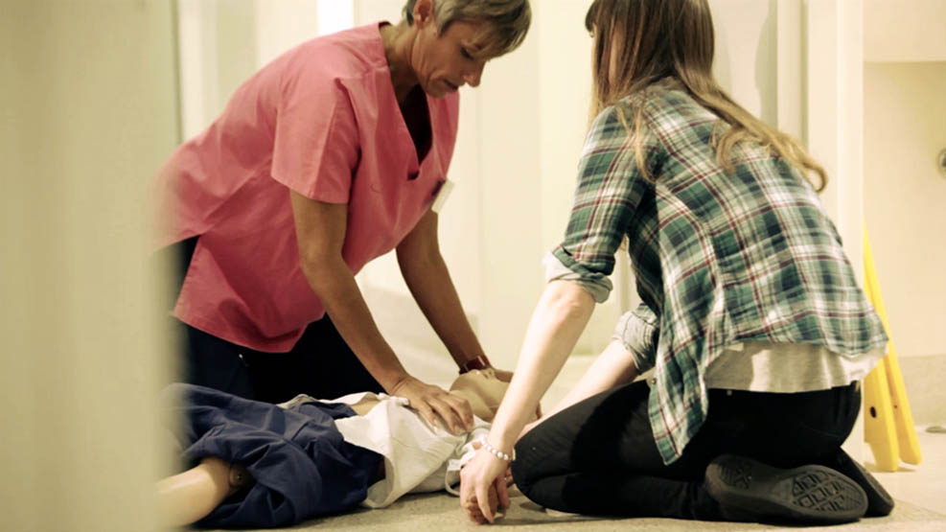
Recap of BLS and ALS
Notes:
Pack of laminated sections of BLS and ALS algorithms
5 mins to order cards into BLS and ALS algorithm sequences & keep displayed on table
Start whole group review of questions with activity:
Tap/clap at CPR rate of 100-120 beats/min - give group min 20 secs – watch, some in group will adapt to others or some stay confident. Encourage whole group to listen to each other & yet know their own beat.
* can use ALSi on CPR rhythm or SR to give audible rate – (set up in advance to ensure volume on iPad is on maximum)
Ask why is CPR rate is at 100-120 beats/min?
- They will know the answer, however knowing doesn’t mean doing…….
clinicians (in simulation) haven’t shown to be great at keeping rate or sustaining depth –
Studies show that we need repeated practice and feedback on performance – ( what they are going to get on the face to face course)
As main evidence for resuscitation is primarily related to effective CPR – need to change manpower to prevent exhaustion & maintain rate and depth

Slide 15
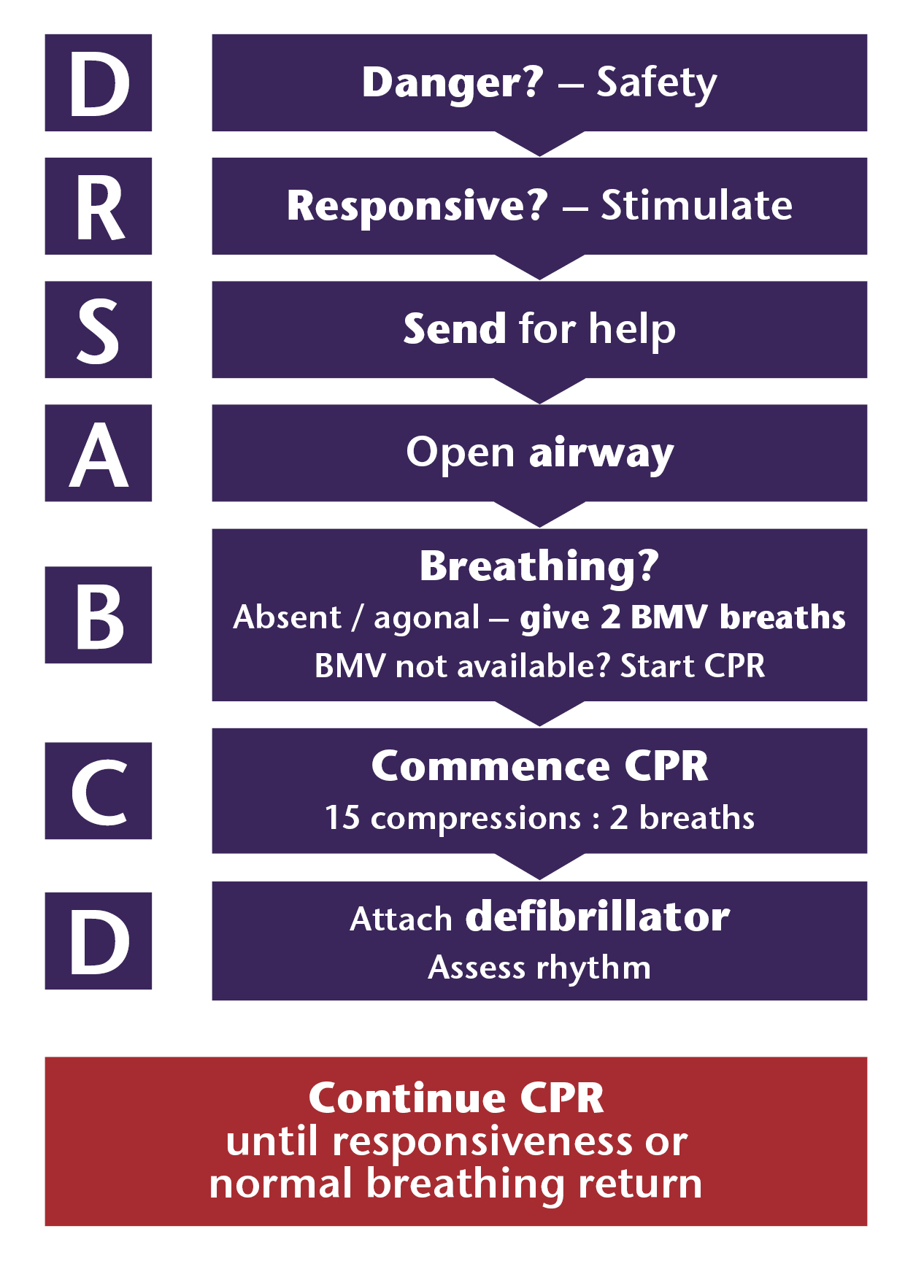
Paediatric BLS for health professionals
ANZCOR/ILCOR 2026
Notes:
Check with cards on the table
Agonal breathing – gasping/laboured breathing
D DANGERS?
Check for danger (assess and manage risks to the rescuer and others)
R RESPONSIVE?
If unresponsive:
S SEND for HELP
A AIRWAY
Open the airway
B BREATHING
Check breathing. If apnoeic or agonal (gasping laboured breathing) give 2 initial ventilations with a bag-mask ventilation (BMV) device.
If a BMV device is not immediately available, commence external cardiac compressions.
C CPR
If unresponsive and apnoeic or agonal breathing, start CPR (15 chest compressions followed by 2 ventilations).
Indications for CPR are no response and apnoeic or agonal breathing. Palpation of a pulse (or its absence) is not reliable as the sole determinant of cardiac arrest and need for chest compressions. Pulse checks (up to 10 seconds) may still be used as part of the assessment for return of spontaneous circulation (ROSC).
Use the two-thumb encircling technique for chest compressions in an infant as it results in consistently greater depth and less fatigue. Consider using the heel of one hand if the rescuer is unable to achieve optimal compression depth using the two-thumb encircling technique.
D DEFIBRILLATION
Attach manual defibrillator or an Automated External Defibrillator (AED) as soon as available and follow the prompts. Place the pads in an antero-posterior position.

Slide 16
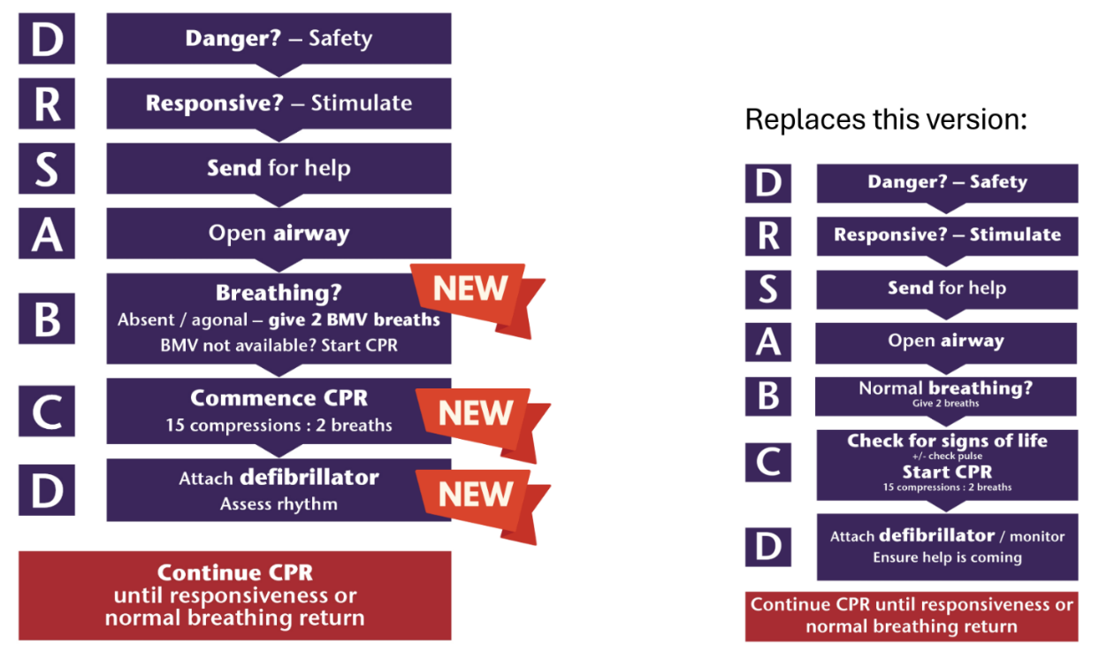
Paediatric BLS for health professionals
ANZCOR/ILCOR 2026

Slide 17
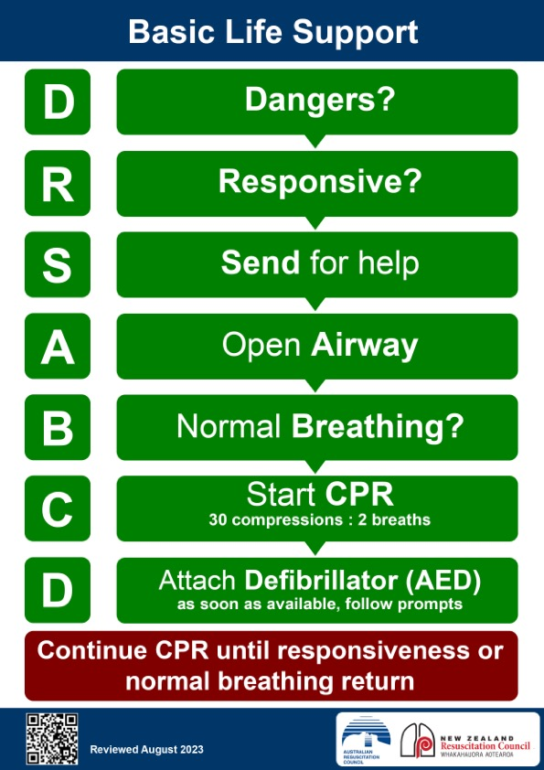
Notes:
Points of difference – this is for the general public
APLS/ANZCOR 2026 PBLS sequence is for trained paediatric healthcare providers
Normal breathing? – Include 2 rescue breaths
(children have hypoxic arrests)
Signs of life?
Start CPR 15:2 vs 30:2

Slide 18
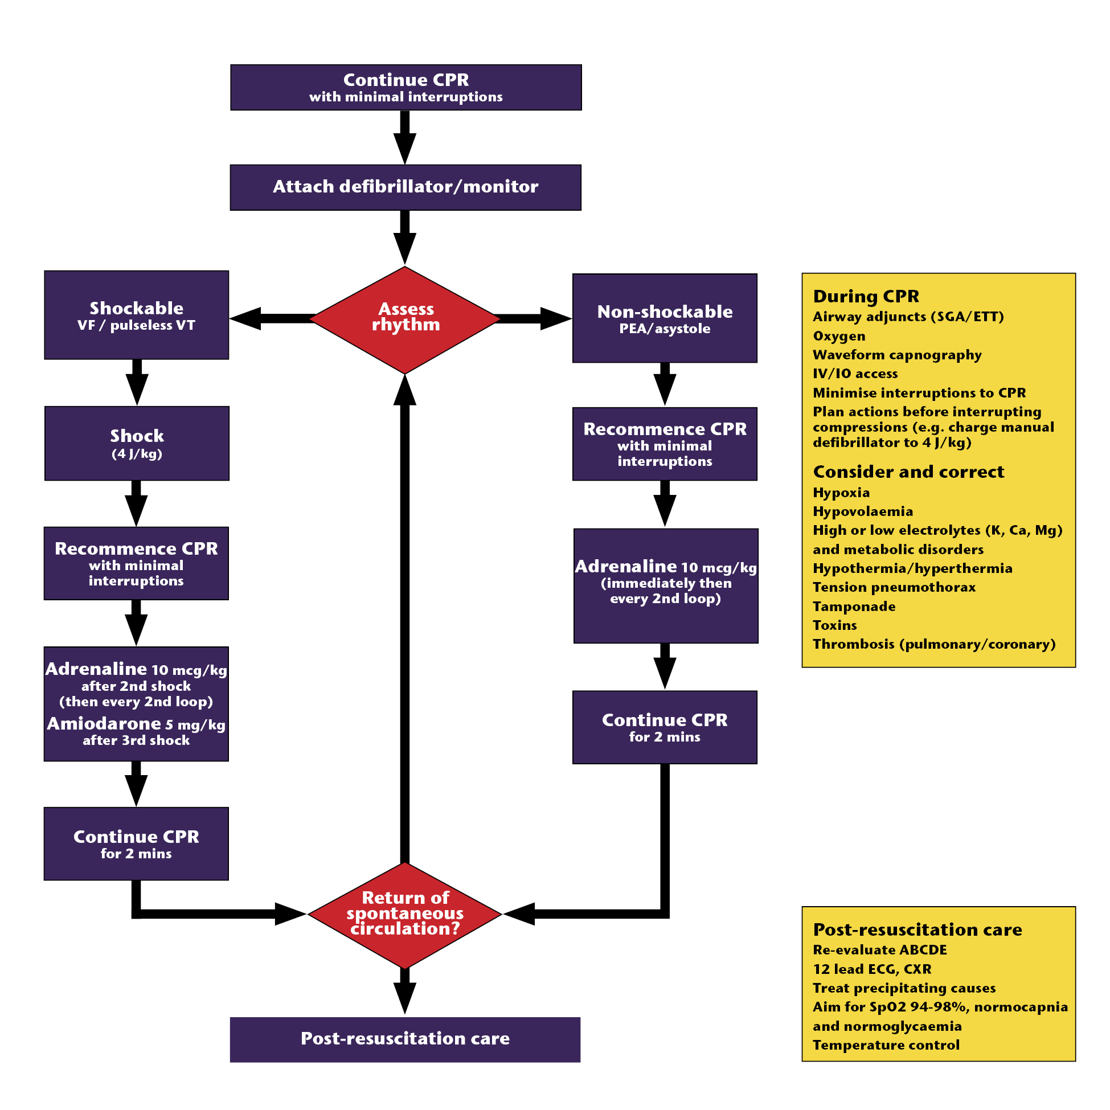

PEA/Asystole algorithm
Ch 18
Notes:
Check with cards on the table
5 mins of small group activity
Questions to be answered in their groups – worksheet with questions provided
How long is a cycle?
What do you do during the 2 minute cycle?
When is adrenaline given? VT/VF vs asystole?
Which of the Hs and Ts are of particular importance in asystole?
hypoxia
hypovolaemia
anything else suggested by history of child’s illness/injury
Which of the Hs and Ts are of particular importance in PEA?
hypovolaemia
hypocalcaemia
tension pneumothorax
cardiac tamponade
hypothermia
pulmonary embolus
How is ROSC assessed? – why feel for a pulse?
Where do you feel for a pulse?
..

Slide 19
VF/VT algorithm
Ch 18
Notes:
This is the part of the ALS algorithm for VF/VT
Questions to be answered in their groups – worksheet with questions provided
How long is a cycle?
What do you do during the 2 minute cycle?
When is adrenaline given? VT/VF vs asystole?
Which of the Hs and Ts are of particular importance in asystole?
hypoxia
hypovolaemia
anything else suggested by history of child’s illness/injury
Which of the Hs and Ts are of particular importance in PEA?
hypovolaemia
hypocalcaemia
tension pneumothorax
cardiac tamponade
hypothermia
pulmonary embolus
How is ROSC assessed? – why feel for a pulse?
Where do you feel for a pulse?
19

Slide 20
?

Slide 21
Summary
Rapid assessment
Airway & Breathing
  Effort
  Efficacy
  Effects
Circulation
Heart rate
Capillary refill time
  Blood pressure
  Skin temperature
Disability
  Conscious level
  Posture & Pupils
Notes:
Remember to include tone & colour when you mention posture
Closure – include that further opportunities to discuss assessment and management of illnesses raised in the Serious Illness plenary will be in the workshops and illness scenarios.

Slide 22
Initiate Management
Airway & Breathing
  Open airway
  Adjuncts
  High flow Oxygen
  Specific treatment
  Assist ventilation
Circulation
  Establish access
  Fluid bolus
  Specific treatment
Disability
  Optimise cerebral blood flow-ABC
  Specific treatment
Notes:
Initial management is similar regardless of cause of the illness
Once more information is available specific treatment can target the cause of the illness
Having a “scaffold” for resuscitation helps the practitioner to provide resuscitation whilst giving more time to gain more information to enable a diagnosis and specific treatment to be found

Slide 23
7th edition
Cases in full for instructor use only
Structured Approach to the Seriously Ill Child and Child in Cardiac Arrest
Notes:
Instructor Notes
This session is 45 mins.
Read notes on facilitating plenaries.

Slide 24
Tyler’s case: Primary assessment and resuscitation
 | On examination | Resuscitation
A | Patent | Call for help Maintain airway (may need intubation) High flow oxygen via face mask IV access and fluids (10-20 mls/kg bolus) Bloods Reassess
B | Resp rate 40/min SpO₂ not recordable Significant recession Poor AE R lower chest
C | Pale Heart rate 170/min Weak peripheral pulses BP 65 mmHg systolic CRT 4 sec
D | AVPU
Notes:
Allow 2 minutes

Slide 25
Tyler’s case:
What emergency treatment?
Key Feature | Diagnosis | Treatment
Creps at right lung base | Severe pneumonia | Resp support IV antibiotics
History of asthma | Severe asthma | Resp support Bronchodilators IV corticosteroids
Fever and rash | Septicaemia | IV/IO Fluid Antibiotics
Signs of heart failure | CHD / Cardiomyopathy | Diuretics, inotropes Prostaglandin
Abnormal ECG rhythm | Arrhythmia | Arrhythmia algorithms
High blood glucose | Diabetes | Fluid, Insulin
Notes:
Show key features and ask for diagnosis and emergency treatment.
Ask whether there are any other key features / diagnoses not listed here.
Allow 4 minutes
See Slide 26 for hidden features, diagnosis and treatment.
Note Prostaglandin is in ‘grey’ font, as a teaching point for infants pg 76-77 (not suitable for Tyler – who is 3 yrs old)

Slide 26
Ruby’s case: Primary assessment and resuscitation
 | On examination | Resuscitation
A | Snoring | Call for help Open and protect airway High flow oxygen via face mask IV/IO access and judicious fluids Blood tests esp blood glucose Start to warm Reassess
B | Resp rate 40/min No recession SpO₂ not recordable
C | Heart rate 140/min Pale Cold peripheries BP 80 mmHg systolic
D | AVPU Pupils: sluggish, equal and reactive
E | Hypothermic - temperature 34.5ºC
Notes:
Allow 2 minutes

Slide 27
Ruby’s case:
What emergency treatment?
Key Feature | Diagnosis | Treatment
Seizures develop | Post-ictal state | Supportive, investigate cause
Bruising, full fontanelle | Head injury | Trauma algorithm
Poor growth or regression | Metabolic condition | BGL, Blood gas, lactate and ammonia Metabolic screen
Acute onset and fever | Meningitis Encephalitis | Antibiotics Consider acyclovir
Possibility of poisoning | Drugs | Supportive Antidotes
Notes:
Show key features and ask for diagnosis and emergency treatment.
Ask whether there are any other key features / diagnoses not listed here.
E.g.
headaches, acute onset – cerebrovascular event
headaches, high BP – hypertensive encephalopathy
vague and inconsistent history, other trauma in an infant – child abuse
The use of the structured approach in these cases will help ensure early and appropriate treatment. Candidates may practice this in the illness simulations which follow.
Allow 4 minutes

