Slide 1
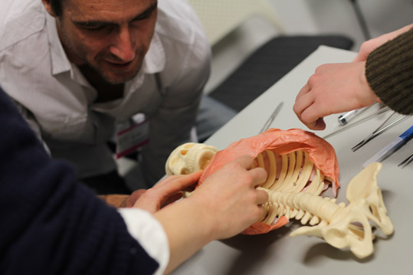
Chest anatomy for chest procedures
Notes:
These slides are aimed at ensuring that our anatomical knowledge is correct and that we are teaching our candidates to do procedures in the right place. The techniques are not hard, but choosing the right anatomical landmarks is poorly done.

Slide 2


Prep for Thoracic Skills
Landmarks (5 mins)
Chest Tube Insertion (7 mins)
https://flowcode.com/p/OZPni3K08?fc=0
https://flowcode.com/p/OZPnRaCvY?fc

Slide 3
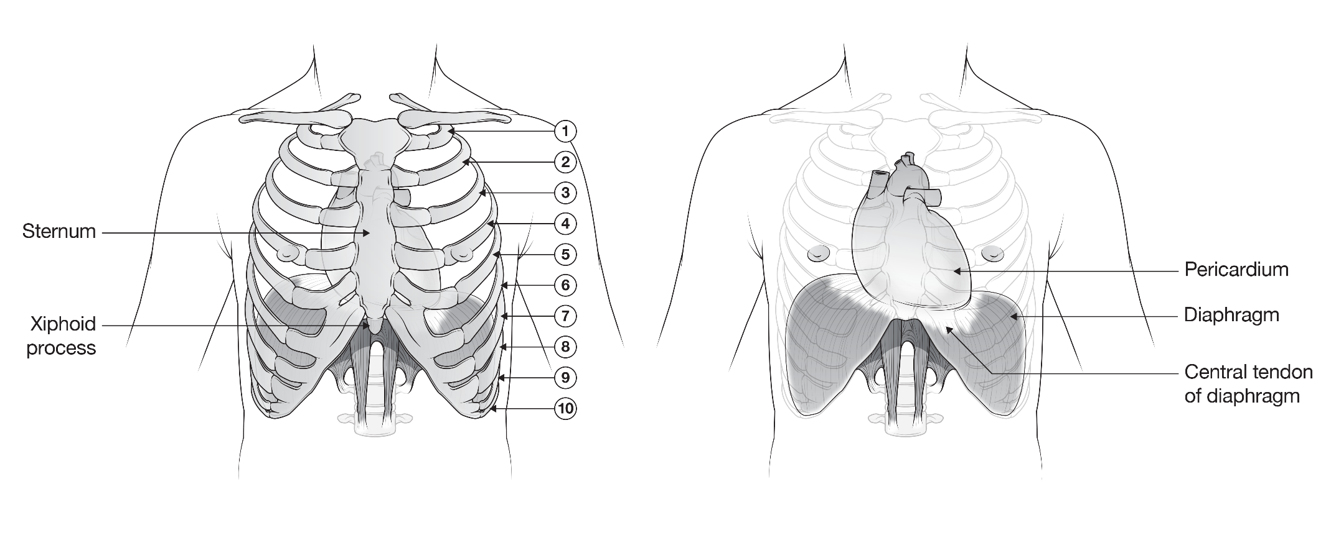
Notes:
The central tendon of the diaphragm is attached to the back of the xiphisternum, and the fibrous pericardium is fused to this.

Slide 4
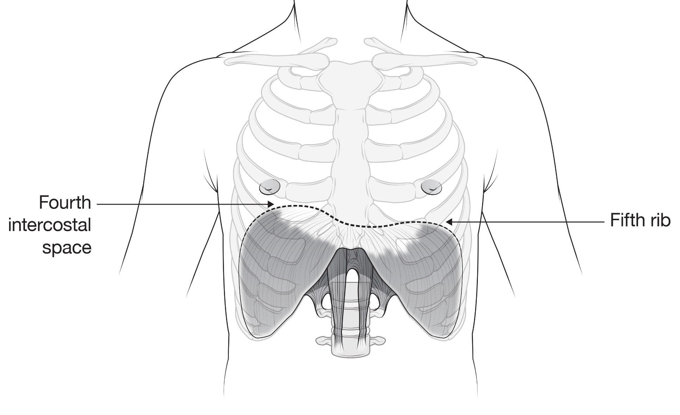
Notes:
The domes of the diaphragm in expiration sit at the 4th interspace on the right and the 5th rib on the left at the front of the chest. That means that chest tubes need to be inserted well above that level to get into the correct space away from the heart, mediastinum and major vessels.

Slide 5
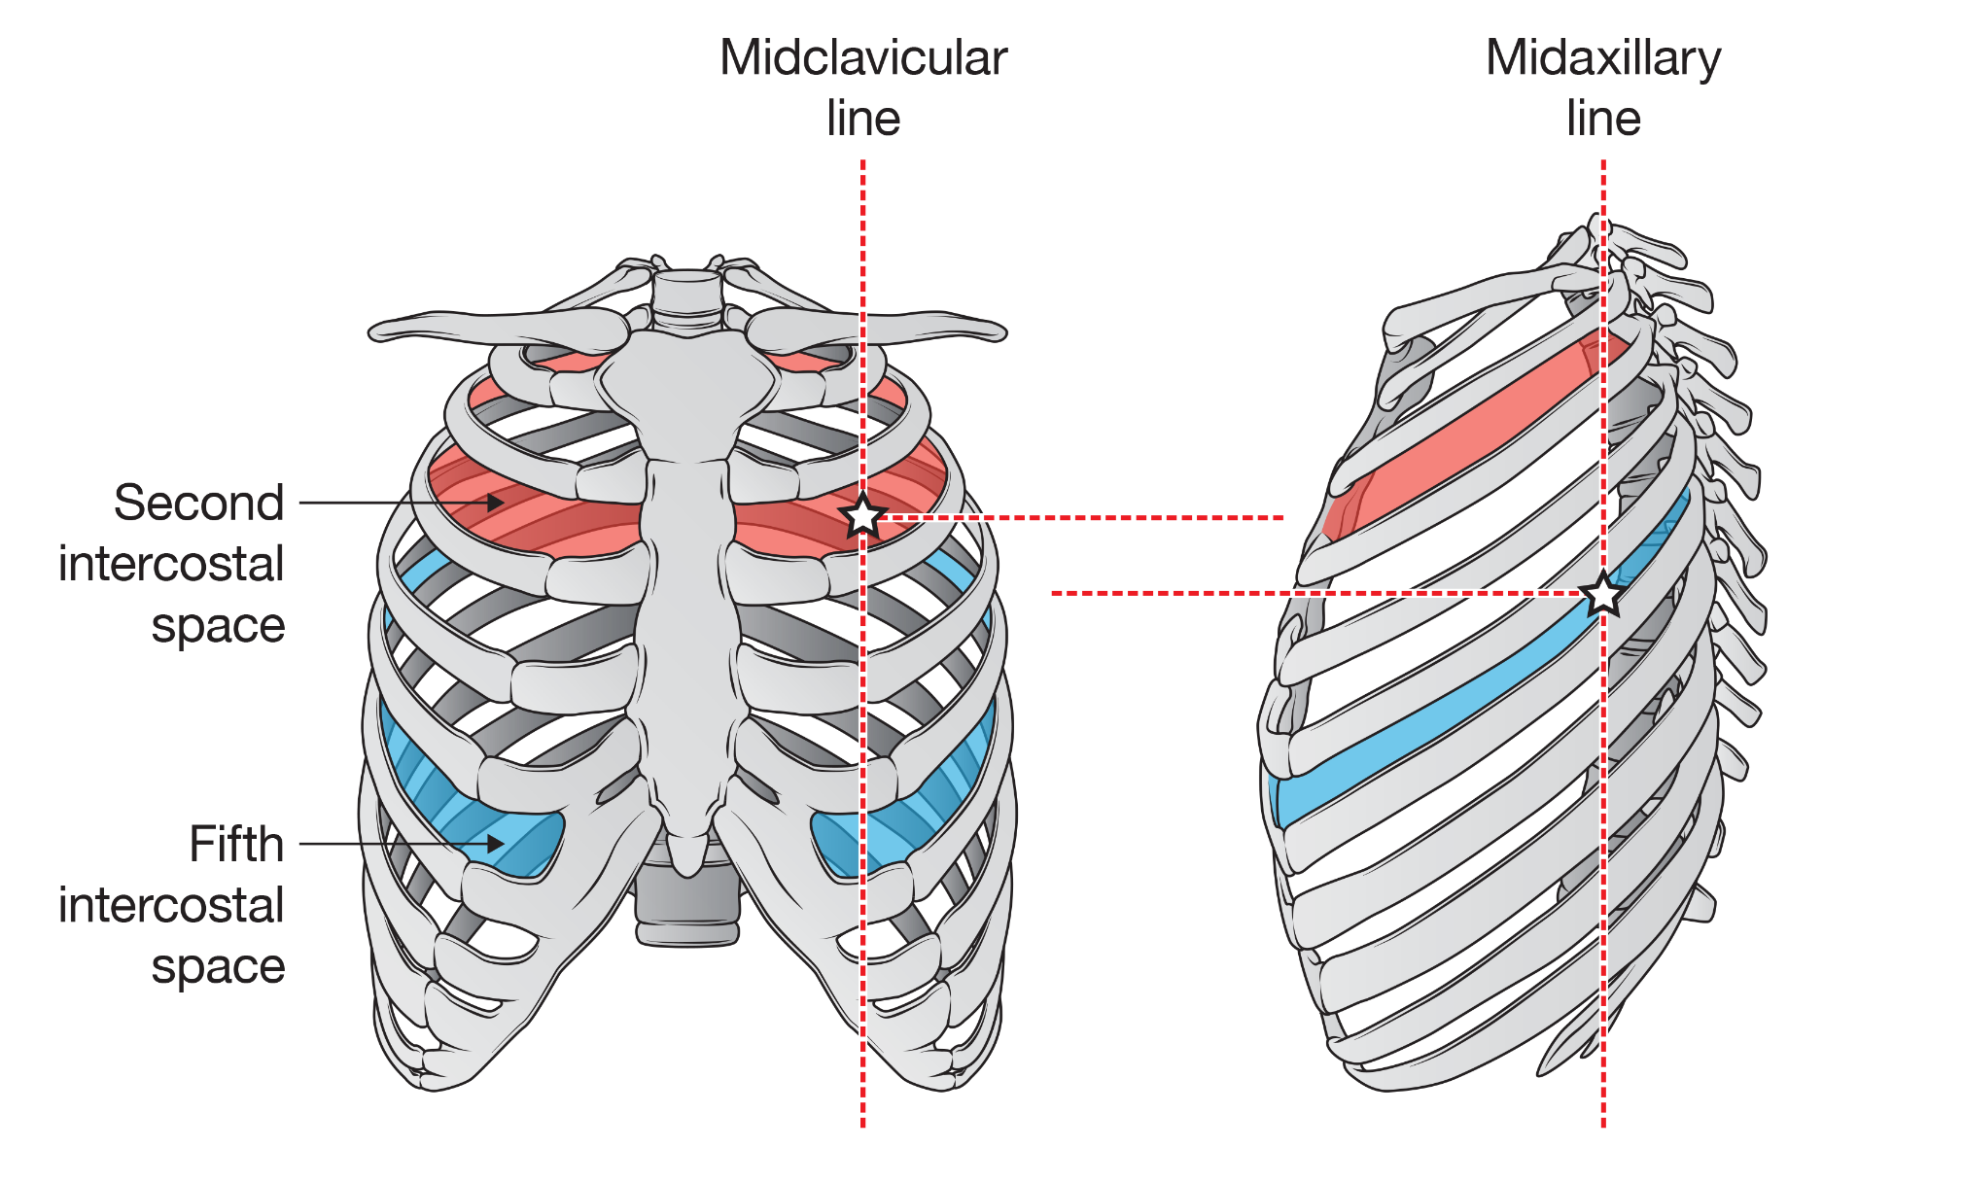
Notes:
Important anatomical points are that the ribs slope downwards so the level of the rib at the front of the chest is very different from the back. The second rib space (for needle thoracocentesis) allows access into a safe area within the thoracic cavity. It is almost at the same level as the 5th IC space in the mid-axillary line (for ICC insertion) as the intention is to get into the same safe area. Ideally an ICC in the 4th IC space would be ideal but it is hard to get that high in the axilla. A common mistake is to think the 2nd space MCL is too high, and the 5th space is too low which will lead to difficulty and risk of complication if performing a chest procedure (ICC or finger thoracostomy).

Slide 6
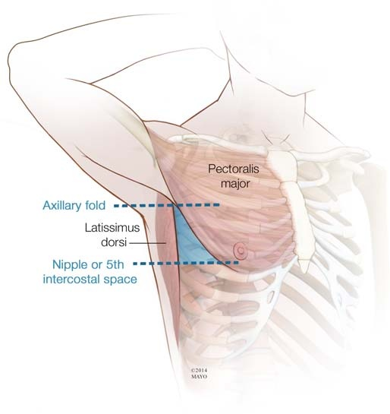

Slide 7
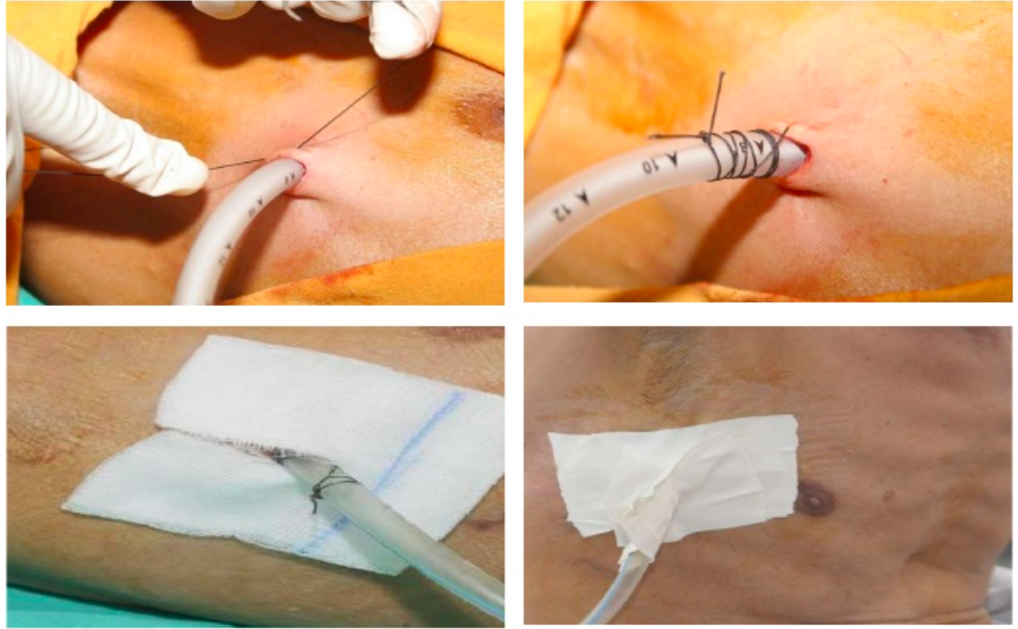
Securing chest drain

Slide 8
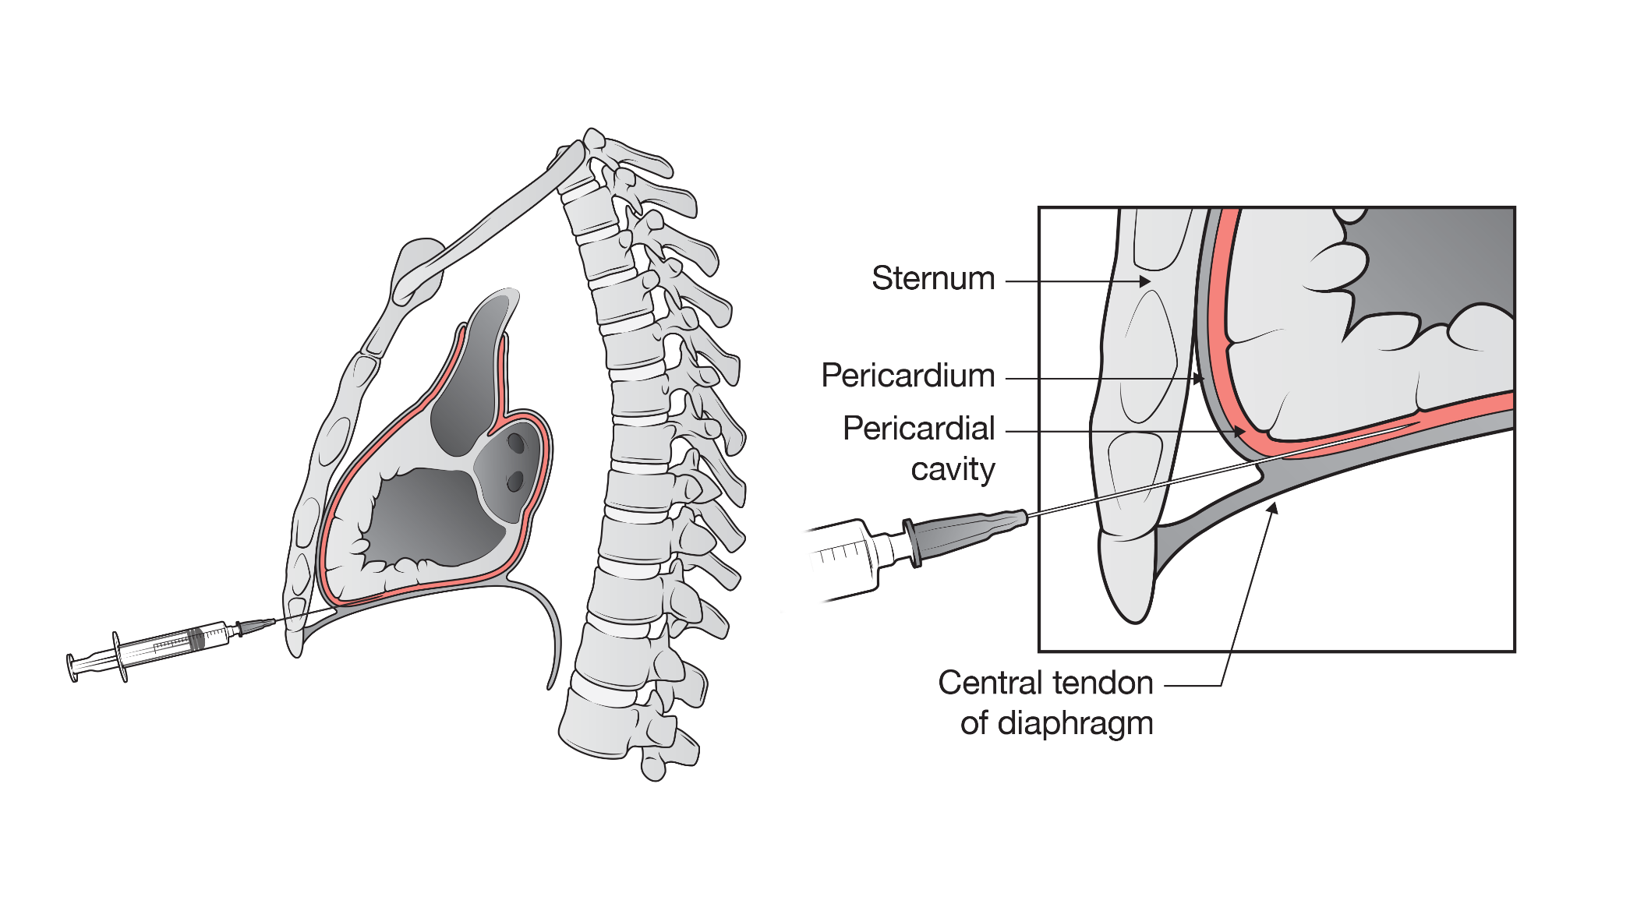
Notes:
Remember that a pericardiocentesis needle is aiming to get into the narrow space between the pericardium and the myocardium, which even in the presence of a pericardial tamponade will not be wide.

Slide 9
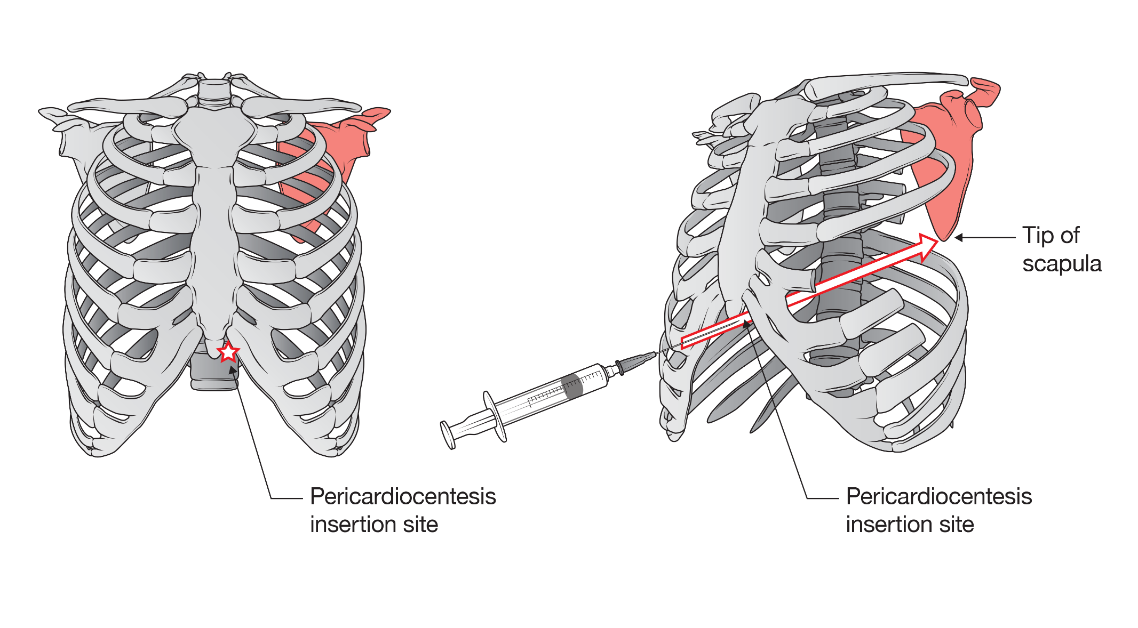
Notes:
The needle is inserted to the left of the xiphisternum and is pointed to the tip (or inferior angle) of the scapula. This is NOT the shoulder, but rather the lowermost part of the scapula. The needle therefore pierces the diaphragm and pericardium and runs between the myocardium and pericardium. So when a patient is supine the needle is almost going directly backwards. Angling towards the shoulder will result in perforation of the heart.

