Slide 1
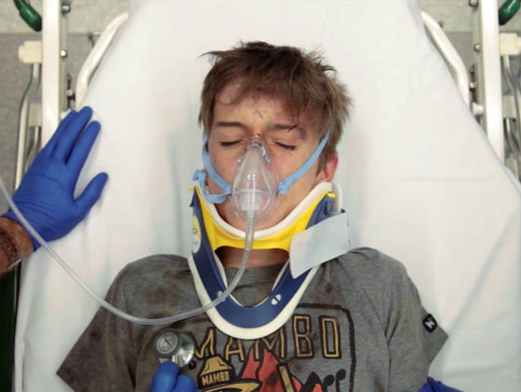
7th edition
Review of the
Seriously Injured Child
Notes:
Time needed- 3mins for 1st 3 slides
Review Instructor notes for each slide
50 minutes – interactive session – with whole candidate group
Requirements
4 assistant instructors with appropriate prompting materials needed. One for each group.
Powerpoint slide set
Handouts to groups
Pencils
Activity 1 and 2 on A3
Activity 3 on A3
Environment/Set
Allow candidates to get themselves into 4 groups
One instructor allocated per group

Slide 2
Learning outcomes
Demonstrate an understanding of:
  the structured approach to the seriously injured child
  the identification and treatment of life-threatening injuries in a child
Notes:
Read as on slide

Slide 3
Format
  3 activities
    General aims of trauma primary survey
    Preparation for life threatening injury and initial actions based on ambulance triage
    Primary survey findings – likely diagnoses
    Specific investigation and treatment for likely diagnoses
Notes:
Read as on slide
Time 03mins (Time 03 mins at completion)

Slide 4
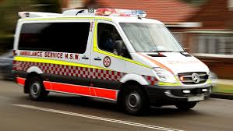
Activity 1
 | Goals
(C)
A
B
C
D
E
Other Actions
What are the broad goals of the primary survey?
4 mins
Notes:
Activity 1 – Goals of the Primary Survey
Time needed 04 mins (Running time 7 mins at completion)
4 min breakout
Small group activity
Handout proforma – Activity 1
Tell the groups to write on the A3
Read the following
‘List the goals of each component of the structured approach of the primary survey’
A facilitator is allocated to assist
Start the groups at different places. This ensures all areas are covered well. They have to listen though as the area they are allocated next will be different
They should try and get through all goals but will be responsible for reporting back on the one they started on
Allocate 1st group start with A, 2nd Group B, 3rd group C, 4th group D/E/Other. 1 facilitator per group with 4 slide handout to keep group on track.
Activity 1 – Primary Survey Goals
Review the goals of each component of the structured approach
This section is not about specific diagnoses – but rather the broad physiologic goals
Bring groups back together for plenary discussion with the next slide

Slide 5
Goals of primary survey
(C) | Control catastrophic external haemorrhage
A | Maintain and protect airway patency Minimise unnecessary cervical spine movement
B
C
D
E
Rx
Notes:
Start at 7 min
Time needed 5mins to complete this exercise (Running time 12 mins at completion)
As per slide
Each group has a representative speak loudly and clearly
After group has presented display ’correct response’

Slide 6
Goals of primary survey
(C) | Control catastrophic external haemorrhage
A | Maintain and protect airway patency Minimise unnecessary cervical spine movement
B | Maintain oxygenation Maintain ventilation
C
D
E
Rx
Notes:
Time needed 5mins to complete this exercise (Running time 12 mins at completion)
As per slide
Each group has a representative speak loudly and clearly
After group has presented display ’correct response’

Slide 7
Goals of primary survey
(C) | Control catastrophic external haemorrhage
A | Maintain and protect airway patency Minimise unnecessary cervical spine movement
B | Maintain oxygenation Maintain ventilation
C | Assess for shock Seek & control haemorrhage Restore & maintain perfusion
D
E
Rx
Notes:
Time needed 5mins to complete this exercise (Running time 12 mins at completion)
As per slide
Each group has a representative speak loudly and clearly
After group has presented display ’correct response’

Slide 8
Goals of primary survey
(C) | Control catastrophic external haemorrhage
A | Maintain and protect airway patency Minimise unnecessary cervical spine movement
B | Maintain oxygenation Maintain ventilation
C | Assess for shock Seek & control haemorrhage Restore & maintain perfusion
D | Identify neurological injury Prevent secondary insult
E
Rx
Notes:
Time needed 5mins to complete this exercise (Running time 12 mins at completion)
As per slide
Each group has a representative speak loudly and clearly
After group has presented display ’correct response’

Slide 9
Goals of primary survey
(C) | Control catastrophic external haemorrhage
A | Maintain and protect airway patency Minimise unnecessary cervical spine movement
B | Maintain oxygenation Maintain ventilation
C | Assess for shock Seek & control haemorrhage Restore & maintain perfusion
D | Identify neurological injury Prevent secondary insult
E | Identify other threats to life & limb Extremities, exposure but maintain temp & euglycaemia
Rx
Notes:
Time needed 5mins to complete this exercise (Running time 12 mins at completion)
As per slide
Each group has a representative speak loudly and clearly
After group has presented display ’correct response’

Slide 10
Goals of primary survey
(C) | Control catastrophic external haemorrhage
A | Maintain and protect airway patency Minimise unnecessary cervical spine movement
B | Maintain oxygenation Maintain ventilation
C | Assess for shock Seek & control haemorrhage Restore & maintain perfusion
D | Identify neurological injury Prevent secondary insult
E | Identify other threats to life & limb Extremities, exposure but maintain environment & euglycaemia
Rx | Expedite definitive treatment, transfer Limit suffering
Notes:
Time needed 5mins to complete this exercise (Running time 12 mins at completion)
As per slide
Each group has a representative speak loudly and clearly
After group has presented display ’correct response’

Slide 11
Paul’s case
  Paul is a 13 year old boy (40kg) who was climbing a tree in his own garden, which overhung the street.
His mother was out shopping and on her return, she found that he had fallen from the tree, onto a low garden wall, and then onto the pavement.
He could not stand up and she called an ambulance.
Notes:
Start at 12 min-
Time needed 2 mins for next 2 slides (Running time 14 mins at completion)
The initial presentation of the case is now relayed to the candidates over the next two slides.
This is your typical prehospital notification which is brief but not comprehensive.
The groups will now think about how they prepare their environment for this patient reception based on the likely injuries to each area of the primary survey

Slide 12
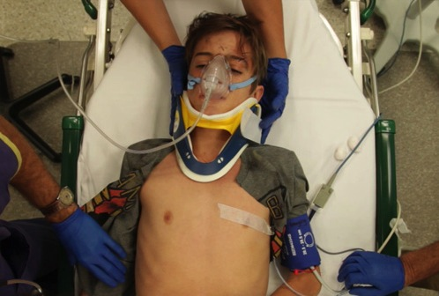
Activity 2:
En route
Paul 13yo, 40Kg
In pain, bruised left forehead
with left chest and abdominal pain
RR ~38/min, Sp0₂ 98%
HR 140/min, BP 140/75
CRT 3 sec, GCS 14, given IN fentanyl
What preparation is needed to address his potential injuries?
6 mins
 | Prep
(C)
A
B
C
D
E
Rx
Notes:
Time 2 mins (Running time 14 mins at completion)
Activity 2 – prehospital info preparation
Candidates will work through this case, using a structured approach, discuss in their groups the likely injuries, preparation for these.
Time needed 6 mins for activity (Running time 20 mins at completion)
Allocate groups different starting points. . This ensures all areas are covered well. They have to listen though as the area they allocated next will be different
They should try and get through all goals but will be responsible for reporting back on the one they started on.
Works best going anticlockwise or right to left, so that Group 4 get A (had D/E) , Group 1 now get B (had A), group 2 get C (had B), , group 3 get D/E/Other (had C),
This way each group is moving down the primary survey rather than backward, and once reaching the end start at the beginning again.
That is once they have finished E they’ll be dealing with A next.
1 facilitator per group with 4 slide handout to keep group on track.
Activity 2 – Preparations
- groups should list the specific preparations for the likely injury

Slide 13
Activity 2
Pre arrival preparation
(C) | Stop exsanguinating haemorrhage - compression, suture, binder
A | Airway equipment Minimise unnecessary neck movement
B
C
D
E
Rx
Notes:
Activity 1B – Prehospital preparation
Start at 20 min - Time needed 8 mins for feedback (Running time 28 mins at completion)
A – important to stress that haemoglobin is responsible for 95% oxygen carriage. As trauma patients may be losing haemoglobin, oxygen is imperative to allow dissolved oxygen, PO2, to carry oxygen to the tissues in the absence of haemoglobin. Manipulation of the airway, particularly in the obtunded patient, should respect the possibility of an occult or unstable neck injury, and so unnecessary neck movement should be minimised

Slide 14
Activity 2
Pre arrival preparation
(C) | Stop exsanguinating haemorrhage - compression, suture, binder
A | Airway equipment Minimise unnecessary neck movement
B | ICC for tension pneumothorax, massive haemothorax, open pneumothorax, ventilation for flail chest/lung contusion, CXR
C
D
E
Rx
Notes:
Activity 1B – Prehospital preparation
Time needed 8 mins for feedback (Running time 28 mins at completion)
B – with the history of blunt trauma and left chest pain any of these conditions are possible. Preparation for how to clinically detect these conditions, with the aid of chest x-ray, and how to rapidly manage, need to be prepared for.

Slide 15
Activity 2
Pre arrival preparation
(C) | Stop exsanguinating haemorrhage - compression, suture, binder
A | Airway equipment Minimise unnecessary neck movement
B | ICC for tension pneumothorax, massive haemothorax, open pneumothorax, ventilation for flail chest/lung contusion, CXR
C | IVC x2, warmed IV crystalloid 10 mL/kg +/- 10 mL/kg O -ve blood, tranexamic acid, massive transfusion protocol, ?FAST, pelvic X-ray
D
E
Rx
Notes:
Activity 1B – Prehospital preparation
Time needed 8 mins for feedback (Running time 28 mins at completion)
C - C – ABC – the focus is on detecting and stopping exsanguinated blood loss. Systematic approach to how to look for areas of declared as well as occult blood loss need to be thought about, as well as the utility of chest x-ray, pelvic x-ray, FAST scan. Areas of active bleeding should be managed with direct compression bandaging, suturing, reduction of fractures, pelvic binding.
Large bore IV access is needed. Circulating blood volume should be maintained, with infusion of warmed fluid.
The choice of resuscitation fluid is dependent on multiple variables including the presence of shock, estimated starting haemoglobin, the detectable areas of active bleeding and whether there is ongoing bleeding or not, and the response to initial fluid resuscitation. TXA helps decrease clot dissolution which contributes to acute traumatic coagulopathy. MTP is reserved for those requiring large volumes of blood or who are shocked at any stage.

Slide 16
Activity 2
Pre arrival preparation
(C) | Stop exsanguinating haemorrhage - compression, suture, binder
A | Airway equipment Minimise unnecessary neck movement
B | ICC for tension pneumothorax, massive haemothorax, open pneumothorax, ventilation for flail chest/lung contusion, CXR
C | IVC x2, warmed IV crystalloid 10 mL/kg +/- 10 mL/kg O-ve blood, tranexamic acid, massive transfusion protocol, ?FAST, pelvic X-ray
D | Rapid neurological assessment, AVPU or GCS, pupils, limb movement, secondary brain and spinal protection – avoid hypotension, hypoxia
E
Rx
Notes:
Activity 1B – Prehospital preparation
Time needed 8 mins for feedback (Running time 28 mins at completion)
D- A crude but important neurological assessment is necessary. Progress of neurological status needs to be observed. Factors that aggravate primary brain injury result in secondary brain injury. The major focus is avoiding hypotension and hypoxia. But hypercarbia, hyper/hypoglycaemia, hyperthermia, acidosis, hyponatraemia, seizures all need to be optimised to prevent this occurring.

Slide 17
Activity 2
Pre arrival preparation
(C) | Stop exsanguinating haemorrhage - compression, suture, binder
A | Airway equipment Minimise unnecessary neck movement
B | ICC for tension pneumothorax, massive haemothorax, open pneumothorax, ventilation for flail chest/lung contusion, CXR
C | IVC x2, warmed IV crystalloid 10 mL/kg +/- 10 mL/kg O-ve blood, tranexamic acid, massive transfusion protocol, ?FAST, pelvic X-ray
D | Rapid neurological assessment, AVPU or GCS, pupils, limb movement, secondary brain and spinal protection – avoid hypotension, hypoxia
E | Extremity review, exposure – log roll to assess posterior and thoracolumbar spine Environment – keep warm & check BGL
Rx
Notes:
Activity 1B – Prehospital preparation
Time needed 8 mins for feedback (Running time 28 mins at completion)
E – exposure and a thorough examination of the posterior aspect and extremities of the patient is critical to not missing injuries. Remembering that heat loss needs to be minimised.

Slide 18
Activity 2
Pre arrival preparation
(C) | Stop exsanguinating haemorrhage - compression, suture, binder
A | Airway equipment Minimise unnecessary neck movement
B | ICC for tension pneumothorax, massive haemothorax, open pneumothorax, ventilation for flail chest/lung contusion, CXR
C | IVC x2, warmed IV crystalloid 10 mL/kg +/- 10 mL/kg O-ve blood, tranexamic acid, massive transfusion protocol, ?FAST, pelvic X-ray
D | Rapid neurological assessment, AVPU or GCS, pupils, limb movement, secondary brain and spinal protection – avoid hypotension, hypoxia
E | Extremity review, exposure – log roll to assess posterior and thoracolumbar spine Environment – keep warm & check BGL
Rx | Trauma page, blood, trauma imaging, consider analgesia, O-ve blood, Notify surgeon, anaesthetist, telemedicine, inter-facility transfer?
Notes:
Activity 1B – Prehospital preparation
Time needed 8 mins for feedback (Running time 28 mins at completion)
Rx - Other actions – the patient’s mechanism of injury and initial descriptions of injuries and vital signs would recommend the presence of trauma team on arrival. As well as this notification of relevant complimentary services such as radiology, Blood Bank, surgical team, anaesthetic and intensive care team would be appropriate depending on the facility.

Slide 19
Activity 3:
Progress on arrival (7min)
(C) | Nil
A | groaning, gurgling secretions
B | Sp0₂ 94% non-rebreather bag, RR 40/min Decreased A/E, left chest, hyperresonant and tender
C | Pale, cold & clammy pulse thready, HR 155/min BP 90/ systolic, CRT 6 sec
D | Confused conversation, occasionally combative, GCS 10, left pupil dilated
E | Temp 35°C, no extremity abnormalities, moving all limbs (7 mins)
 | Dx
(C)
A
B
C
D
E
Other
Rx/Ix
Notes:
Activity 3 – Diagnoses & further Actions
Time needed 2 mins for this slide (Running time 30 mins at completion)
Start at 28 min-
Time needed 2 mins for this slide (Running time 30 mins at completion)
Read the following
‘Pt now arrives. A number of features of his primary survey have progressed.
Utilise the next seven minutes to consider his latest primary survey injury status and the associated treatment or intervention required.
Both areas of activity 3 need to be filled out on the A3 forms for this exercise. You have 7 minutes’
Time 7 mins (Time 37 mins at completion)
Time needed 7 mins for activity (Running time 37 mins at completion)
Start the groups at different places. This ensures all areas are covered well.
They should try and get through all goals but will be responsible for reporting back on the one they started on.
Works best going anticlockwise or right to left, so that Group 4 get B (had A) , Group 1 now get C (had B), group 2 get D/E/Other (had C), group 3 get A (had D/E/Other),
This way each group is moving down the primary survey rather than backward, and once reaching the end start at the beginning again.
That is once they have finished E they’ll be dealing with A next.
1 facilitator per group with 4 slide handout to keep group on track.

Slide 20
Activity 3:
What are the diagnoses
and treatment/investigations?
(C) | Nil
A | groaning, gurgling secretions
B | Sp0₂ 94% non-rebreather bag, RR 40/min Decreased A/E, left chest, hyperresonant and tender
C | Pale, cold & clammy pulse thready, HR 155/min BP 90/ systolic, CRT 6 sec
D | Confused conversation, occasionally combative, GCS 10, left pupil dilated
E | Temp 35°C, no extremity abnormalities, moving all limbs (7 mins)
 | Dx
(C)
A
B
C
D
E
Other
Rx/Ix
Notes:
Activity 3 – Diagnoses & further Actions
Time needed 2 mins for this slide (Running time 30 mins at completion)
Start at 28 min-
Time needed 2 mins for this slide (Running time 30 mins at completion)
Read the following
‘Pt now arrives. A number of features of his primary survey have progressed.
Utilise the next seven minutes to consider his latest primary survey injury status and the associated treatment or intervention required.
Both areas of activity 3 need to be filled out on the A3 forms for this exercise. You have 7 minutes’
Time 7 mins (Time 37 mins at completion)
Time needed 7 mins for activity (Running time 37 mins at completion)
Start the groups at different places. This ensures all areas are covered well.
They should try and get through all goals but will be responsible for reporting back on the one they started on.
Works best going anticlockwise or right to left, so that Group 4 get B (had A) , Group 1 now get C (had B), group 2 get D/E/Other (had C), group 3 get A (had D/E/Other),
This way each group is moving down the primary survey rather than backward, and once reaching the end start at the beginning again.
That is once they have finished E they’ll be dealing with A next.
1 facilitator per group with 4 slide handout to keep group on track.

Slide 21
A
(C) | Nil
A | groaning, gurgling secretions
B | Sp0₂ 94% non-rebreather bag, RR 40/min Decreased A/E, left chest, hyperresonant and tender
C | Pale, cold & clammy pulse thready, HR 155/min BP 90/ systolic, CRT 6 sec
D | Confused conversation, occasionally combative, GCS 10, left pupil dilated
E | Temp 35°C, no extremity abnormalities, moving all limbs (7 mins)
 | Dx
(C)
A
B
C
D
E
Other
Rx/Ix
Notes:
Activity 3 – Diagnoses & further Actions ‘Lets start with A’ -
Refresher whilst group give answers over next 2 slides
Let them give answer before showing answer
Time needed 2 mins for this and next 2 slides (Running time 39 mins at completion)

Slide 22
Re-assessment
- Possible diagnoses
(C)
A | Airway threatened, may become obstructed secondary to diminished LOC (closed head injury, opiates, shock)
B
C
D
E
Notes:
A – likely issues

Slide 23
Treatment and investigation
(C)
A | HFO NRB, suction, OPA ? NPA maintain cspine immobilization – BVM, prepare for RSI
B
C
D
E
Notes:
A – likely intervention. Talk about MILS with intubation. Avoidance of NPA with facial fractures but not if no evidence of such.

Slide 24
B
(C) | Nil
A | groaning, gurgling secretions
B | Sp0₂ 94% non-rebreather bag, RR 40/min Decreased A/E, left chest, hyperresonant and tender
C | Pale, cold & clammy pulse thready, HR 155/min BP 90/ systolic, CRT 6 sec
D | Confused conversation, occasionally combative, GCS 10, left pupil dilated
E | Temp 35°C, no extremity abnormalities, moving all limbs (7 mins)
 | Dx
(C)
A
B
C
D
E
Other
Rx/Ix
Notes:
Activity 3 – Diagnoses & further Actions. ‘Lets talk about B’
Refresher whilst group give answers over next 2 slides
Let them give answer before showing answer
Time needed 2 mins for this and next 2 slides (Running time 41 mins at completion)

Slide 25
Re-assessment
- Possible diagnoses
(C)
A | Airway threatened, may become obstructed secondary to diminished LOC (CHI, opiates, shock)
B | Tension pneumothorax Massive haemothorax Flail chest & pulmonary contusions ? Diaphragmatic hernia
C
D
E
Notes:
B – likely DDx for decreased A/E

Slide 26
Treatment and investigation
(C)
A | HFO NRB, suction, OPA ? NPA maintain C-spine immobilisation – BVM, prepare for RSI
B | Left ICC – before or after RSI? CXR before/after?
C
D
E
Notes:
B – indications for ICC. CXR before if sats > 90% and not shocked or tension Ptx. CXR may reveal contusion or traumatic diaphragmatic hernia that doesn’t need ICC.
If A needs intubation, what is timing for ICC ? Before or after intubation. With preparation for tension Ptx, better to do once intubated.

Slide 27
Notes:
CXR DDx for decreased air entry – not all need ICC
Pneumothorax

Slide 28
Notes:
CXR DDx for decreased air entry – not all need ICC
Lung contusion

Slide 29
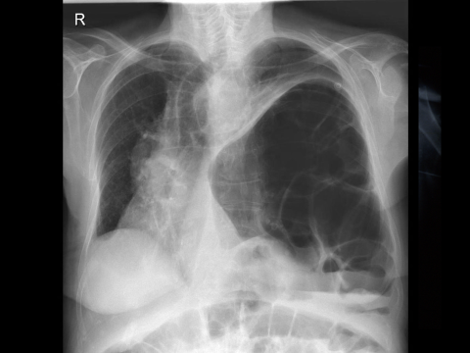
Notes:
CXR DDx for decreased air entry – not all need ICC
Traumatic diaphragmatic hernia

Slide 30
C
(C) | Nil
A | groaning, gurgling secretions
B | Sp0₂ 94% non-rebreather bag, RR 40/min Decreased A/E, left chest, hyperresonant and tender
C | Pale, cold & clammy pulse thready, HR 155/min BP 90/ systolic, CRT 6 sec
D | Confused conversation, occasionally combative, GCS 10, left pupil dilated
E | Temp 35°C, no extremity abnormalities, moving all limbs (7 mins)
 | Dx
(C)
A
B
C
D
E
Other
Rx/Ix
Notes:
Start at 41 mins
Activity 3 – Diagnoses & further Actions. ‘Lets talk about C’
Refresher whilst group give answers over next 2 slides
Let them give answer before showing answer
Time needed 2 mins for this and next 2 slides (Running time 43 mins at completion)

Slide 31
Re-assessment
- Possible diagnoses
(C)
A | Airway threatened, may become obstructed secondary to diminished LOC (closed head injury, opiates, shock)
B | Tension pneumothorax Massive haemothorax Flail chest & pulmonary contusions ? Diaphragmatic hernia
C | Intra peritoneal haemorrhage – ruptured spleen Retro-peritoneal haemorrhage – pelvis +/- kidney Cardiac tamponade/contusion. BP 90 systolic = large blood loss
D
E
Notes:
C – likely Dx if tachycardia = bleeding. If BP low = significant bleeding. Need to search for blood loss.

Slide 32
Treatment and investigation
(C)
A | HFO NRB, suction, OPA ? NPA maintain C-spine immobilization – BVM, prepare for RSI
B | Left ICC – before or after RSI? CXR before/after?
C | Pelvic binder + Xray. ?FAST. 10mL/kg warmed blood, 10mL/kg crystalloid until available. Tranexamic acid. Surgeon needed
D
E
Notes:
C – Note output from ICC. Bind pelvis and Xray to ensure no fracture or position with binder satisfactory.
CXR and Pelvic Xray if NAD helpful for excluding these areas as sources for significant blood loss.
FAST scan in accredited hands detects blood in abdomen – if blood present then
– need surgeon NOW
- resus with blood, TXA and consider MTP,
- pt needs advanced imaging (CT abdo).

Slide 33
Notes:
Xray with pelvic binder in place

Slide 34
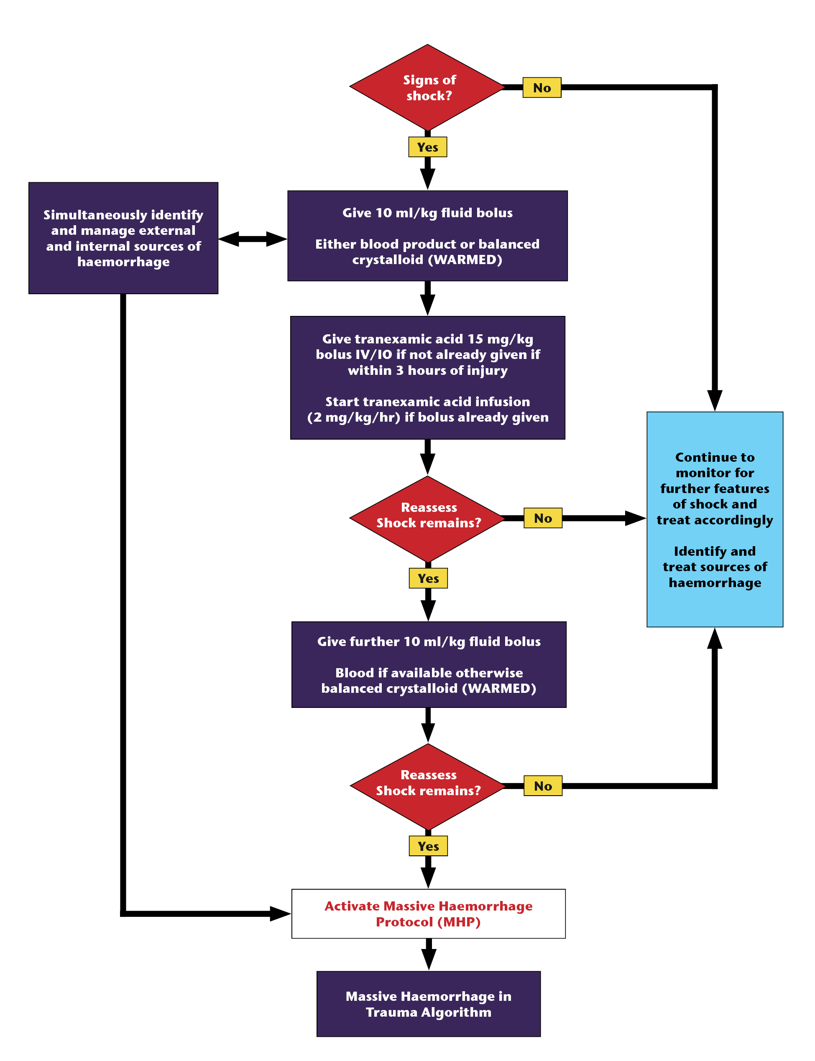
Fluid resuscitation in trauma
Shock?
  Tranexamic acid
  10mL/kg blood
  10mL/kg blood
  Massive transfusion protocol (MTP)
  Crystalloid if blood not available
Notes:
1 minute for these 4 fluid resus slides – remind them re early use of blood, activate MTP when 20 mls/kg fluid and ongoing shock/bleeding
Now Advocating Tourniquets, direct pressure and early tranexamic acid
Minimal Volume resuscitation

Slide 35
Fluid resuscitation in trauma
Shock?
  Tranexamic acid
  10mL/kg blood
  10mL/kg blood
  Massive transfusion protocol (MTP)
  Crystalloid if blood not available
Notes:
1 minute for these 4 fluid resus slides – remind them re early use of blood, activate MTP when 20 mls/kg fluid and ongoing shock/bleeding
Now Advocating Tourniquets, direct pressure and early tranexamic acid
Minimal Volume resuscitation

Slide 36
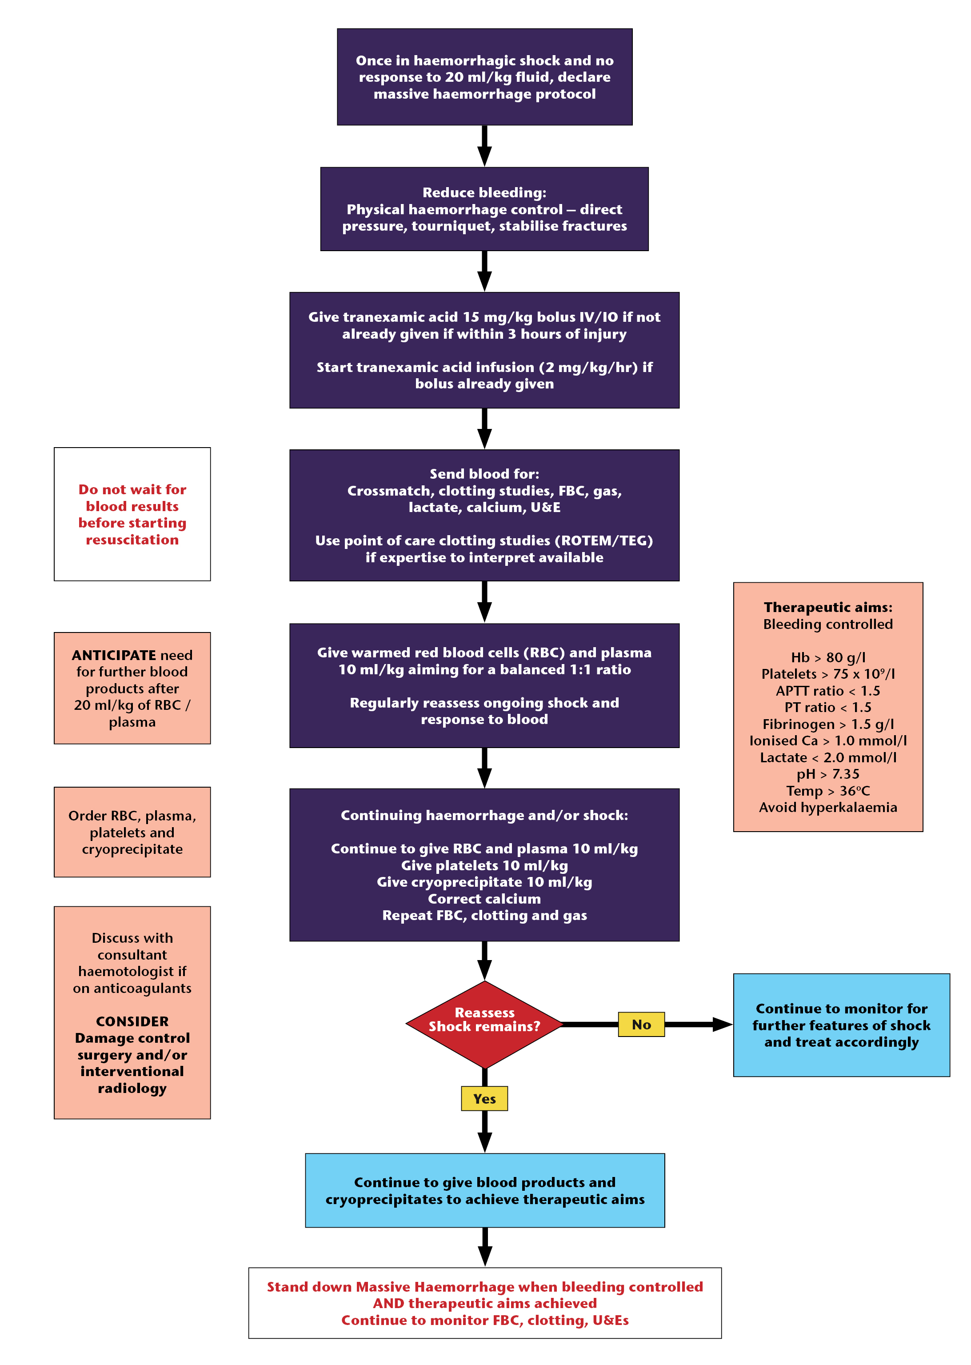
Massive haemorrhage in trauma
Shock and no response to 20 ml/kg fluid
  declare massive haemorrhage protocol
  Give warmed RBC and plasma 10 ml/kg aiming for a balanced 1:1 ratio
Continuing shock/blood loss
  RBC 10 ml/kg
  FFP 10 ml/kg
  Platelets 10 ml/kg
  Cryoprecipitate
  Check Calcium..
Use local guidelines

Slide 37
Massive haemorrhage in trauma
Shock and no response to 20 ml/kg fluid
  declare massive haemorrhage protocol
  Give warmed RBC and plasma 10 ml/kg aiming for a balanced 1:1 ratio
Continuing shock/blood loss
  RBC 10 ml/kg
  FFP 10 ml/kg
  Platelets 10 ml/kg
  Cryoprecipitate
  Check Calcium..
Use local guidelines

Slide 38
D
(C) | Nil
A | groaning, gurgling secretions
B | Sp0₂ 94% non-rebreather bag, RR 40/min Decreased A/E, left chest, hyperresonant and tender
C | Pale, cold & clammy pulse thready, HR 155/min BP 90/ systolic, CRT 6 sec
D | Confused conversation, occasionally combative, GCS 10, left pupil dilated
E | Temp 35°C, no extremity abnormalities, moving all limbs (7 mins)
 | Dx
(C)
A
B
C
D
E
Other
Rx/Ix
Notes:
Activity 3 – Diagnoses & further Actions. ‘Lets talk about D’
Refresher whilst group give answers over next 2 slides
Time needed 2 mins for this and next 2 slides (Running time 46 mins at completion)

Slide 39
Re-assessment
- Possible diagnoses
(C)
A | Airway threatened, may become obstructed secondary to diminished LOC (closed head injury, opiates, shock)
B | Tension pneumothorax Massive haemothorax Flail chest & pulmonary contusions ? Diaphragmatic hernia
C | Intra peritoneal haemorrhage – ruptured spleen Retro-peritoneal haemorrhage – pelvis +/- kidney Cardiac tamponade/contusion. BP 90 = large blood loss
D | Progressive head injury – raised ICP, lateralising signs. Progressive spinal injury needs consideration
E
Notes:
D – Decreased GCS and signs raised ICP – severe head injury

Slide 40
Treatment and investigation
(C)
A | HFO NRB, suction, OPA ? NPA maintain C-spine immobilization – BVM, prepare for RSI
B | Left ICC – before or after RSI? CXR before/after?
C | Pelvic binder + Xray. FAST. 10 mL/kg warmed blood, 10mL/kg crystalloid until available. Tranexamic acid. Surgeon
D | A VPU – likely intracranial haemorrhage – secondary brain protection Avoid hypotension or hypoxia. Hyperventilate (pCO2 35-40) Mannitol/hypertonic saline?
E
Notes:
D – management – secondary brain protection principles. Best outcome for D is to ensure A, B and particularly C stable. Safe intubation, hyperventilation to PCO2 30-35 is most HD stable way to decrease raised ICP – rapid effect within mins. HTS also better if trying to avoid hypotension and diuresis, but takes 20-30 mins to have effect.

Slide 41
E to end
(C) | Nil
A | groaning, gurgling secretions
B | Sp0₂ 94% non-rebreather bag, RR 40/min Decreased A/E, left chest, hyperresonant and tender
C | Pale, cold & clammy pulse thready, HR 155/min BP 90/ systolic, CRT 6 sec
D | Confused conversation, occasionally combative, GCS 10, left pupil dilated
E | Temp 35°C, no extremity abnormalities, moving all limbs (7 mins)
 | Dx
(C)
A
B
C
D
E
Other
Rx/Ix
Notes:
Activity 3 – Diagnoses & further Actions. ‘Lets talk about E and Rx’
Refresher whilst group give answers over next 2 slides
Time needed 2 mins for this and next 2 slides (Running time 48 mins at completion)

Slide 42
Re-assessment
- Possible diagnoses
(C)
A | Airway threatened, may become obstructed secondary to diminished LOC (closed head injury, opiates, shock)
B | Tension pneumothorax, Massive haemothorax Flail chest & pulmonary contusions ? Diaphragmatic hernia
C | Intra peritoneal haemorrhage – ruptured spleen Retro-peritoneal haemorrhage – pelvis +/- kidney Cardiac tamponade/contusion. BP 90 = large blood loss
D | Progressive head injury – raised ICP, lateralising signs. Progressive spinal injury needs consideration
E | Hypothermia, hypoglycaemia, hidden injuries
Notes:
E – keep warm, check BSL, log roll for occult injury.

Slide 43
Treatment and investigation
(C)
A | HFO NRB, suction, OPA ? NPA maintain C-spine immobilisation – BVM, prepare for RSI
B | Left ICC – before or after RSI? CXR before/after?
C | Pelvic binder + X-ray, FAST, 10 mL/kg warmed blood, 10mL/kg crystalloid until available. Tranexamic acid. Surgeon
D | A VPU – likely ICH – secondary brain protection Avoid hypotension, hypoxia. Hyperventilate. Mannitol/hypertonic saline?
E | Exposure, look for injuries, keep warm, euglycaemia
Ix, Meds | ?Whole body CT (WBCT) - or CT cervical spine, brain, abdo, +/- chest? Consider radiation dose with WBCT CXR, pelvic X-ray Surgical and neurosurgical review
Notes:
Pt needs CT Abdo, CTB, CT Cx spine
Concerns re radiation dose with WBCT
Need surgical and Neurosurgical attendance

Slide 44
Diagnoses & Specific therapy
Diagnoses
CXR – ICC, resolved left pneumothorax, # ribs Pelvic X-ray – # left pubic ramus CT brain – Left subdural haematoma with midline shift CT C-spine – NAD CT abdomen – Splenic rupture / multiple lacerations left kidney
Specific therapy options
Conservative ? Operative ? Interventional radiology ? Telemedicine ? Interfacility transfer required ?
Notes:
Start at 48 min Time 4 mins (Time 52 mins at completion of next 4 slides)
Eventual findings
Review the treatment options – but do not dwell upon these
The important point of all management options is that emergent paediatric trauma surgery should be available.
What are the pre-requisite conditions for conservative management?
Frequent monitoring
Blood bank service including coagulation factors
Accurate fluid management
Emergent paediatric surgery immediately available
What are the indications for immediate laparotomy?
Perforated viscous
Penetrating injuries
Refractory shock with clinical suspicion of intra-abdominal haemorrhage

Slide 45
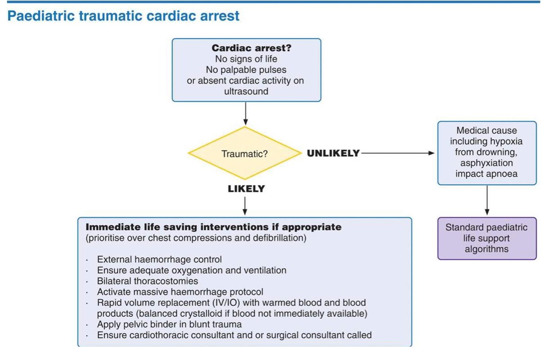
Paediatric traumatic cardiac arrest – principles of management
Notes:
Briefly review the important principles of managing a traumatic cardiac arrest

Slide 46
Paediatric traumatic cardiac arrest – principles of management
Treat reversible causes
prioritise over compressions and defibrillation
(C)
  Treat catastrophic haemorrhage
A/B
  Oxygenate / ventilate
  Thoracostomies x 2
C
  Fluids
  Exclude pericardial tamponade
Notes:
Briefly review the important principles of managing a traumatic cardiac arrest

Slide 47
?

Slide 48
A structured approach …
<C> - control external bleeding
Airway - oxygen, C-spine control
Breathing - ventilatory support
Circulation - haemorrhage control
Disability - prevent secondary insult
Exposure - temperature control

Slide 49
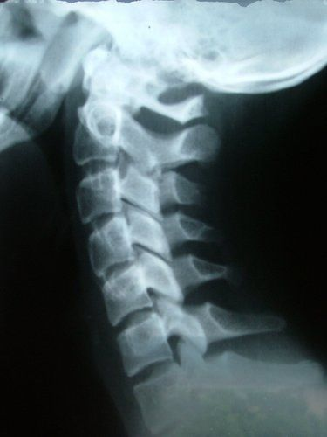
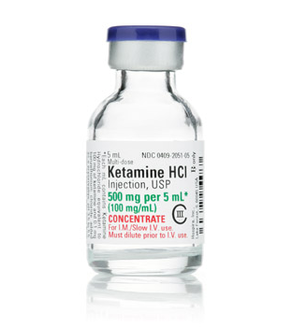
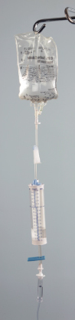

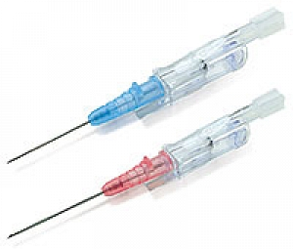
Airway & C-spine
Imaging
Circulation/ MTP/TXA
Blunt vs penetrating
Notes:
A prompting slide to remind the candidates of the differences in resuscitation of the traumatic patient v the ill patient
- control of catastrophic haemorrhage, care of the cervical spine, need for x 2 Ivs, early blood products in major haemorrhage, analgesia…

Slide 50


Prep for Thoracic Skills
Landmarks (5 mins)
Chest Tube Insertion (7 mins)
https://flowcode.com/p/OZPni3K08?fc=0
https://flowcode.com/p/OZPnRaCvY?fc

