Slide 1
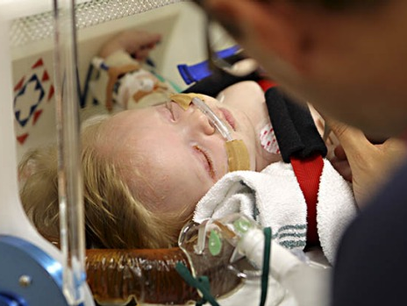
Transfer and communication
Notes:
Please read the notes under the slides
Updated for use with APLS ANZ 6e manual, March 2017 & online learning module safe transfer & transport
Revised April 2023 – name changed Transfer & Communication – not Stabilisation & Transfer

Slide 2
Objectives
On completing this workshop, you should be able to:
Identify the principles for effective communication when referring a sick/injured child for definitive / specialised care
Plan and help ensure the safe and successful transfer by using standard checklists/resources/language
Notes:
ENVIRONMENT:
Equipment
Overhead projector/Screen/Computer
+/- Flip chart or white board,
Laminates:
x 3 one referring team, one coordinating team, one receiving team
x 3 Retrieval Forms
x 2 paper copy of retrieval form for coordinating team
x 1 laminate of the case for referring team
Aim for inter-group learning using expertise within the group with regard to effective communication
1 case as basis for candidate recall/application of knowledge for their clinical context.
SET:
Slides 1 & 2
Introduction to workshop – aims of transport that they are going to achieve in the role play – 2 mins
DIALOGUE:
Slide 3
Aims: The ‘right’ transfer – 3 minutes discussion re problems & solutions to problems – can use whiteboard/flip chart to capture or just discuss – enables opportunity to gauge learner’s experience. Care to keep to point & participants not telling long stories that eat into activity.
Slide 4 & 5
Divide into pairs & hand out appropriate laminate for each pair
Role play instructions – 5 minutes to let candidates discuss in their own pairs
Role Play Phone calls – 15 minutes – pause & discuss x 2 after each phone call
CLOSURE:
Slide 6 - questions
Slide 7 – summary & take home learning points

Slide 3
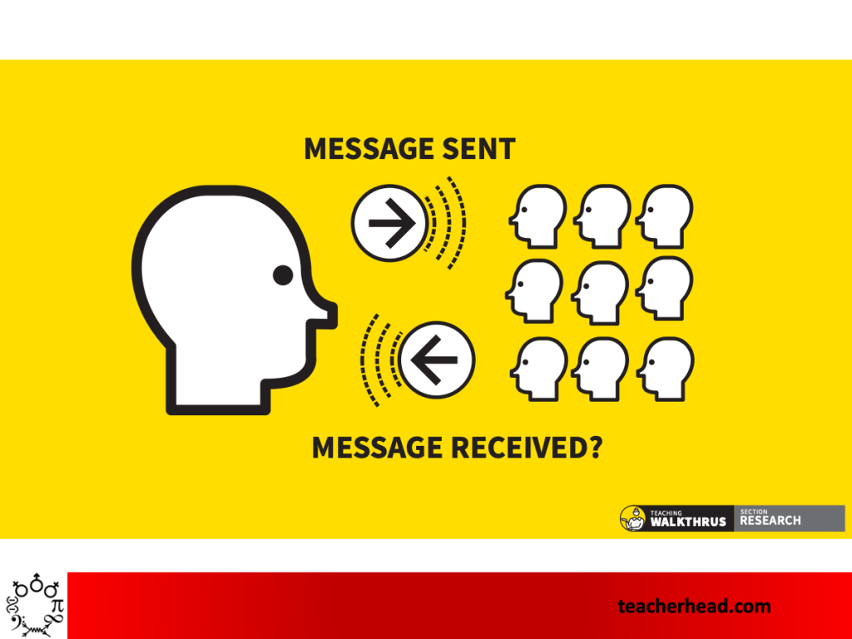
Aims of safe transfer
Need to ensure transfer of
the right patient
at the right time
by the right people
to the right place
by the right form of transport
receiving the right care throughout
Notes:
A quick discussion (3 minutes) on the potential problems that may occur in a transfer – these can be listed on a flip chart or just discussed
Worth briefly discussing this but the main problems are in communication not management of technical difficulties.
Wrong person making the call. Should be most experienced clinician available.
Not expressing degree of urgency or what is wanted from the referring team. – opening sentence to capture urgency
Poor communication of summary.
The keys are to try to get some important points from the group efficiently (quickly/succinct examples from the group rather than long stories) from the groups own experiences in slide three before allocating into pairs,
In real life what happens usually:
1. The sending team rings a coordination centre and speaks to a coordinator and a retrieval consultant. This needs to be done by the most experienced person from the sending team in a timely manner in the correct way with the correct information.
2. A conversation then occurs between the sending team and the coordinating team which at the same time starts organising transport if this is time critical.
3. A second conversation then may occur as a conference call between the sending doctor, coordination team and the receiving doctor and other sub-specialists as required.

Slide 4
Role play
Referring Team
Use case to determine what requests you need
Retrieval/Coordinating team
Receive phone call from referring team
Receiving Team
Receive phone call and offer advice as required
Make a phone call to communicate you requests
Use retrieval document for information gathering and planning
Utilise retrieval document to ensure all information handed over for safe clinical care & advice
Notes:
Divide the group into pairs (one pair is the referring team, another pair the coordination team, another pair the receiving team/subspecialists)
Try to split nursing / PICU staff between the groups.
Instructions are that they have a case that they will be asking for transfer & will role play a phone call.
We will “Pause & Discuss” at various opportunities throughout the role play to discuss key learning points & then count you back into the role play.
Hand appropriate Laminate to each pair – Referring team/Coordinating Centre/Receiving team
Give each group the Laminated Retrieval Form and also give Group 2 (coordinating pair) and Group 3 (Receiving team) the paper copy of the Retrieval Form to use to write on.
Give Referring team the laminated case.
Referring Hospital - ‘small and remote’ (ideally choose places/names relevant to candidates)
Receiving Hospital - 'The large metropolitan'
Inform them that they will make a telephone call in 5 minutes.
Allow each pair time to review Retrieval Document & discuss what information they think they might need in addition to the form.
After giving time to review their own laminate & consider what information they need (5 mins) start the role play by requesting the referring team to place the phone call. Instructor can play the switchboard and ask the referring ‘doctor’ who they wish to speak to, put them through to the Coordinator Team.

Slide 5
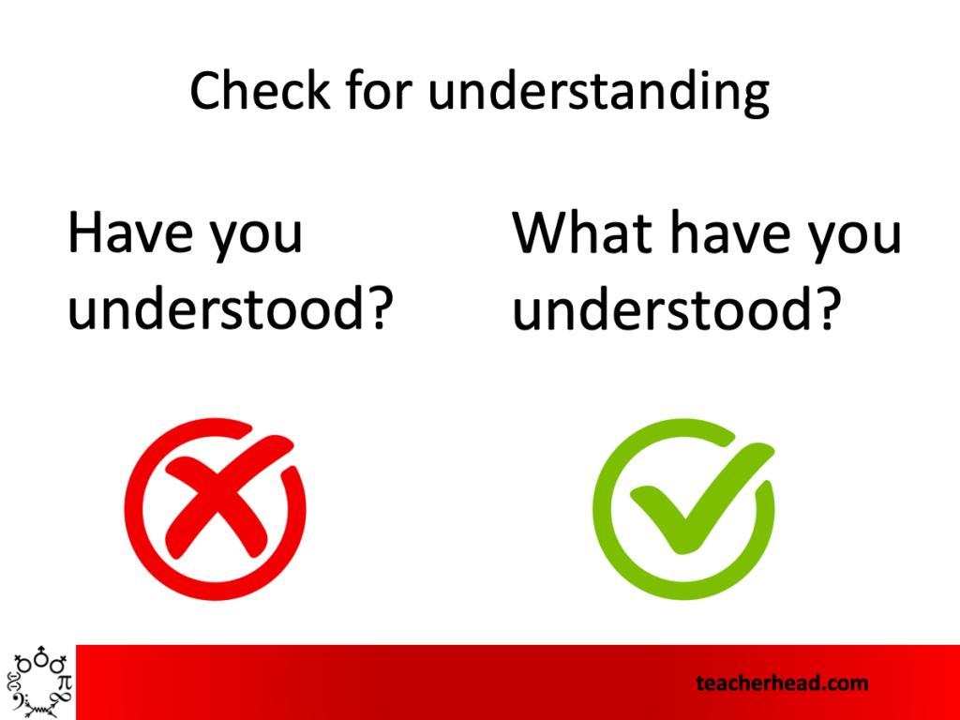
Set up of role play
Break into pairs
Read allocated laminate
Discuss in own pairs plan for phone call – who, what, how
Simulate phone call to retrieval teams

Slide 6
Regional ED, 1hr From nearest tertiary hospital
8y old (26kg) pedestrian RTA 1 hour ago
Left sided head injury
Large contusion over lateral aspect of L thigh
Unconscious at scene
GCS –10 on arrival then 8 with HR 110/m, RR 10/m, BP 110/70
Intubated → Ventilated Vt 190ml, f 10bpm, PEEP 3cmH20
22G IV cannula left forearm
0.9% saline at 35 ml/hr
Right pupil 3 mm, Left pupil 6 mm & sluggish
CT scan: left extradural haematoma
Midazolam 4 mg/hr + Fentanyl 200 mcg/hr
Temp 35.7ºC
Child now needs ongoing care
Notes:
See Laminated Case
Options to pause & discuss at the end of each ISBAR eg
1.After Referring team have finished & requested retrieval.
2. After second conversation with Receiving team (PICU/ED Consultant)
Pauses should be short – not a mini-lecture – eg phrases:
“What do you think is going on”
“Is there anything else the group thinks is important to add at this stage”
“What are your priorities now”
Restart role play scenario after a few minutes discussion to allow candidates to explore own journey of communication.
Quick pauses at key points to highlight the important aspect of communication and providing safe transfer
Use the pauses during the call if the discussion is getting long and have one of those as a connection to the next phone call (bringing in the accepting consultant)

Slide 7
?

Slide 8
Summary
Use of a standard tool to
communicate effectively to ensure safe and successful transfer of a sick/injured child
Use effective communication strategies to ensure message heard and message received is understood for comprehensive transfer of a child

