Slide 1

6th edition
Welcome & Aims

Slide 2
APLS f2f Program
To consolidate the knowledge necessary for
effective treatment and stabilisation of children with life threatening emergencies
To teach the practical procedures necessary
for effective management of childhood
emergencies
To test the acquisition of these skills

Slide 3
APLS f2f Program
Notes:
Activity: Ask the candidates to find the other members of their “coloured” group, sit together and take a few minutes to get to know each other.
Faculty briefly introduces themselves and states who they are mentoring. This includes the course coordinator who takes this opportunity to address any housekeeping.
Then ask everyone to briefly introduce themselves – consider asking what they would have done if they were not in their current profession.

Slide 4


Pre-course
Pre-course Online Learning
Manual
Notes:
Pre-course online learning designed to draw out the clinical priorities of the APLS manual

Slide 5
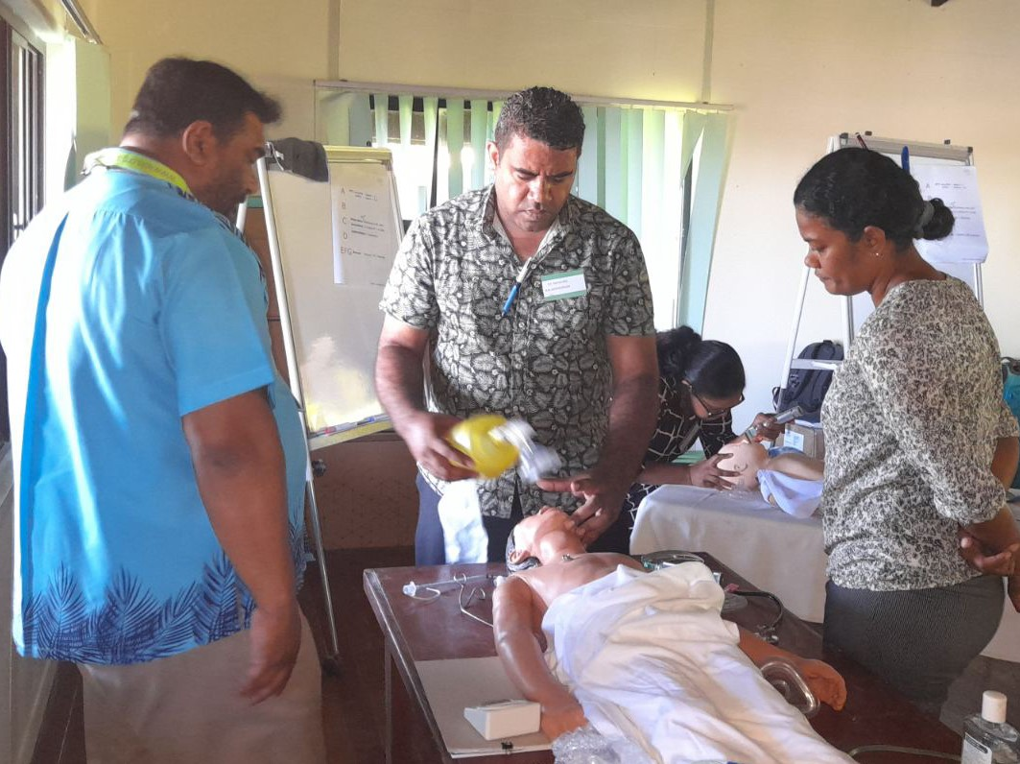
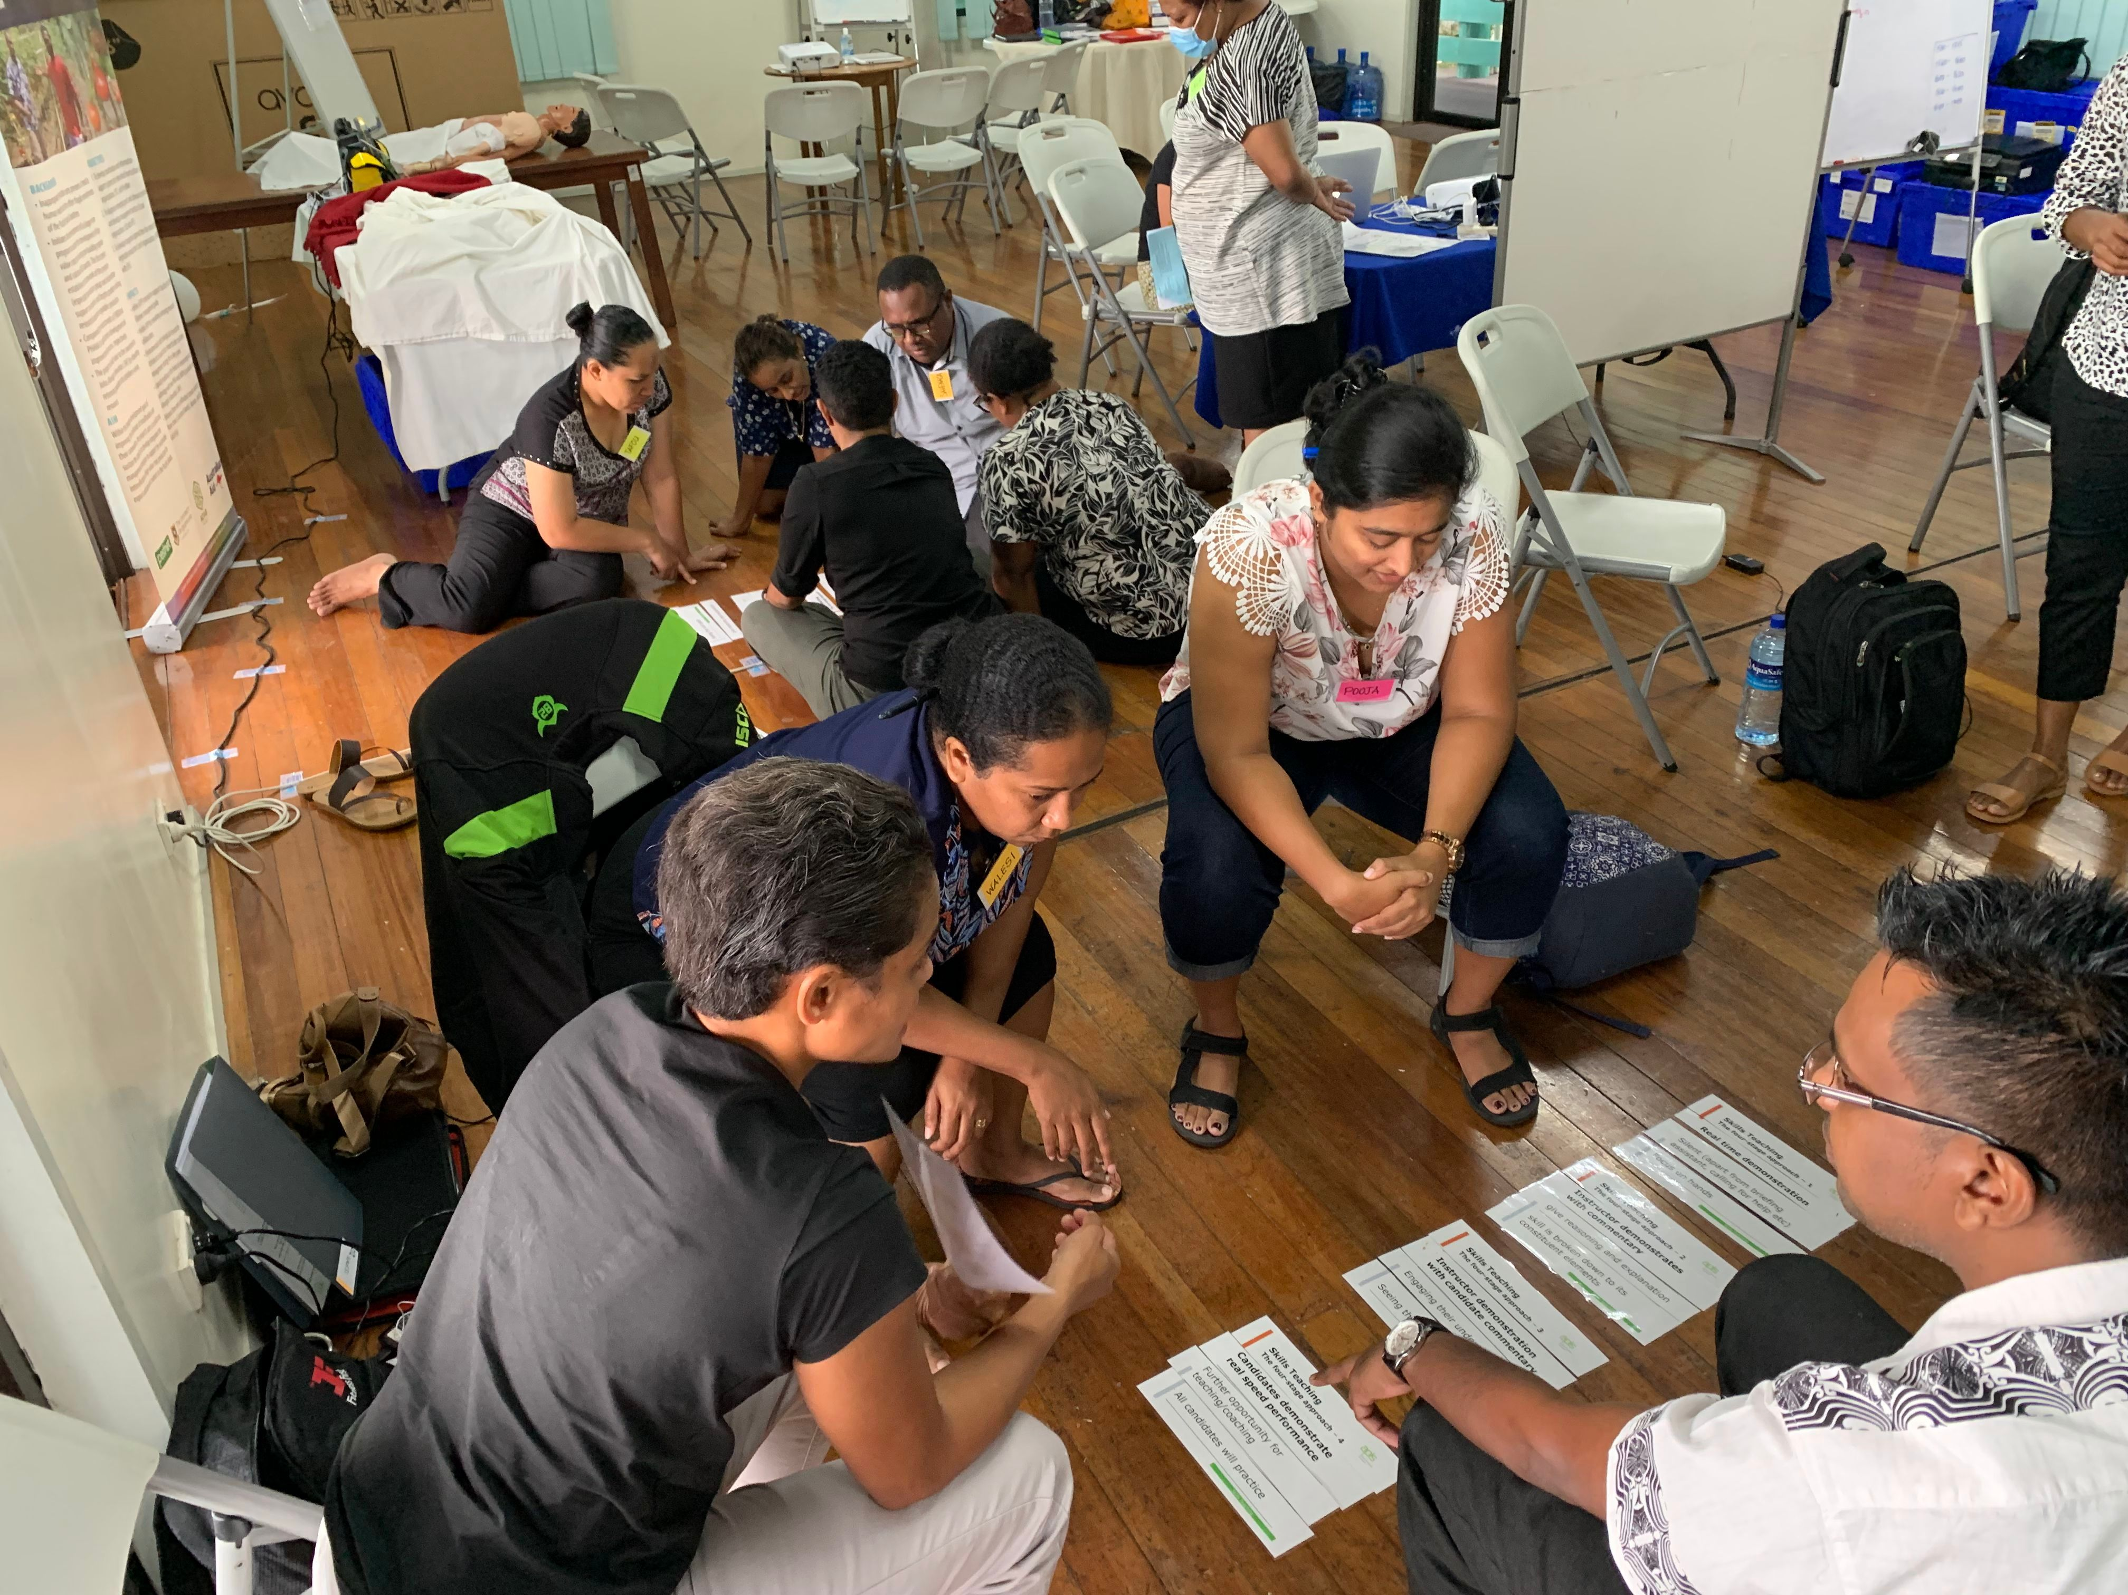
f2f Content
Practical
Skill Stations
Discussions
Notes:
Over the next 3 days we will further consolidate this theory, learn the skills required to put this theory into practice

Slide 6
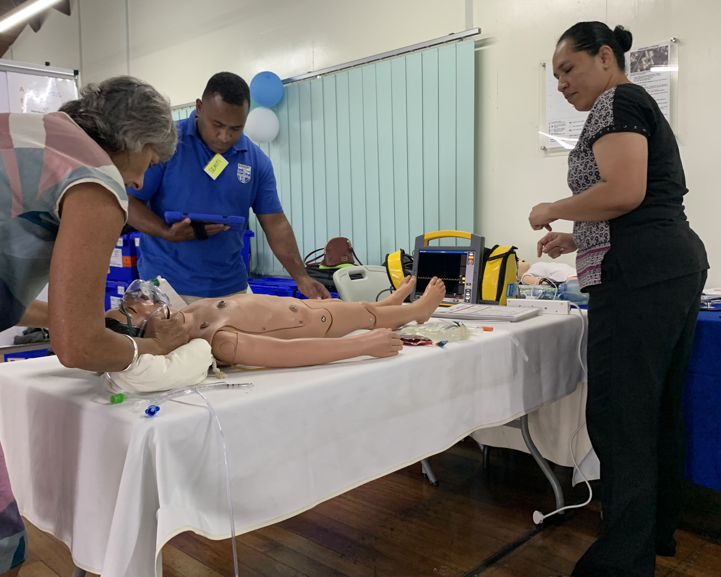
f2f Content
Practical
Scenarios
‘hands on’
Team leader
Notes:
Low fidelity scenarios, designed to consolidate learning when resources are limited.
More time is allocated to practicing structured approach in different clinical scenarios, followed by debriefing (12 mins scenario/ 8 mins group discussion of learning from the case)
Acknowledge stress of ‘performing’ in front of peers
Need candidates to ‘suspend belief’ to maximise the benefits from this form of learning.
Candidates will be expected to a ‘hands on’ team leader:
Prepare for the case
Examine the manikin (to elicit clinical cues from instructor)
Guide the roles of their assistants (other members of their colour group)
Maintain responsibility for team member actions.

Slide 7

f2f Content
Test
Skills
Scenarios
True/False
Notes:
Test your acquisition for these skills & knowledge

Slide 8
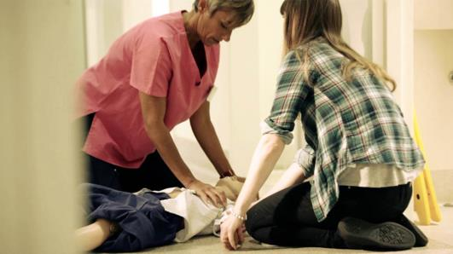
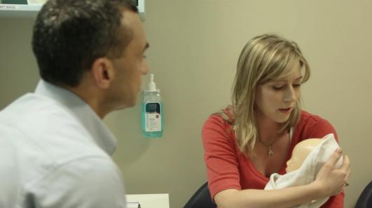
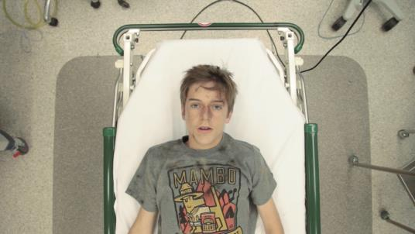
f2f Format
Life Support
Serious Illness
Serious Injury

Slide 9
Respect and feeling safe
During the course you may :
  feel challenged
  be worried or anxious
  try new things
We recognise this and will be supportive
Notes:
See article about creating a Safe Container for simulation
https://journals.lww.com/simulationinhealthcare/Fulltext/2014/12000/Establishing_a_Safe_Container_for_Learning_in.2.aspx

Slide 10
Respect and feeling safe
We acknowledge that you are
  Skilled
  Inquisitive
  Motivated
and bring a wealth of life and work experience
APLS f2f course aims to enhance everyone’s learning - candidates and instructors
By sharing, listening, respecting

Slide 11
Covid-19 Precautions
Hand sanitizer
Social distancing
Frequent equipment cleaning
PPE available when distancing is not feasible
Some adaptation of BLS and ALS techniques to reduce risk
Don’t attend if unwell
Notes:
The health and safety of candidates and instructors is important to the organisation and this includes reducing the risk of exposure to and transmission of Covid-19.
Practices may vary from state to state depending on local guidelines and rates of disease transmission.
*Please make the point that there will not be time for detailed discussion about PPE, techniques to reduce aerosolization etc.

Slide 12

Expectations
You & Faculty
  Prepared
  read the manual
  pre-course online learning
  Attend all sessions on time
  Support your faculty & fellow candidates
  Enjoy yourself

Slide 13
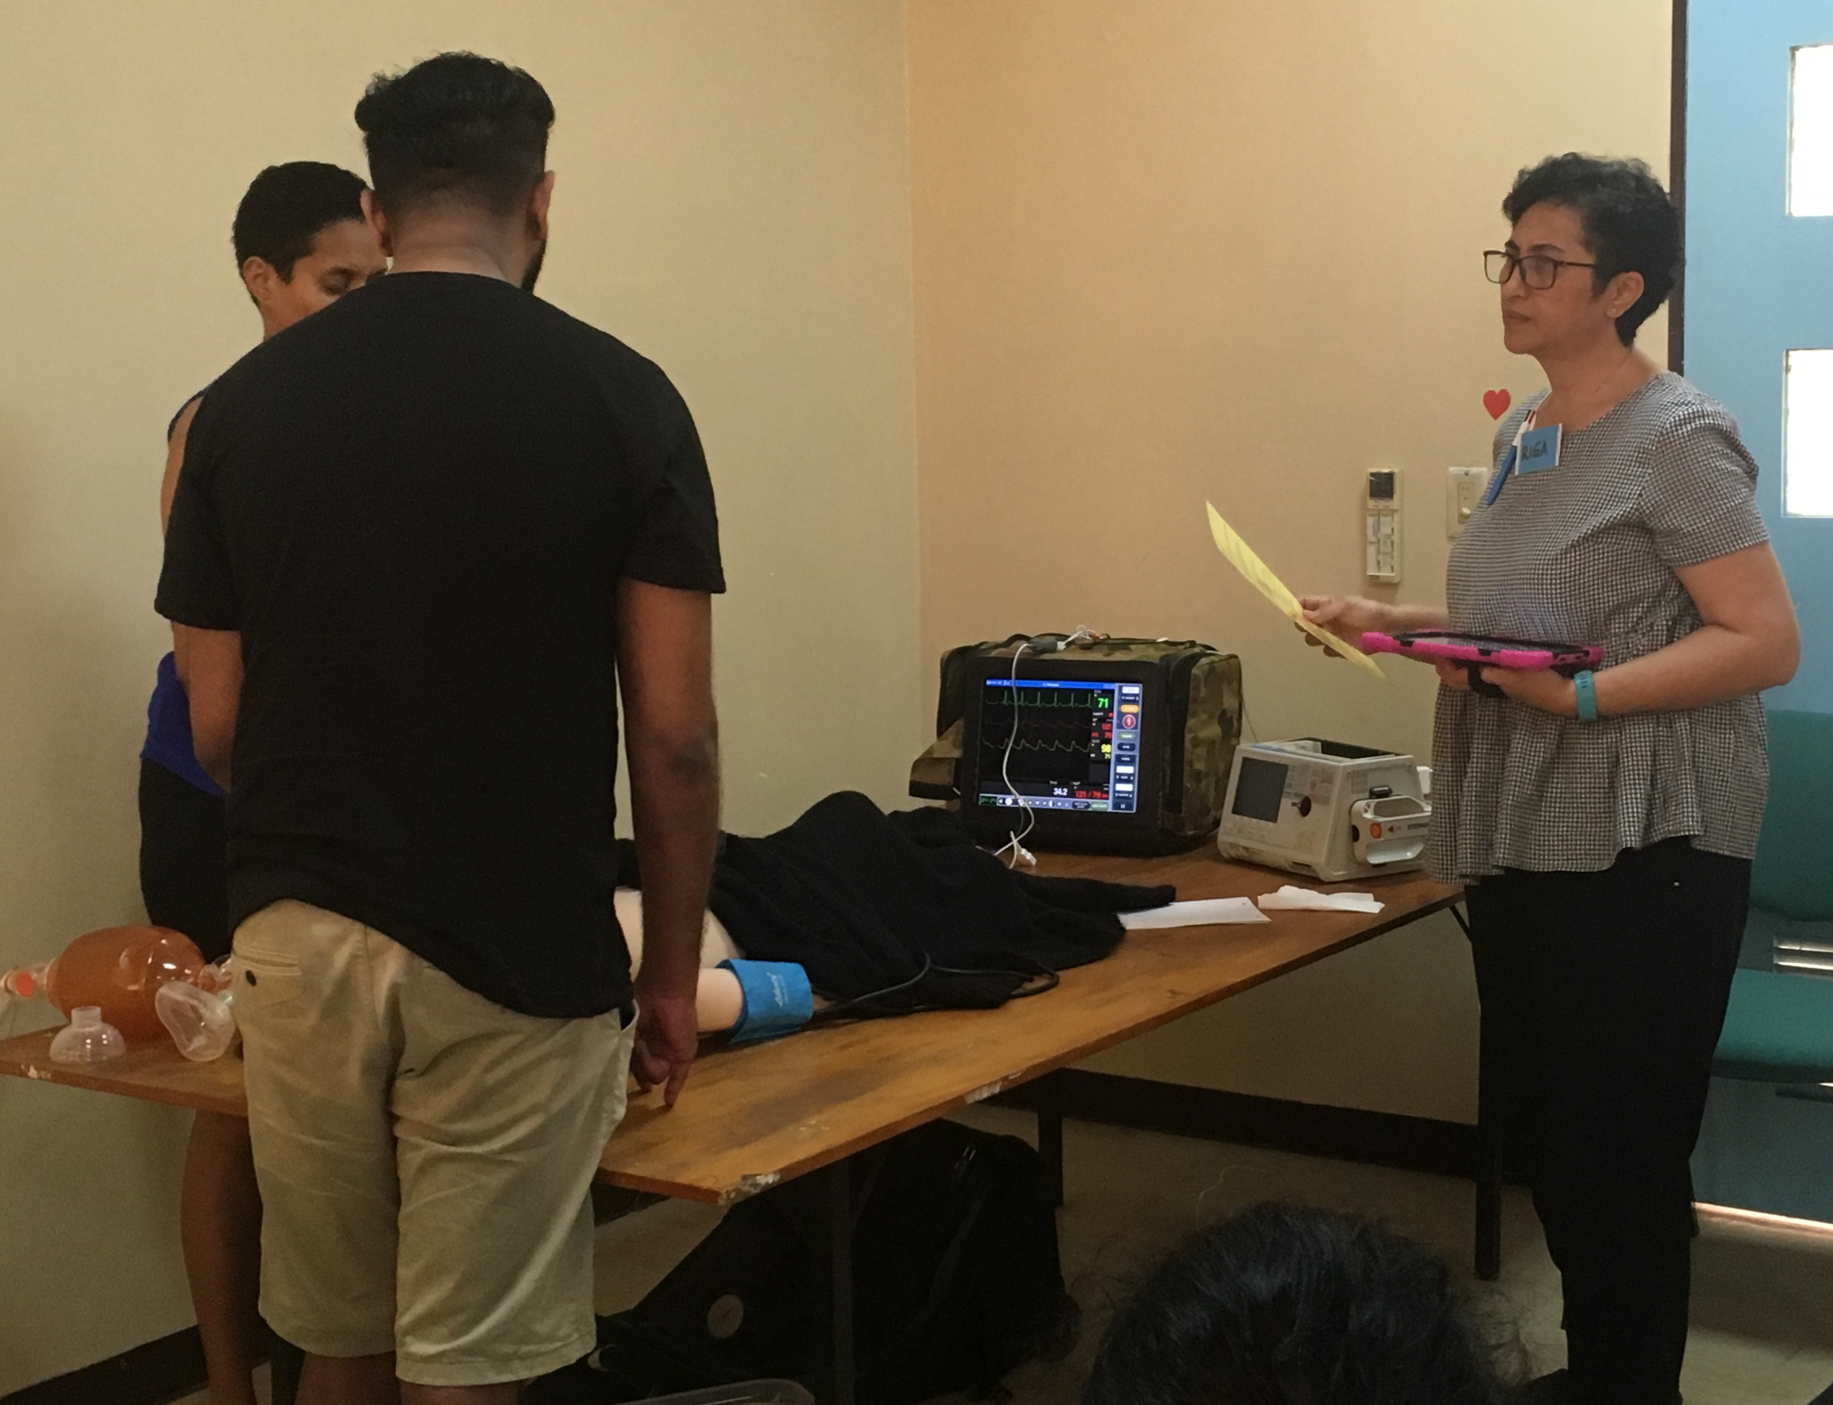
Educational Support
Mentoring
Critiquing
Feedback
Notes:
The content of this is actually a good prompt

Slide 14

Post course support
Access to website
APLS online learning for one month following completion of the f2f program
APLS app & algorithms
PAC Conference on demand, bite–size video updates, newsletters
APLS Community of Practice
Feedback of experiences
Notes:
APLS feedback can be emailed to feedback@apls.org.au, or via online feedback forms.

Slide 15
?

